Slide 2
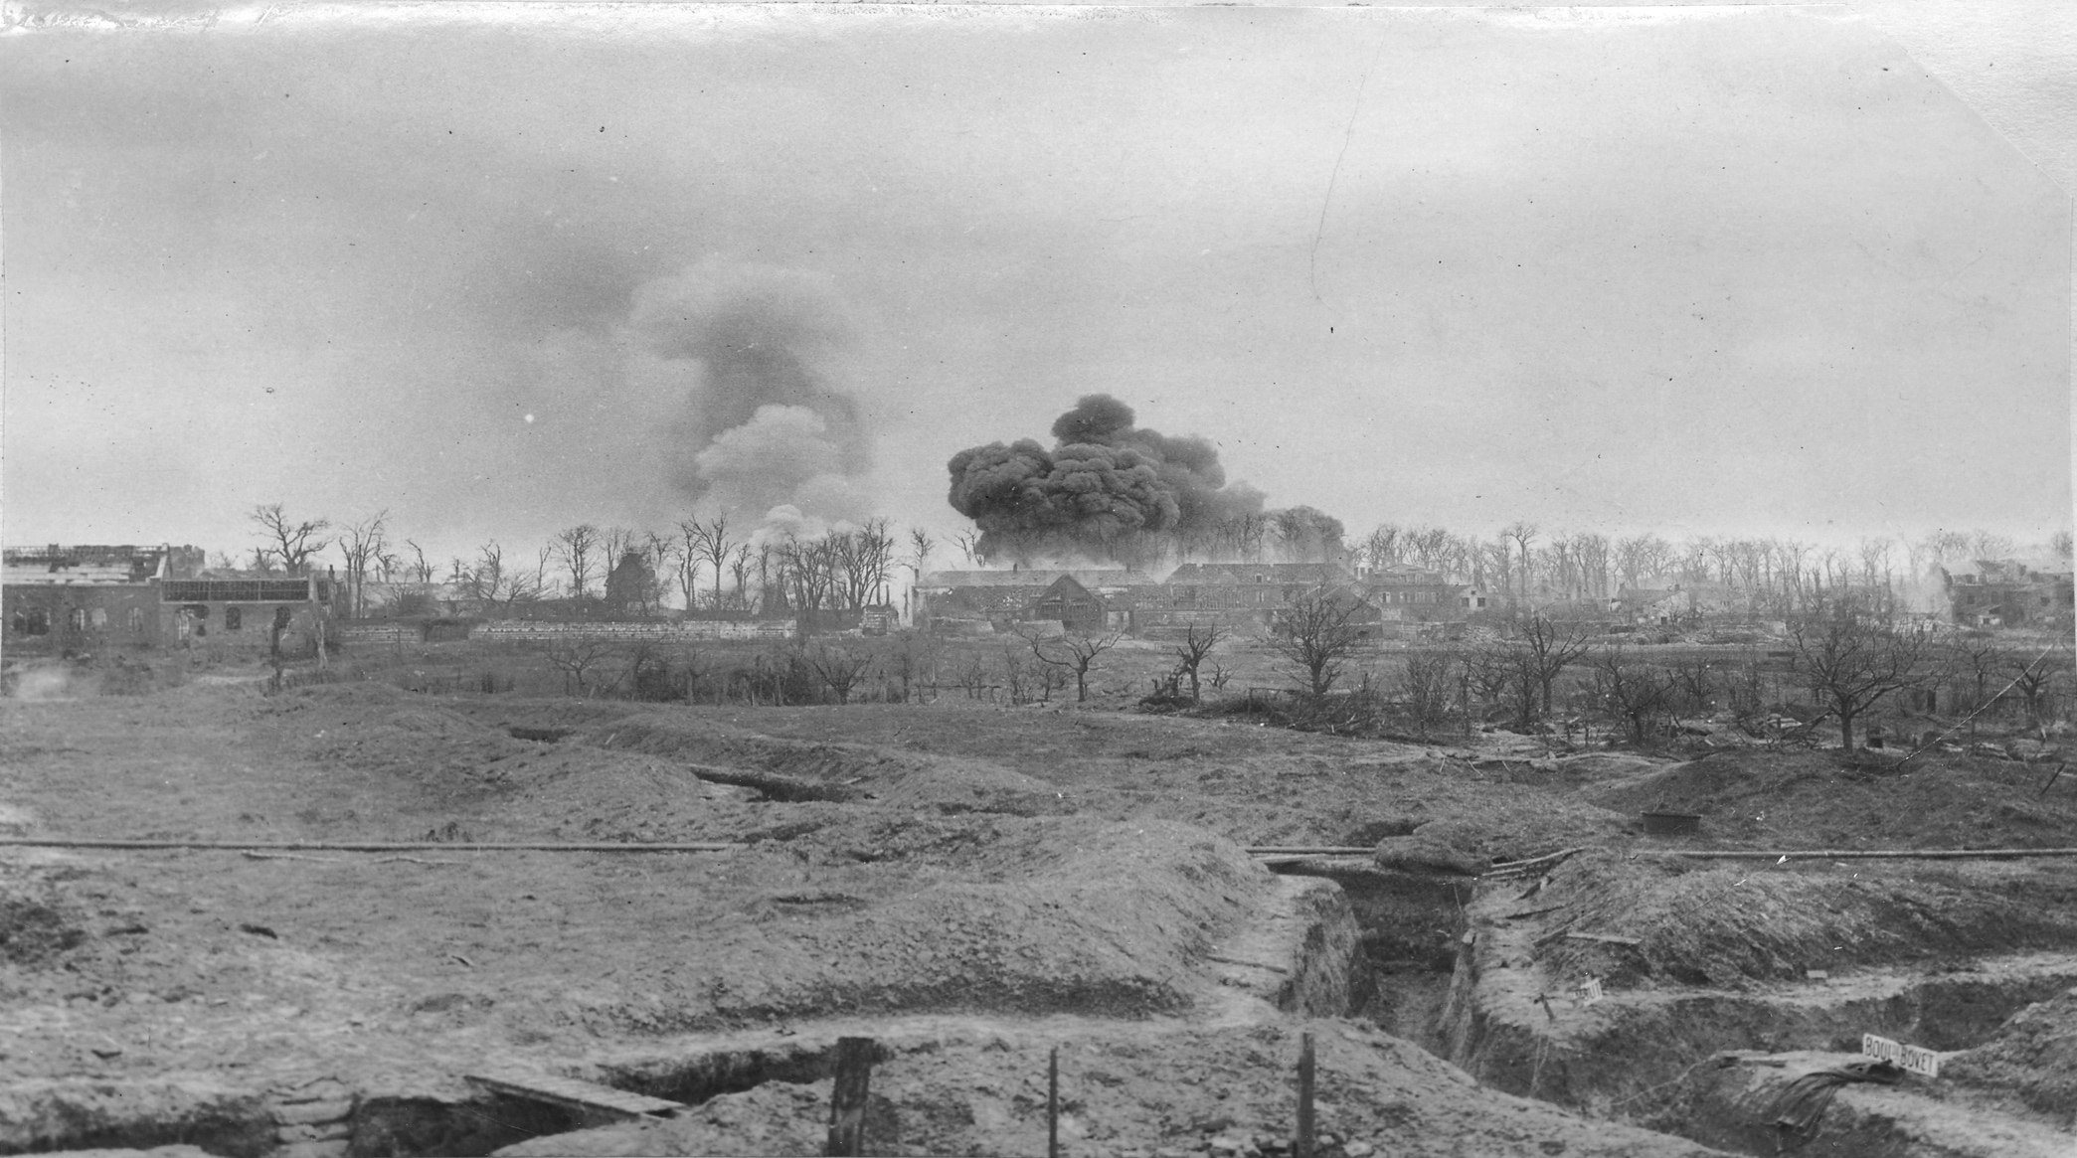
July 1914 - November 1918
First man-made catastrophe of the 20th century
17 million people killed, deadliest war of its time
Trenches in a war zone of France

Slide 3
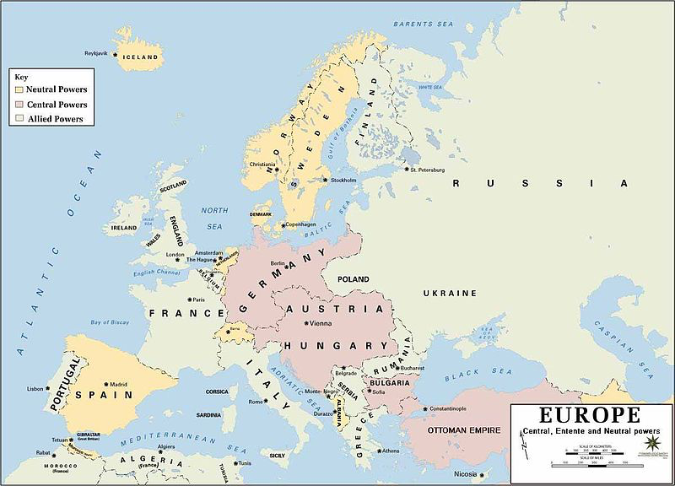
No single event led to World War I
Causes are complicated and intertwined
+
Chain of events
History of involved countries
Outbreak of fighting
Central Powers
Allied Powers
Neutral Countries

Slide 4
ilitarism
lliances
mperialism
ationalism

Slide 5
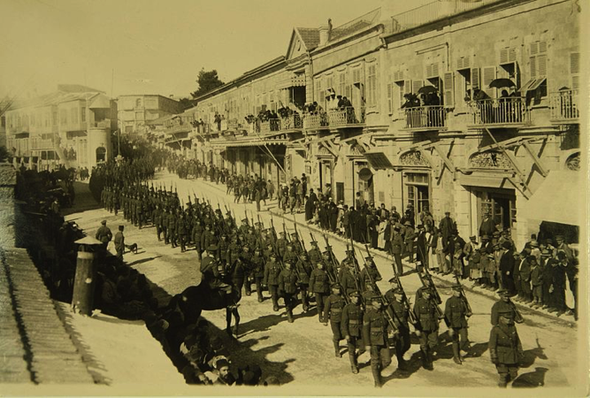
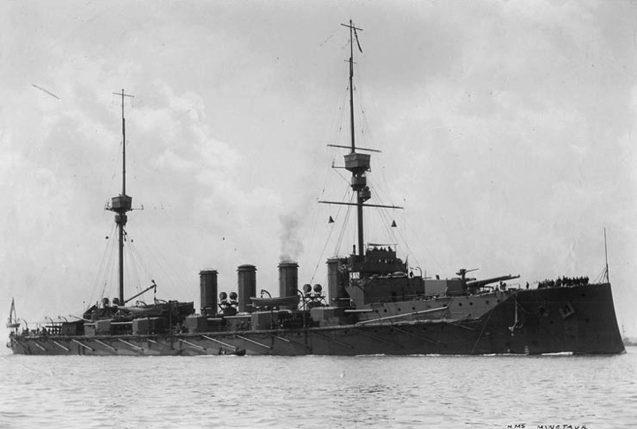
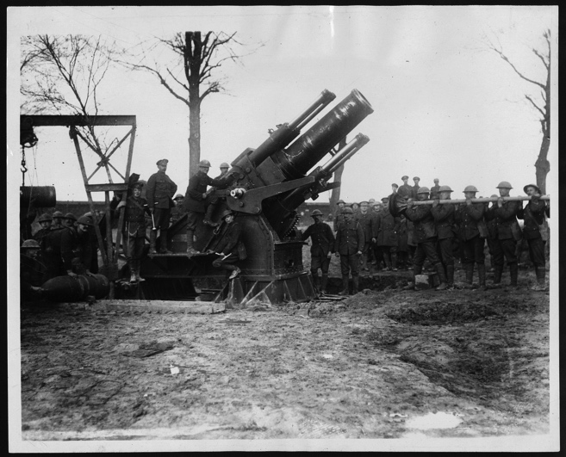
Many countries were strengthening their military forces.
France and Germany doubled their armies between 1870 and 1914.
Great Britain and Germany had the world’s largest and most powerful navies and competed for dominance of the sea.
Industrialization allowed countries to manufacture more powerful weapons.
The military was given a high priority in the economy and politics.

Slide 6
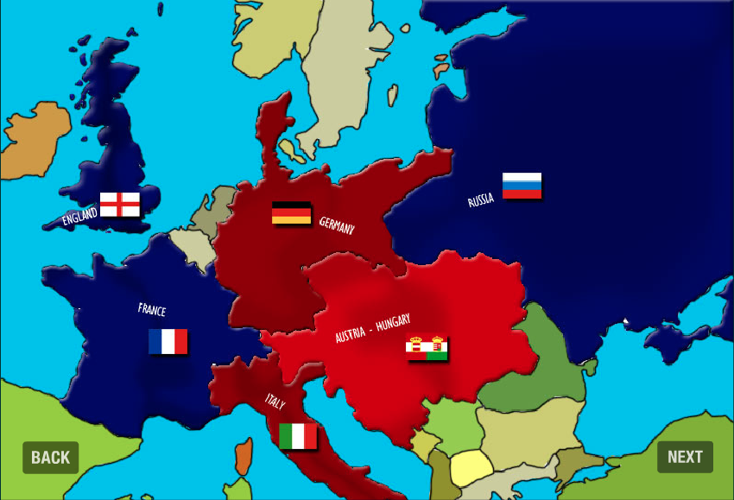
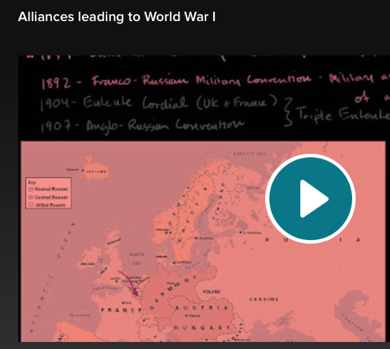
mutual defense agreements meant that if one country was attacked, the other allied countries would have to help
Italy, Austria-Hungary, and Germany formed the Triple Alliance.
France, Great Britain, and Russia formed the Triple Entente.
Russia and Serbia also formed an alliance.
European countries hoped that these alliance would keep countries from attacking one another and peace would be maintained.
Notes:
**Click the map. The video can be found at www.mrzahran.com/history/mme/WWoneNI.swf
Click “Next” to proceed to the next slide. Stop the 6th slide, which is the slide before the one explaining the assassination of Archduke Ferdinand.
**Click the video. This video is a link to Kahn Academy at www.khanacademy.org/humanities/history/euro-hist/world-war-I-tutorial/v/alliances-leading-to-world-war-i

Slide 7
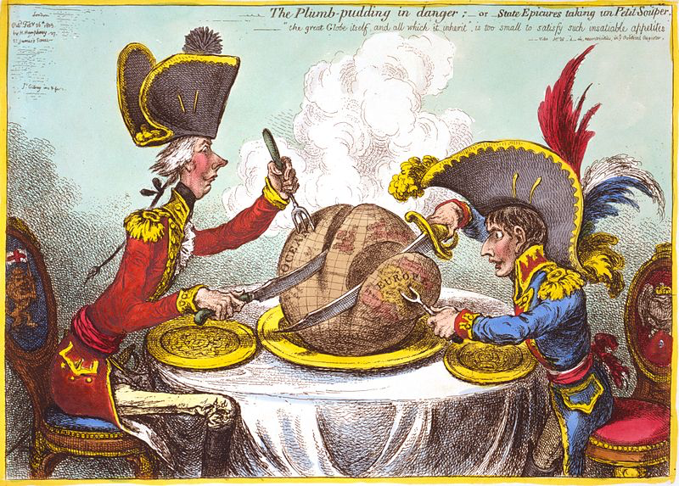
when a country increases its power and wealth by acquiring new lands under its control
Some European countries, such as France and Great Britain, had created large worldwide empires.
Other countries, like Germany and Russia, wanted to begin building their own empires.

Slide 8
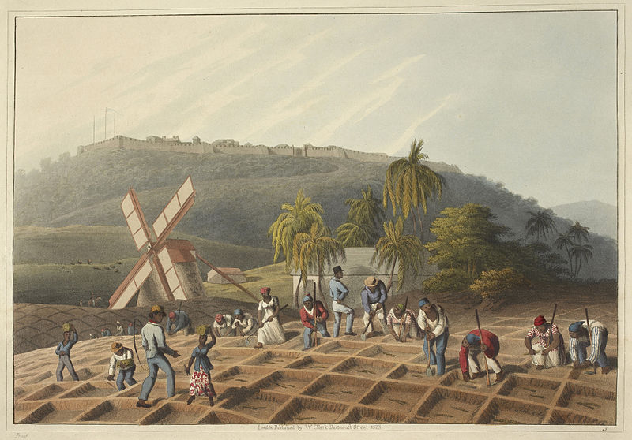
diamonds
gold
silver
natural resources like rubber
Countries became very rich from exploiting the natural resources contained in these new lands and the labor force.

Slide 9
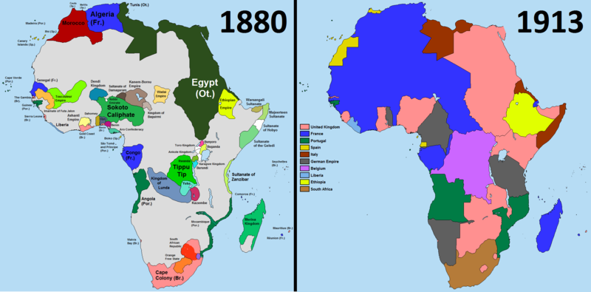
The Scramble for Africa is one example of how these countries competed in colonizing “unclaimed” land. This rush for land acquisition caused competition and conflict between many countries.

Slide 10
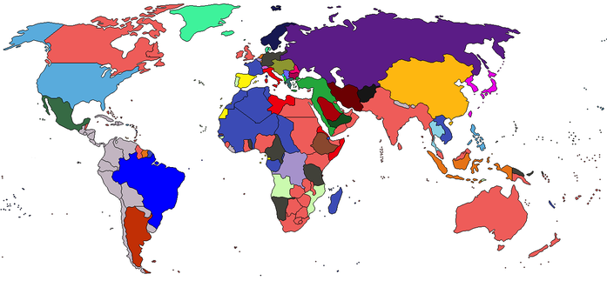
Great Britain had acquired so much land, it was said “The sun never sets on the British Empire.”
Somewhere in the world, the sun was shining on a colony of Great Britain.
Notes:
***Click the map to play the video (from Kahn Academy), which can be found at www.khanacademy.org/humanities/history/euro-hist/world-war-I-tutorial/v/empires-before-world-war-I
It shows the empires in the world before WWI.

Slide 11
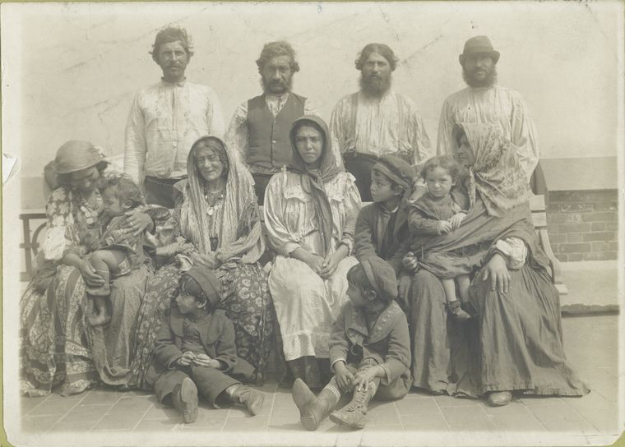
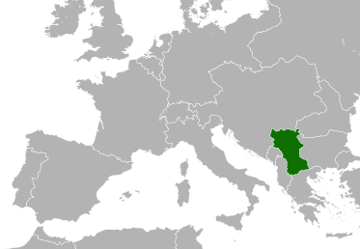
having a strong sense of pride for one’s own nation or ethnic group
people who share a common cultural background
Many Europeans felt their own nations or ethnic groups were superior to others.
The Slavs were an ethnic group in eastern Europe.
Nationalism was high in Serbia, a country just south of Austria-Hungary.

Slide 12
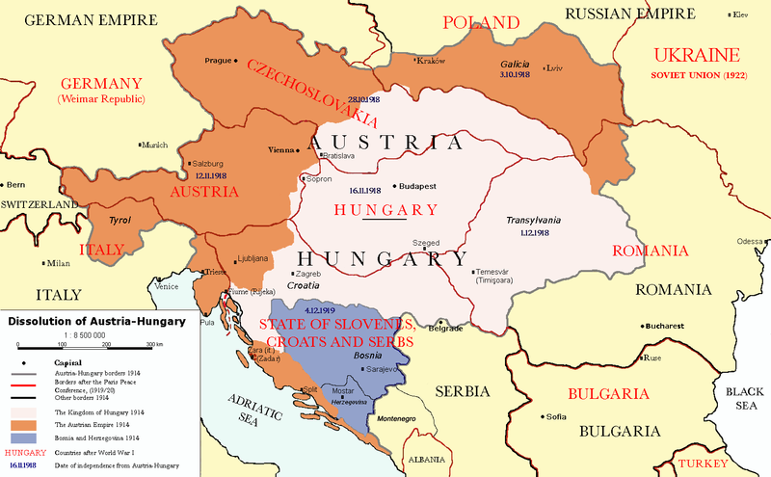
Bosnia was a region located in the southern part of Austria-Hungary.
Many Slavs lived here and in Serbia.
The Slavs wanted to have their own country free from Austria-Hungary.
Serbian Slavs wanted the freedom of the Bosnians, too.
These nationalistic feelings led to the event that sparked the outbreak of WWI.

Slide 13
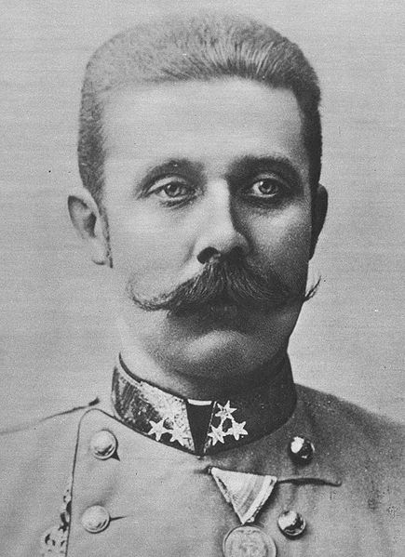
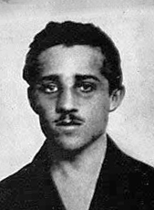
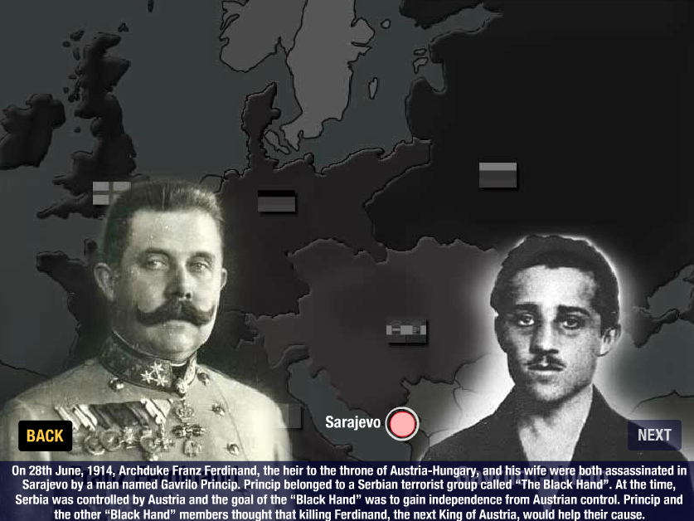
On June 28, 1914, Archduke Ferdinand, heir to the Austria-Hungary throne, was visiting Sarajevo, a city located in the former Bosnian region.
Bosnians wanted to be an independent nation from Austria-Hungary.
REMEMBER →
Gavrilo Princip, a Serbian nationalist, fired into the Archduke’s car, fatally wounding the Archduke and his wife.
Notes:
***Click the photo in the lower left. The site is http://www.mrzahran.com/history/mme/WWoneNI.swf
Show the 7th slide, which explains the assassination.

Slide 14
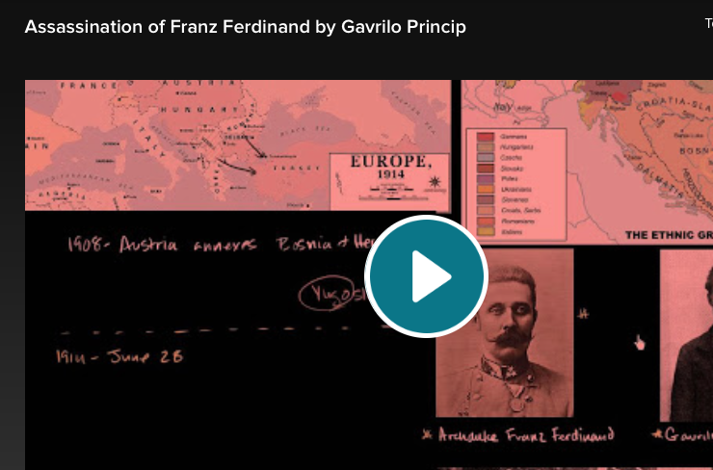
Austria-Hungary believed the assassination was organized by the Serbian government.
Notes:
***The video is from Kahn Academy and is about the assassination of Archduke Franz Ferdinand www.khanacademy.org/humanities/history/euro-hist/world-war-I-tutorial/v/assassination-of-franz-ferdinand-by-gavrilo-princip

Slide 15
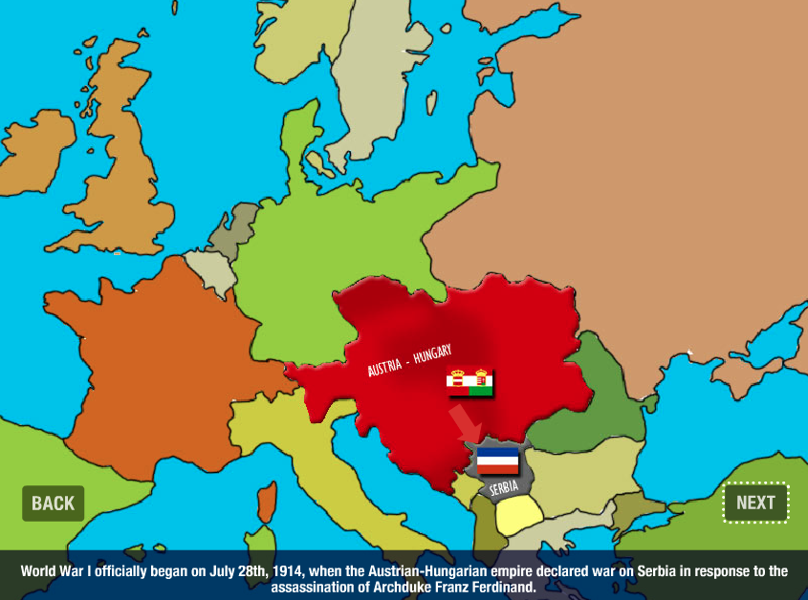
Forty-eight hours after the assassination, Austria-Hungary declared war on Serbia.
This set off a chain reaction of European countries joining the war.
Russia mobilized to help defend Serbia.
Germany invaded France because of France’s alliance with Russia.
When Germany attacked France and Belgium, Great Britain joined.
Notes:
***Click on the map. Begin on the 8th slide and continue to the 14th slide. This section shows why each country joined WWI. The website is www.mrzahran.com/history/mme/WWoneNI.swf

Slide 16
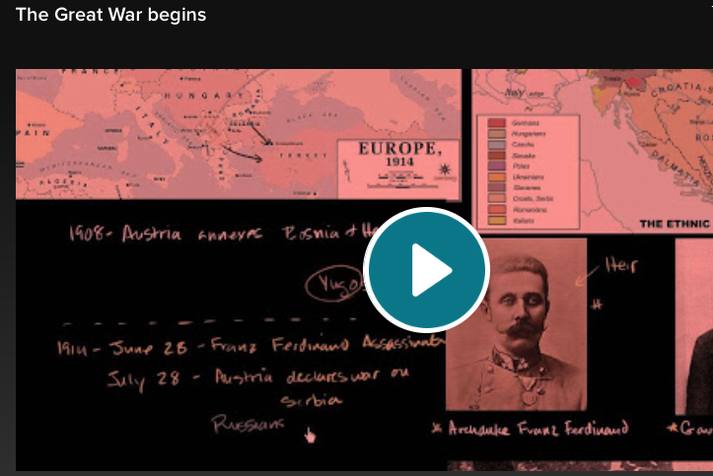
Both sides believed the war would be over before the end of the year. Little did they know that this great war would last over four years.
Notes:
***The video is from Kahn Academy www.khanacademy.org/humanities/history/euro-hist/world-war-I-tutorial/v/the-great-war-begins

