Slide 1
A Trip Through Geologic Time
Chapter 10

Slide 2
Mystery Fossil Activity

Slide 3
GROUP DIRECTIONS:
1. cut out the mystery fossil bones.
2. as a group, put together the skeleton of the animal.
3. glue the bones on a large piece of paper.
4. decide what the outside of the animal looked like. Was it covered with skin, fur, scales, something else? How large was it? What did it eat?
5. complete the 10 Summary Questions.
6. Read the article and answer the questions.

Slide 4
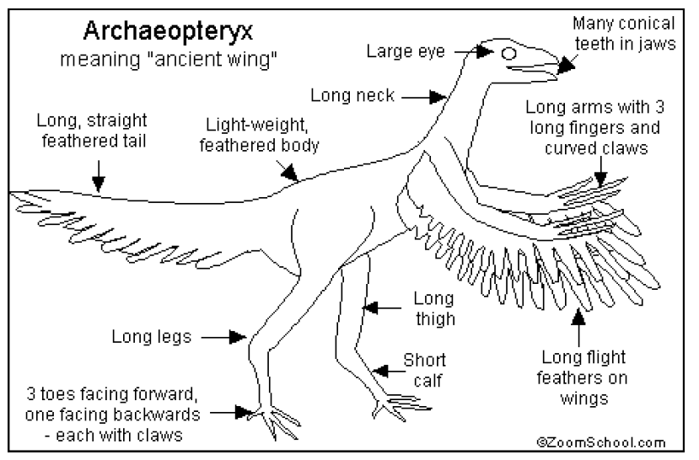
Mystery Revealed
FACTS:
1. The Archaeopteryx may have eaten insects and small animals. It lived during the
Jurassic Period, about 150 million years ago.
2. Its name means “Ancient Wing.” It’s pronounced: ark-ee-OP-ter-iks
3. The Archaeopteryx seemed to be part-bird and part-dinosaur. Unlike modern-day birds,
it had teeth, three claws on each wing, and a long, bony tail. Like modern-day birds, it
had feathers and a very light body with hollow bones.
4. Length - 1 foot long from beak to tail
Wingspan - 1.5 feet
Weight - 11 to 18 ounces
5. This is the size of the Archaeopteryx
next to an adult male:
6. Archaeopteryx is one of the oldest-known birds.

Slide 6
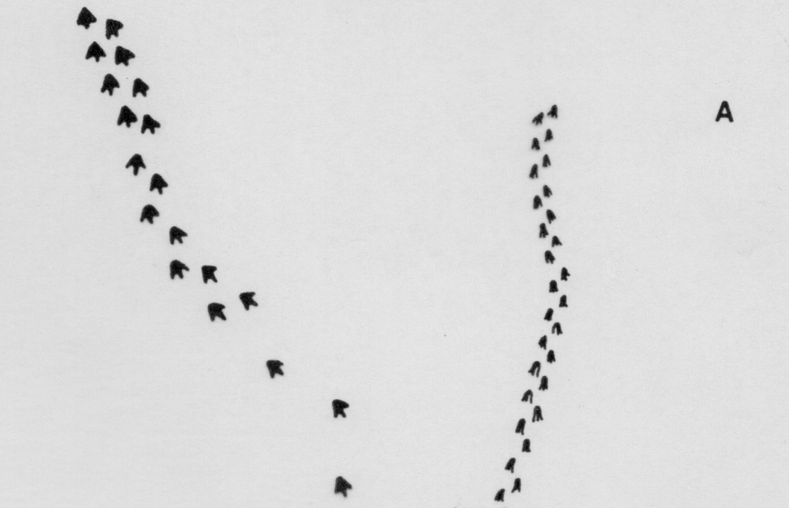
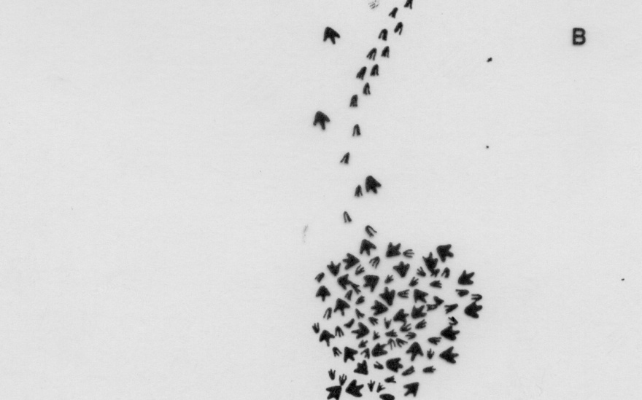

Interpreting Fossil Prints
Make FOUR observations (facts) about the fossilized footprints. Consider such factors as size, shape, and position of the footprints.

Slide 7
Interpreting Fossil Prints
Make FOUR inferences (educated guesses) about the prints that reconstruct the events that could have caused this pattern. There is more than one possible answer.

Slide 8
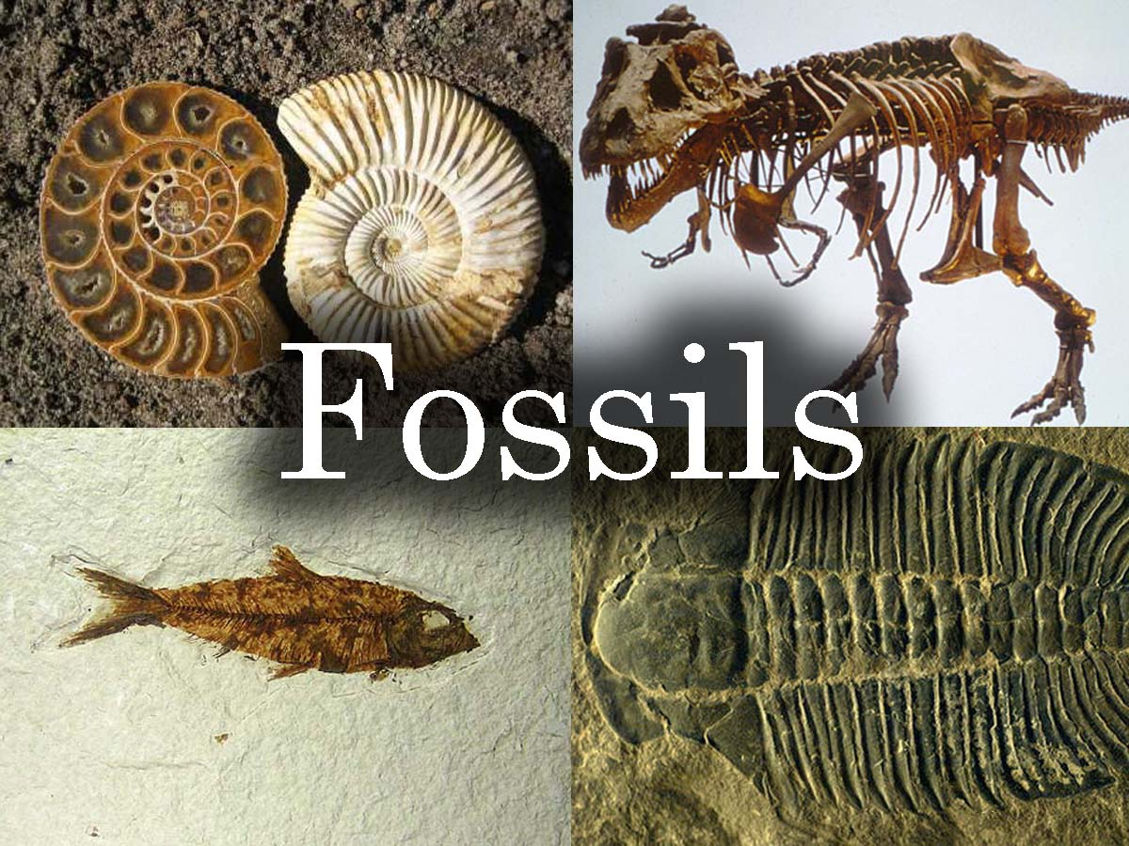
Section 1- Fossils
Fossils are the preserved remains or traces of living things.
Fossils provide evidence of how life has changed over time

Slide 9
How Fossils Form
Most fossils form when living things die and are buried by sediments.
These sediments slowly harden into rock and preserve the shapes of organisms.
What is sedimentary rock?
When an organism dies, the soft fleshy parts are decayed or eaten by other organism, while the hard parts create fossils.

Slide 10
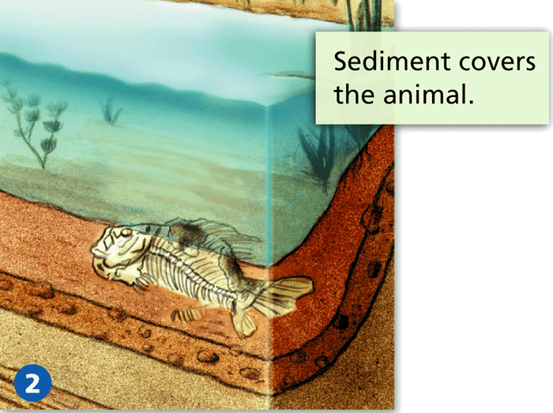
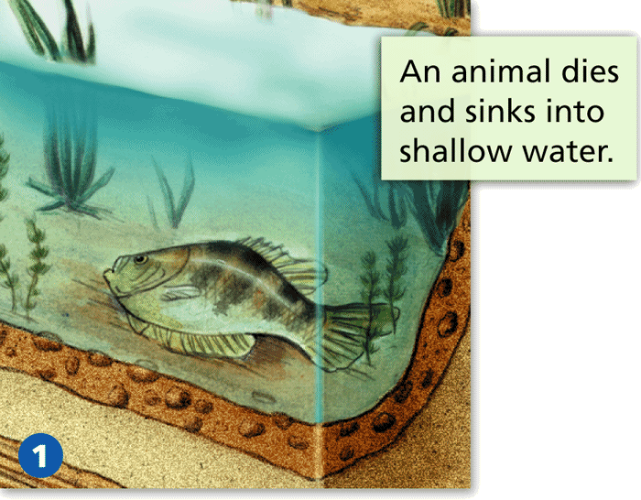
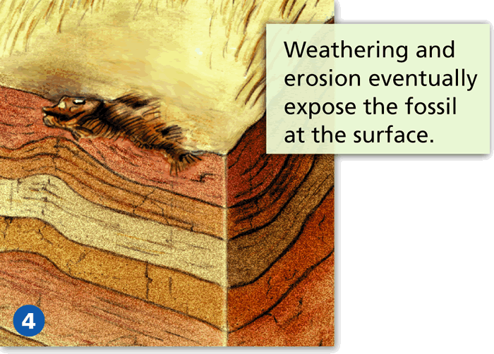
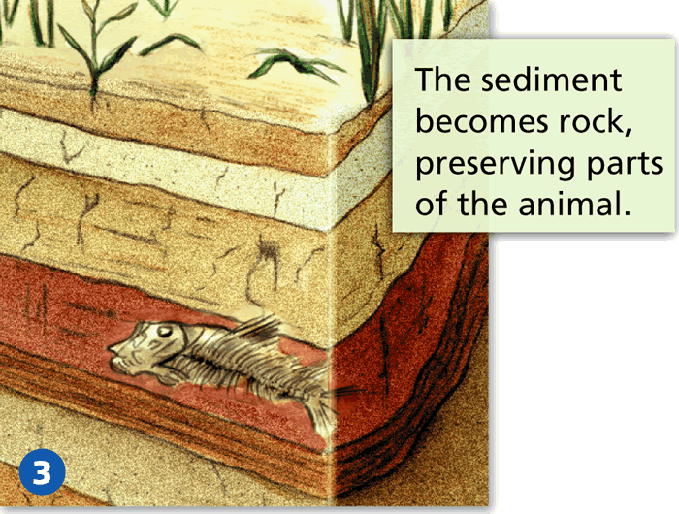

Slide 11
Fossils found in rock include:
  molds and casts
  petrified fossils
  carbon films
  trace fossils
Other fossils form when the remains of organism are preserved in substances such as tar, amber, or ice.

Slide 12
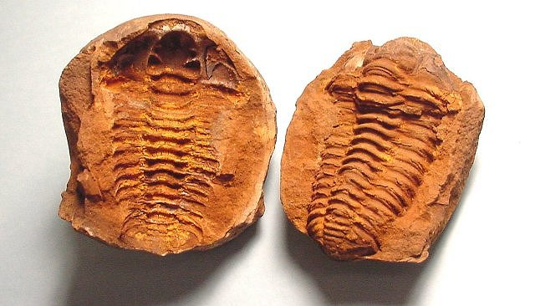
Molds and Casts
Most common fossils
A mold is a hollow area in sediment in the shape of or part of an organism.
Water deposits minerals and sediments into the empty space of a mold creating a cast.
A cast is the solid copy of the shape of the organism.

Slide 13
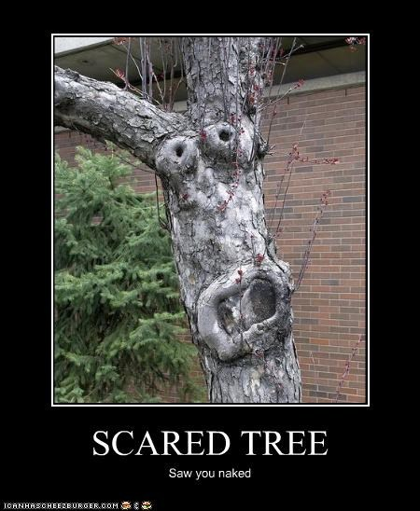
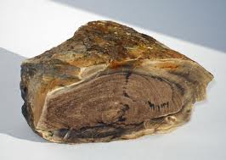
Petrified Fossils
Petrified- “Turned into Stone”
Petrified fossils- fossils that minerals replace all or part of an organism.
Minerals fill in spaces, hardens and preserves it.

Slide 14
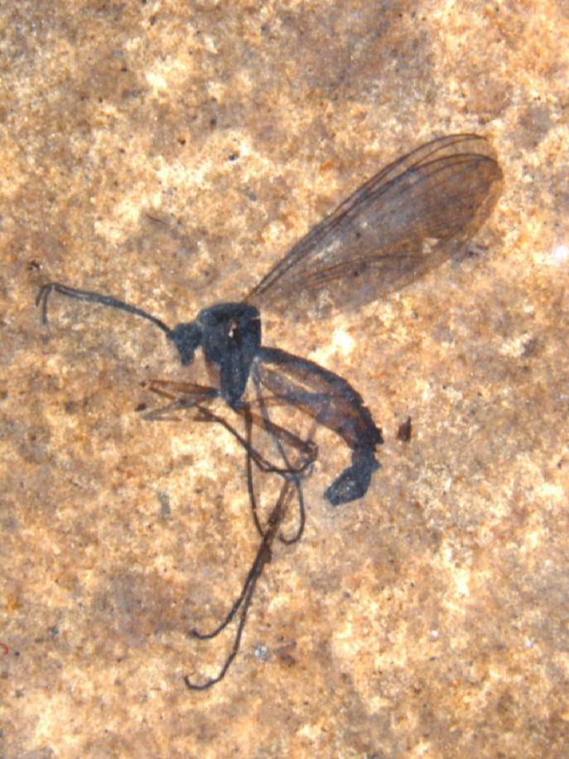
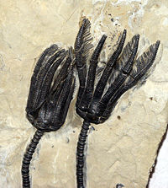
Carbon Films
Carbon films have a thin coating of carbon on the rock.
All living things contain carbon(a building block of life)
Sediments bury an organism releasing some gases leaving carbon behind.
Can preserve fragile parts of plant leaves and insects.

Slide 15
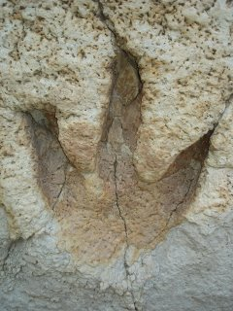
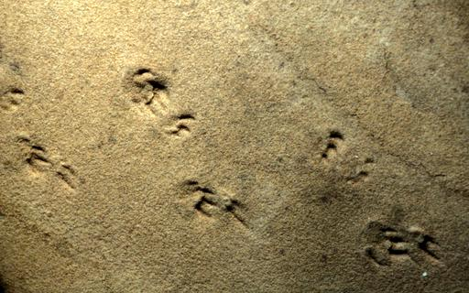
Trace Fossils
Trace Fossils-show an organism’s activity such as a foot print in mud.

Slide 16
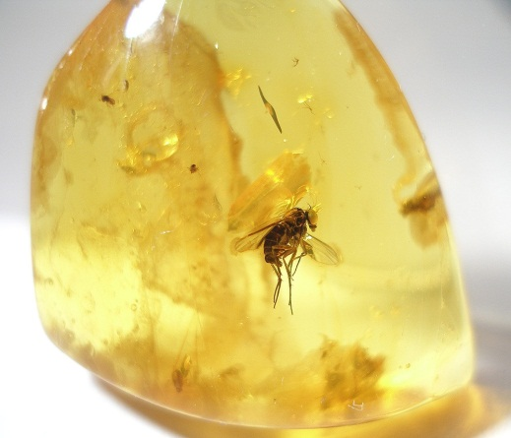
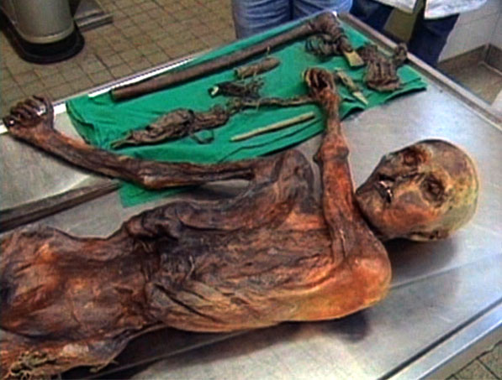
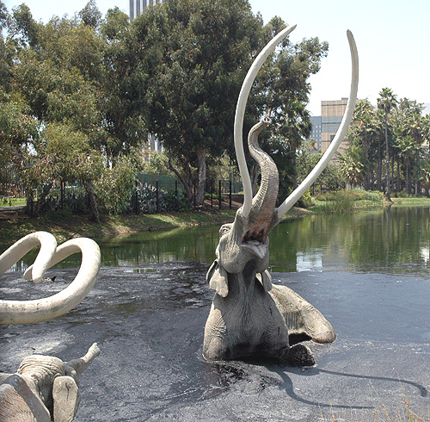
Preserved Remains
Tar, Ice, and Amber keep an organism preserved with little or no change.
Keeps organisms from decaying.

Slide 17
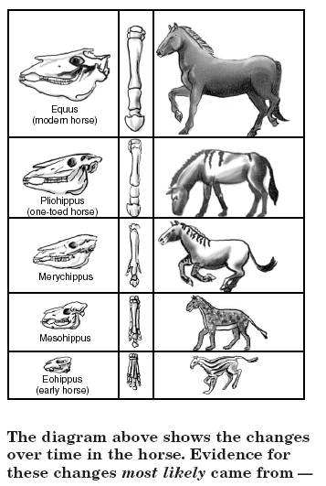
Change Over Time
Paleontologists- scientists who study fossils and classify them.
Information gathered about organism’s past life is called the fossil record.
The fossil record provides evidence of the history of life and past environments on Earth.
Also shows how organisms have changed over time.

Slide 18
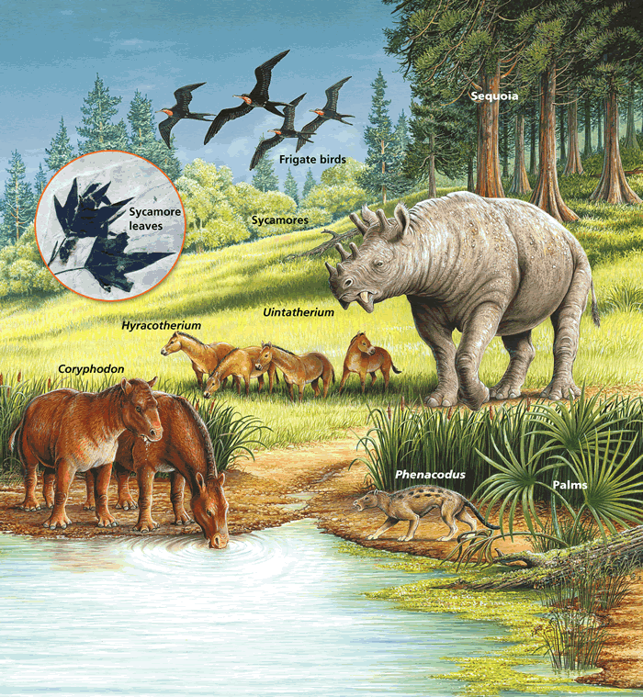
Fossils and Past Environments
Evidence of past climates
  Coal in Antarctica shows the climate must have been warm and swampy in the past.
Changes in past environments and surface.
  Fossils found in dry plains and plateaus show the area used to be swamps, forests, and warm.

Slide 19
Change in the Fossil Record
Fossils occur in a certain order.
Simple organisms came before more complex ones.
Ex- one celled bacteria → modern humans
Fossil record supports the theory of evolution.
What is scientific theory?

Slide 20
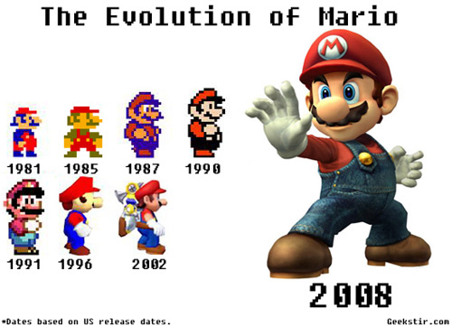
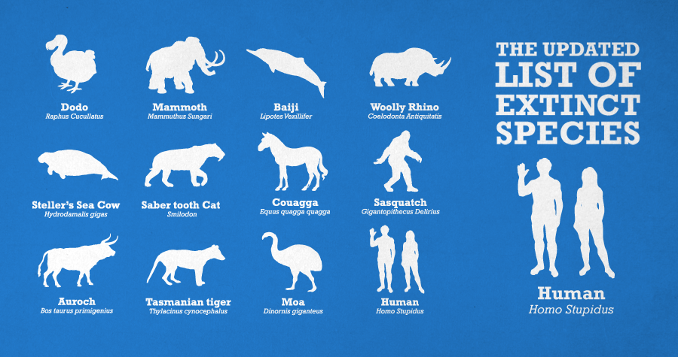
Evolution- the slow change of living things over a long period of time.
Some organisms that were not able to evolve or adapt to their environment become extinct.
Extinct- organism no longer lives on Earth and will never again exist on Earth.

Slide 21
http://www.youtube.com/watch?v=H2_6cqa2cP4 (evolution of Earth 24 hrs)
http://www.brainpop.com/science/diversityoflife/fossils/

Slide 22
Warm up: Grab your binder
Special fossils that indicate to geologists the boundaries of geological time.
A. Index Fossils
B. Trace Fossils
C. Mold Fossils
D. Cast Fossils

Slide 23
Section 2
The Relative Age of Rocks

Slide 24
What Does the Relative Age of Rocks Mean?
How do sedimentary rocks form?
  Layers of deposited sediments build up over time in layers
Fossils can be trapped in sediments.
How do we tell how old a rock and a fossil are?
  Relative age of rocks- comparing the age of a rock to the rocks around it.

Slide 25
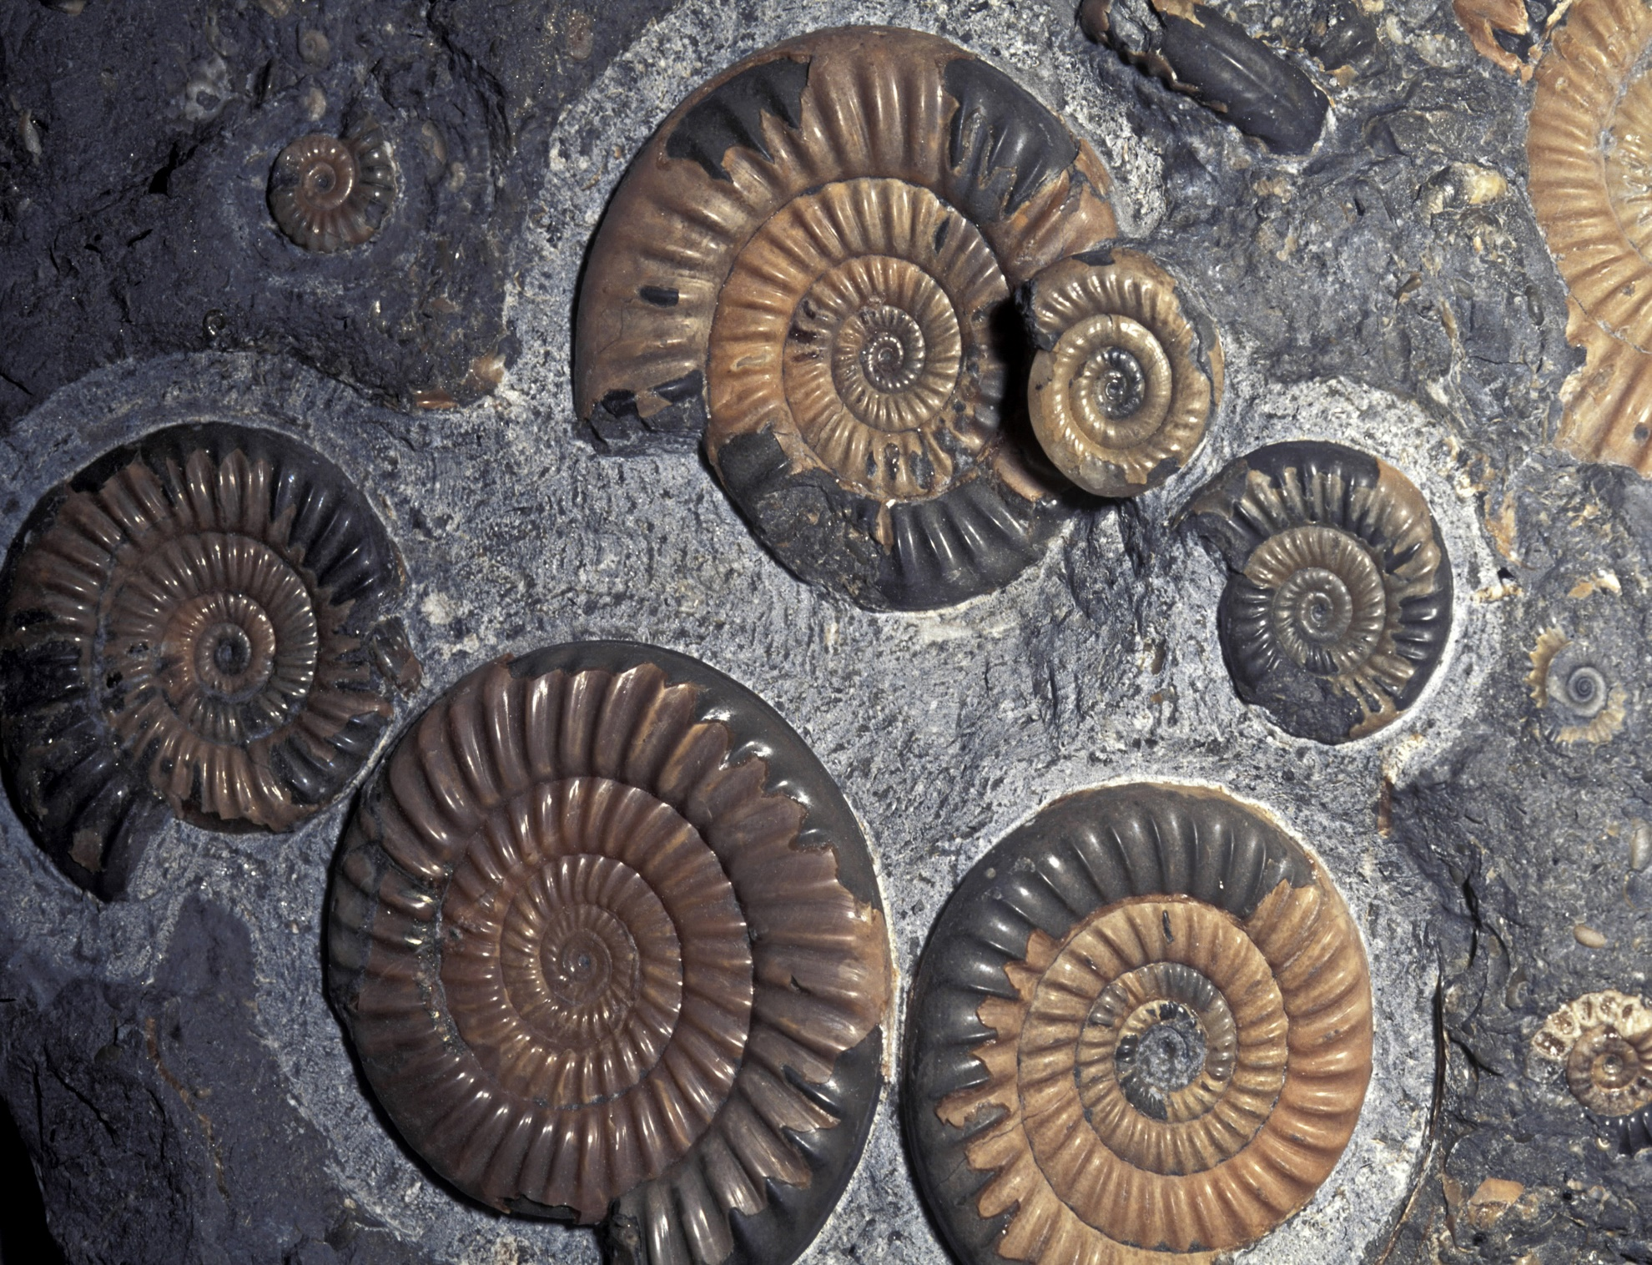

Slide 26
What is absolute age?
  The number of years since the rock formed.
So how do geologists determine the relative age of rocks?
  The position of rock layers-(superposition)
  Extrusions and intrusions of igneous rocks
  Gaps in the geological record.

Slide 27
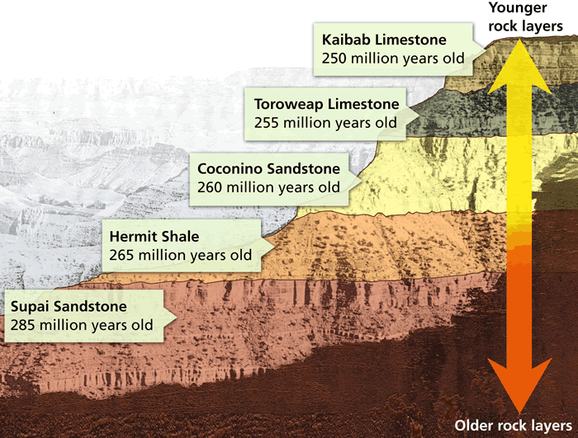
The Law of Superposition
Determines the relative ages of rocks
In horizontal sedimentary rocks, the oldest layer is at the bottom and the newest layer is on the top.

Slide 28

Review
Warm Up
(Extrusion/ Intrusion)- lava hardens on the surface
Objective:
Demonstrate the historical evidence that determines the History of Earth from Types of Fossils activity & Continental Drift.

Slide 29
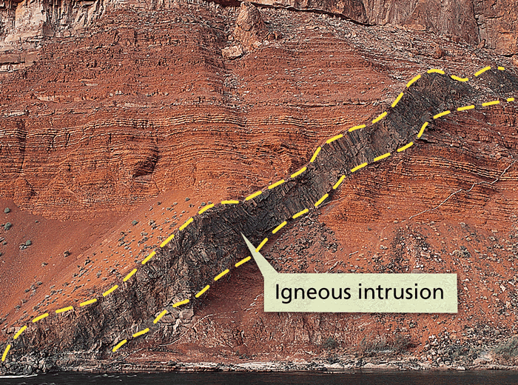
Clues from Igneous Rocks
How does an igneous rock form?
  Lava or magma hardens
Who remembers what extrusion and intrusion is?
  Extrusion- lava hardens on the surface
  Intrusion-magma cools beneath (inside)the surface.
Both types are always younger than the rocks around or beneath it.

Slide 30
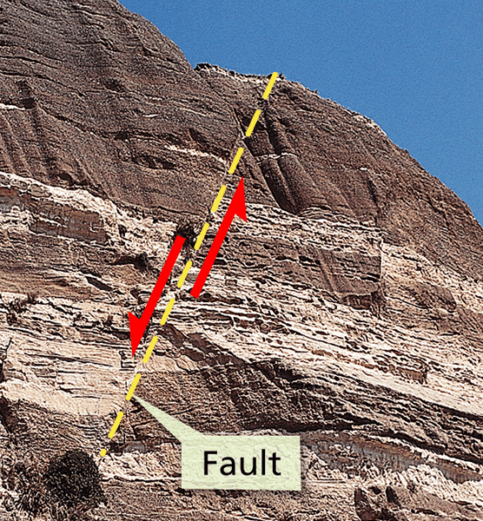
Clues from Faults
What is a fault?
  A break in the Earth’s crust.
A fault is always younger than the rock that cuts through it.
Movements along faults make it difficult to determine the relative age of rocks because rock layers don’t always line up.

Slide 31
Gaps in the Geological Record
Though sediment slowly builds up the layers of sedimentary rocks, layers may erode away, then have new sediment build on top.
Unconformity- the surface where new rock meets up with a much older rock surface.

Slide 32
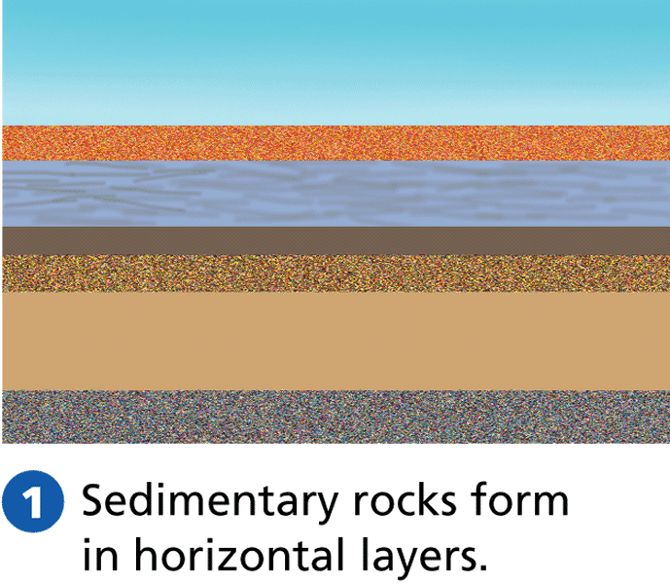
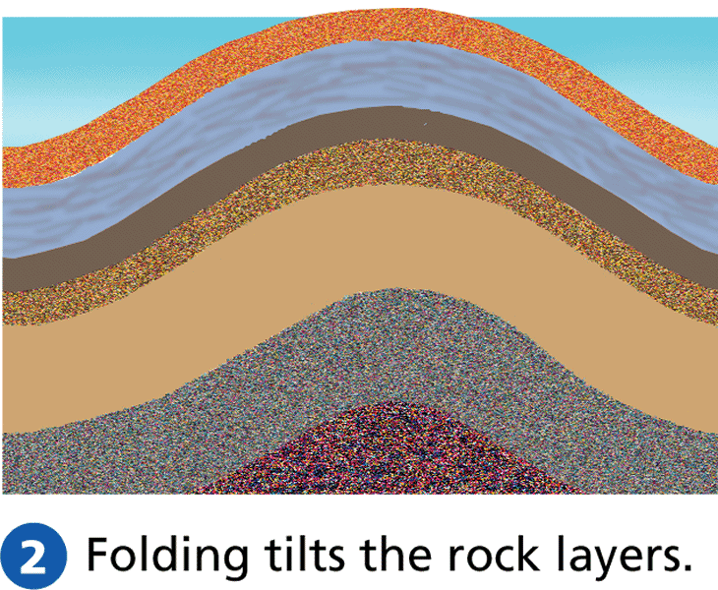
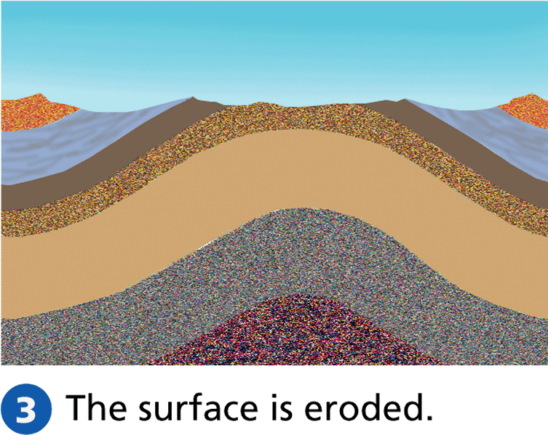
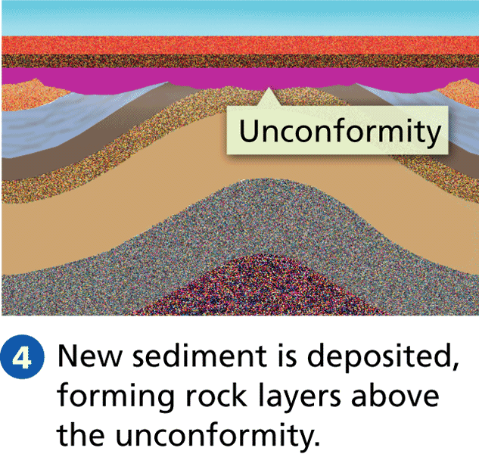

Slide 33
Using Fossils to Date Rocks
Certain fossils can help geologists match rock layers.
What is an index fossil?
  A fossil that is widely distributed(placed) and represents(shows) a type of organism that only existed(lived) briefly.
Index fossils are useful because-
  tell the relative ages of rock layers by how they occur.

Slide 34
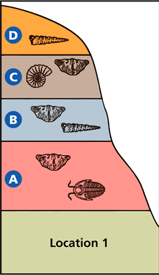
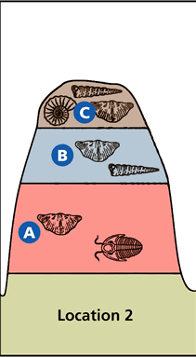
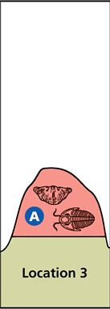
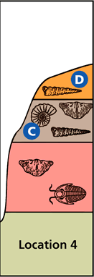

Slide 35
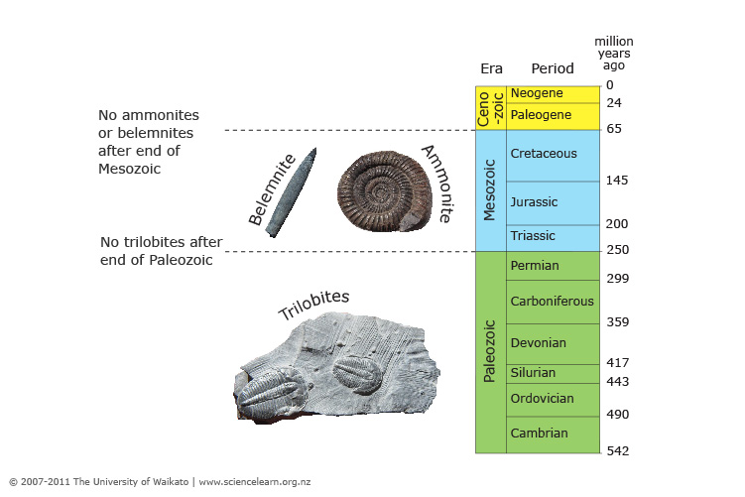

Slide 36
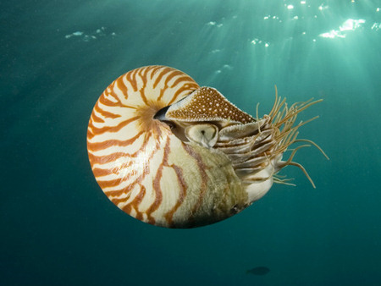
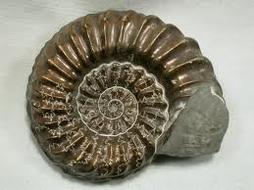
Evolution of the Index Fossil- Ammonites
Ammonites were hard shelled animals
that lived in shallow seas 500 mya to
their extinction 65 mya.
Make a great index fossil for 2 reasons:
  Widely distributed
  Many different types evolved then became extinct
Geologists ID them based on structure
of shells and based on those differences
can ID rock layers which certain
ammonite fossils are found.

Slide 37
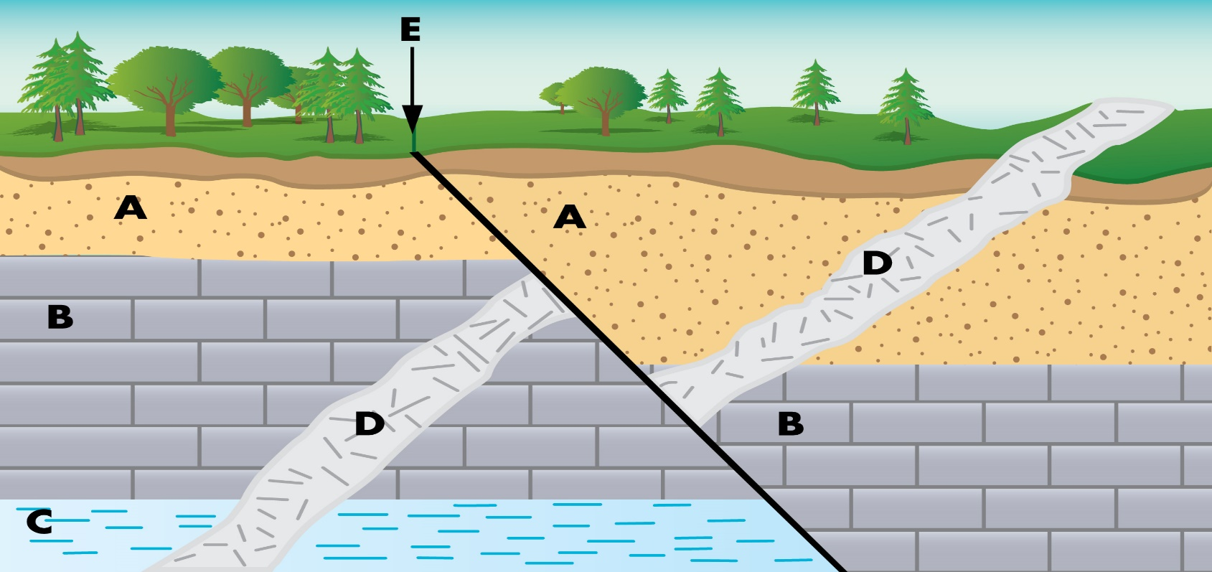
Look at the picture and determine the relative age of the layers. Then write the letters of the layers in order from oldest to youngest rock layer.

Slide 38
Our ANSWER!
C, B, D, E, A

Slide 39
Video
What are the most common elements in Earth's crust?
_________________ usually occurs at great depths below the surface of the Earth where pressure and heat are great.
The half-life of a ______________ element is the amount of time it takes for half of it to decay.
Fossils are most often found in _________________.
What is a geologic column?

Slide 40
Objective
Describe the historical developments that support the plate tectonic theory and classify the different types of fossilization from a computer activity.

Slide 41
Radioactive Dating
Section 3

Slide 42
Radioactive Decay
Tiny particles that make up matter is called an atom.
http://www.brainpop.com/science/matterandchemistry/atoms/
Atoms of the same type of matter make up an element
  H-Hydrogen, C-Carbon, N-Nitrogen, O-Oxygen (building blocks of life)
As elements break down over time they release particles and energy in a process called radioactive decay.

Slide 43
During radioactive decay, atoms from one element break down to form atoms of another element.
  Radioactive- releases particles of energy.
What is the birthday of a rock?
An igneous rock naturally has radioactive elements has a birthday of when the rock hardens.
The radioactive elements in the rock will slowly decay, changing the composition of the rock.

Slide 44
How fast or slow the radioactive elements decay is always constant (never changing)
The rate of this decay is called half-life.
Half-life of a radioactive element is the time it takes for HALF of the radioactive atoms to decay.

Slide 45
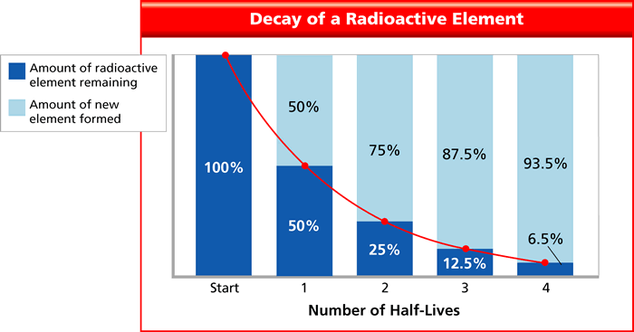

Slide 46
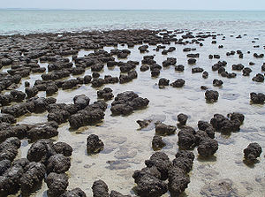
Absolute Dating
Stromatolites- ancient remains of coral reefs; world’s oldest fossils.
Geologists use radioactive dating to determine the absolute age of rocks.
What is absolute age?
http://science.discovery.com/tv-shows/greatest-discoveries/videos/100-greatest-discoveries-radiometric-dating.htm

Slide 47
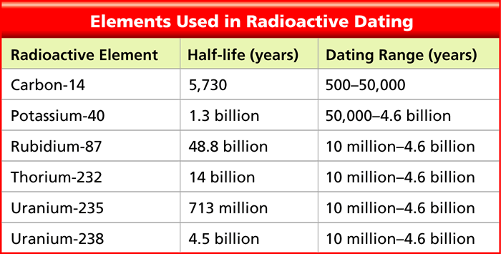
The Dating Game
Potassium-Argon Dating-dating rocks using potassium-40
This decays to argon-40 with a half-life of 1.3 billion years.
Very useful in dating rocks because it has a long half-life.

Slide 48
Carbon-14 Dating
Radioactive form of carbon is carbon-14
  Remember carbon is a building block of life, all plants and animals contain carbon
When an organism dies, carbon decays and turns into nitrogen-14.
Scientists measure the amount of carbon-14 left in an organism to determine absolute age.
Very useful for dating organisms up to 50,000 years ago but not good for rocks
The half-life of carbon-14 is 5,730 years.
http://www.brainpop.com/science/earthsystem/carbondating/

Slide 49
Radioactive Dating of Rock Layers
Radioactive dating is good for igneous rocks but not sedimentary rocks.
Where does the sediment from sedimentary rocks come from?
Scientists can date particles but not layers
Scientists date igneous intrusions and extrusions near sedimentary rock layers.
Why?

Slide 50
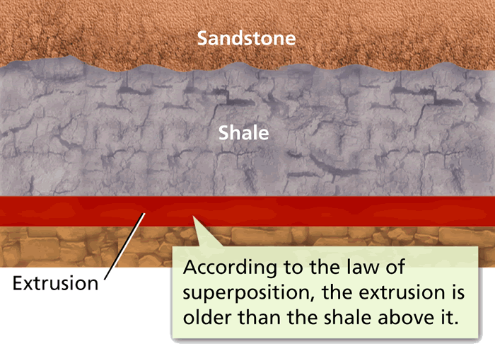
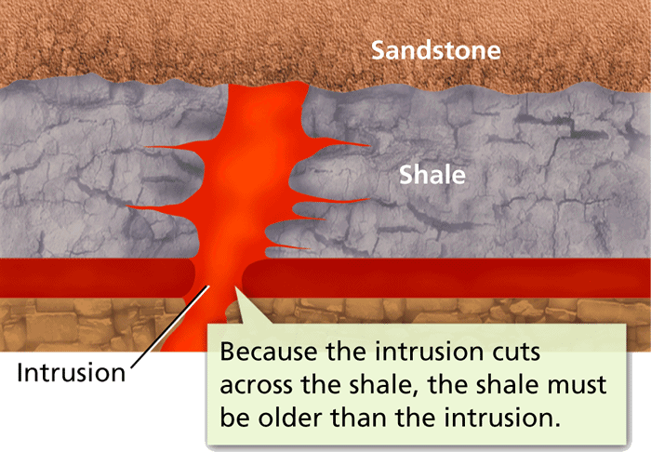

Slide 51
The Geological Time Scale
Section 4

Slide 52
Because the time span of Earth’s past is so great, geologists use the Geological Time Scale to show Earth’s history.
The geological time scale is a record of the life forms and geologic events in Earth’s history.
Scientists study rock layers and index fossils worldwide to create the GTS in relative age.
Later, radioactive dating determined absolute age of divisions in the GTS.

Slide 53
Divisions of Geological Time
Changes in the fossil record mark where one time period ends and another begins.
Time on the scale starts at the beginning with Precambrian Time.
After Precambrian Time, basic units of the GTS are eras and periods.

Slide 54
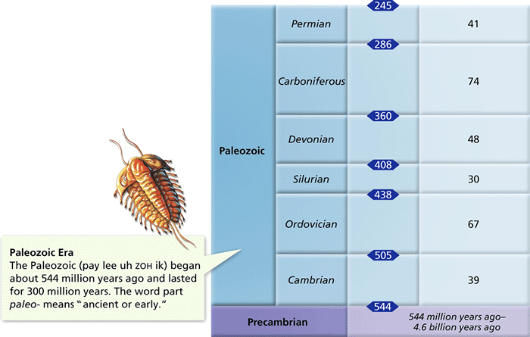

Slide 55
Create your Timescale
YOU have been hired by a travel agency that is promoting travel through time. You are assigned to one of the four major eras in history Cenozoic (modern man). Create a time scale of some event that applies of our modern times. You choose your event that can be presentable in class.

Slide 56
Questions to answer:
1) In what ways do evolutionary events correspond to other types of events during the history of life?
2) How might extinctions affect the evolution of organisms that survive the event?
3) In what ways have geologic changes influenced evolutionary events and/or extinctions?
4) How does the length of the history of life help to explain the evolutionary events of single-celled organisms to complex multicellular organisms like mammals?

Slide 57
Eras- three long units of time from Precambrian Time to the present.
  Ex: The Paleozoic, Mesozoic, and Cenozoic Eras
Periods-units subdivided from eras.
  Ex: The Mesozoic Era includes 3 periods: The Triassic, Jurassic, and Cretaceous Periods.

Slide 58
Early Earth
Section 5

Slide 59
The Planet Forms
Scientists hypothesize that the Earth formed at the same time as other planets and the sun, about 4.6 billion years ago!
How do scientists know the age of the Earth?
  Using radioactive dating, the oldest rocks are about 4 billion years old.

Slide 60
The hypothesis
The Earth and the moon are about the same age.
When Earth was young, it collided with another large object throwing large material into orbit around the Earth, forming the moon.
Moon rocks dated show the oldest moon rocks at 4.6 billions years, so scientists infer Earth is a bit older.

Slide 61
Earth Takes Shape
Earth started as a ball of dust, rock, and ice in space.
Gravity pulled the mass together. As the mass grew larger, gravity increased pulling more ice, rock, and dust.
The energy from this collision created thermal energy, causing the Earth to heat up.

Slide 62
The Earth was so hot that it melted sinking dense materials like iron to the center of Earth, creating the core.
The cold of space cooled down the crust as Earth captured gases such as hydrogen and helium until the sun released a burst of particles blowing away Earth’s first atmosphere.

Slide 63
Earth’s surface forms
During the first several hundred million years of the Precambrian Time, an atmosphere, oceans, and continents began to form.
The atmosphere-made of carbon dioxide, water vapor, and nitrogen formed from Earth’s interior.

Slide 64
The oceans-
Earth’s surface was way too hot in the beginning for water to remain a liquid.
As Earth cooled, water vapor condensed forming rain, accumulating to form the oceans.
Oceans changed the composition of the atmosphere by absorbing carbon dioxide.

Slide 65
The continents-
During Precambrian Time rock cooled and hardened.
Less dense rock at the surface formed landmasses called continents.
Over millions of years Earth’s landmasses have repeatedly formed, broken apart, and crashed together again, forming new continents in continental drift.

Slide 66
Life Develops
Scientists cannot pinpoint when or where life began on Earth.
Scientists have found fossils of single-celled organism in rocks that formed about 3.5 billion years ago.
These earliest life forms were probably similar to present-day bacteria.

Slide 67
2.5 billion years ago, organisms started making their own food from the energy of the sun in a process called photosynthesis.
The waste product of photosynthesis is oxygen.
This process again changed the composition of the atmosphere adding oxygen and creating ozone.
Ozone blocks out deadly ultraviolet rays from the sun allowing organisms to live on the land.

