Slide 1
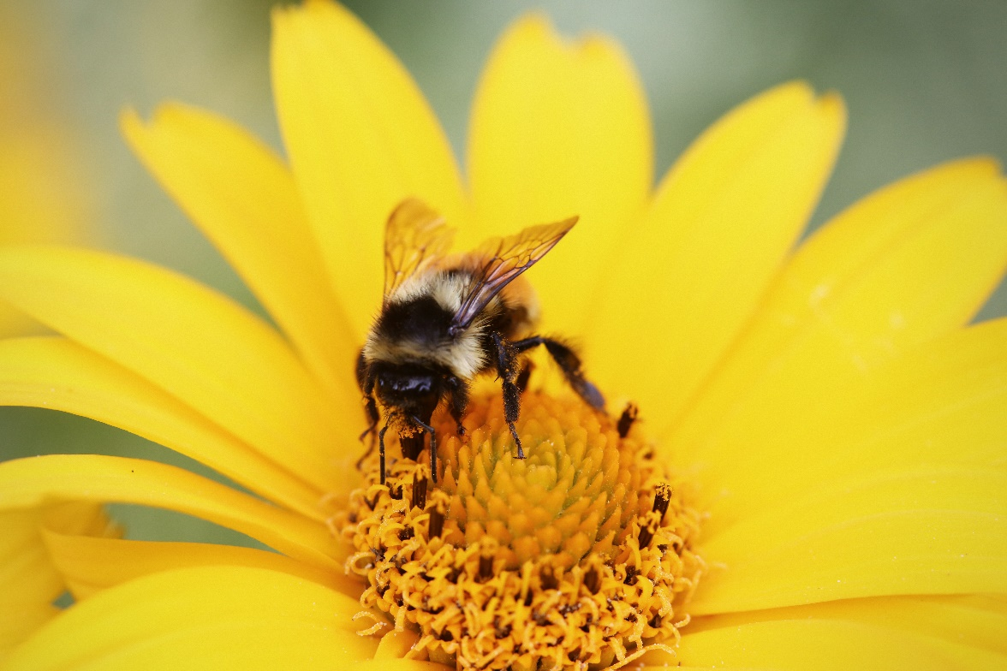
Bee Stings
Student Name

Slide 2
Prevention
Never disturb a nest
Inspect a new work area for nests
Wear proper clothing
Have insect spray handy

Slide 3
Treatment
Call 911 if severe reaction
Remove stinger
Control swelling
Treat symptoms

