Slide 1
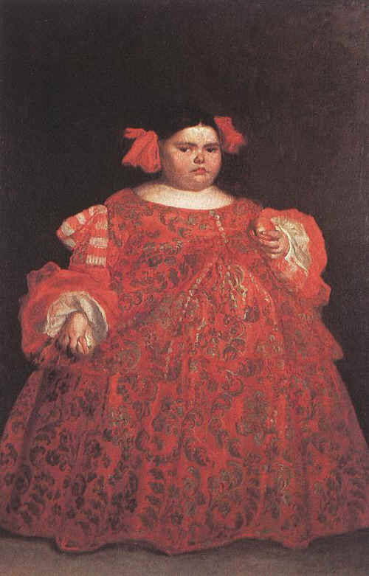
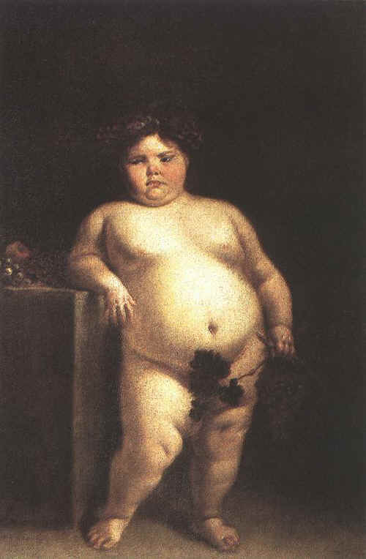
Images from: http://www.fisterra.com/human/3arte/pintura/temas/enanos/enanos.asp
“La Monstrua Vestida” “La Monstrua Desnuda”
Paintings in Prado Museum in Madrid by Juan Carrneño Miranda
of a 5 year old girl named Eugenia Marinez Vallejo

Slide 2
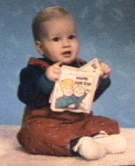
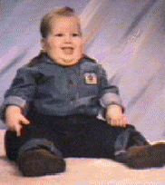
PRADER-WILLI Syndrome
Victor Age 1 Victor Age 2
Born floppy and pale At first refuse to nurse, but later eat until they become obese
Tiny hands and feet Underdeveloped sex organs
Mildly retarded
Spectacular temper tantrums especially if refused food
Exceptional proficiency with Jig-saw puzzles

Slide 3
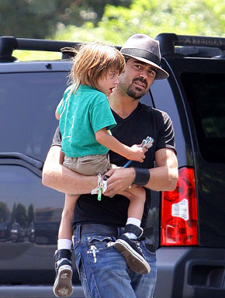
ANGELMAN’S SYNDROME
Taut, not floppy
Thin
Hyperactive
Insomniac
Small head
Move jerkily like puppets
Happy disposition
Severely mentally retarded
Rarer than Prader-Willi
Missing SAME piece of Chromosome #15
Colin Farrell’s son has
Angelman’s syndrome
http://www.usmagazine.com/colin_farrell_and_son

Slide 4
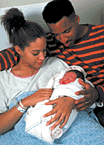
WHAT’S THE DIFFERENCE?
In Prader-Willi missing piece of #15 was from father
In Angelman’s, missing piece of #15 was from the mother
How does a gene “remember” where it came from?
GENOMIC IMPRINTING

Slide 5
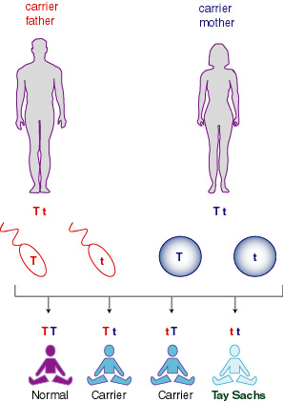
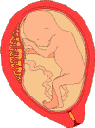
AP BIOLOGY Chapter 15 Chromosomal Basis of Inheritance
http://www.biochem.arizona.edu/classes/bioc460/spring/rlm/genetics.jpeg

Slide 6
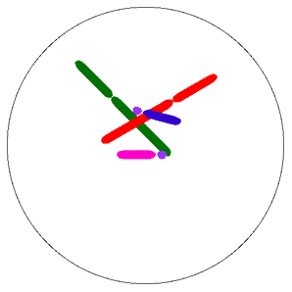
Concept 15.1: Mendelian inheritance has its physical basis in the behavior of chromosomes
Several researchers proposed in the early 1900s that genes are located on chromosomes
The behavior of chromosomes during meiosis was said to account for Mendel’s laws of segregation and independent assortment

Slide 7
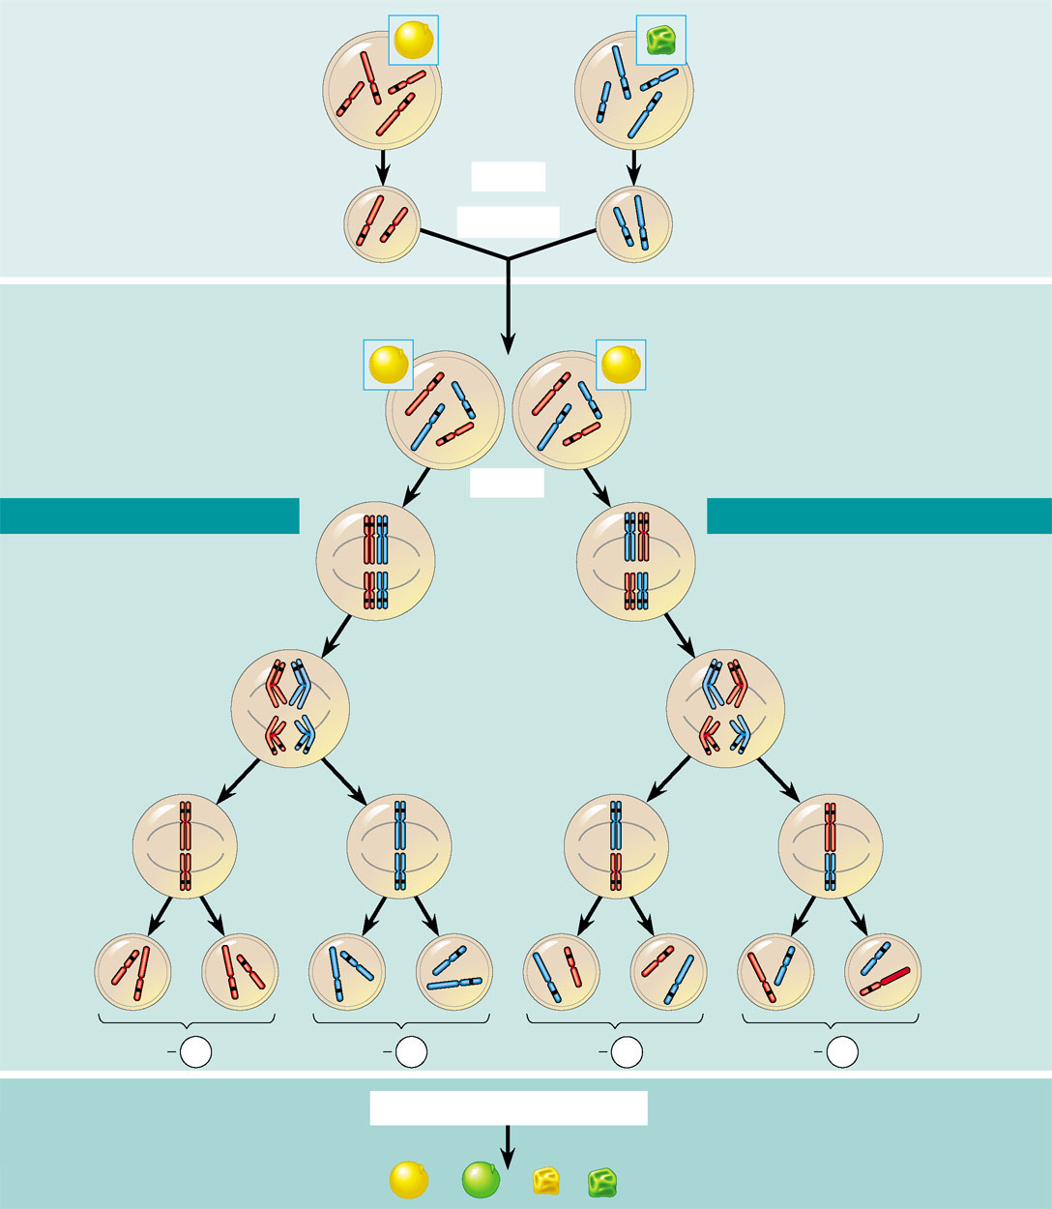
P Generation
Yellow-round
seeds (YYRR)
Green-wrinkled
seeds (yyrr)
Starting with two true-breeding pea plants,
we follow two genes through the F₁ and F₂
generations. The two genes specify seed
color (allele Y for yellow and allele y for
green) and seed shape (allele R for round
and allele r for wrinkled). These two genes are
on different chromosomes. (Peas have seven
chromosome pairs, but only two pairs are
illustrated here.)
Y
y
R
r
Y
R
y
r
Meiosis
R
Y
Fertilization
y
r
Gametes
All F₁ plants produce
yellow-round seeds (YyRr)
F₁ Generation
R
y
R
y
r
r
Y
Y
Meiosis
LAW OF SEGREGATION
R
r
r
R
LAW OF INDEPENDENT ASSORTMENT
Two equally
probable
arrangements
of chromosomes
at metaphase I
Y
y
Y
y
1
1
Alleles at both loci segregate
in anaphase I, yielding four
types of daughter cells
depending on the chromosome
arrangement at metaphase I.
Compare the arrangement of
the R and r alleles in the cells on the left and right
The R and r alleles segregate
at anaphase I, yielding
two types of daughter
cells for this locus.
R
r
r
R
Anaphase I
Y
y
Y
y
2
R
r
r
R
Each gamete
gets one long
chromosome
with either the
R or r allele.
Metaphase II
2
Y
y
y
y
Each gamete gets
a long and a short
chromosome in
one of four allele
combinations.
Y
Y
Y
Y
Y
Y
y
y
Gametes
R
R
r
r
r
r
R
R
1
4
YR
1
4
yr
1
4
yr
1
4
yR
F₂ Generation
Fertilization among the F₁ plants
3
3
Fertilization
recombines the
R and r alleles
at random.
Fertilization results
in the 9:3:3:1
phenotypic ratio in
the F₂ generation.
Figure 15.2
9
: 3
: 3
: 1

Slide 8
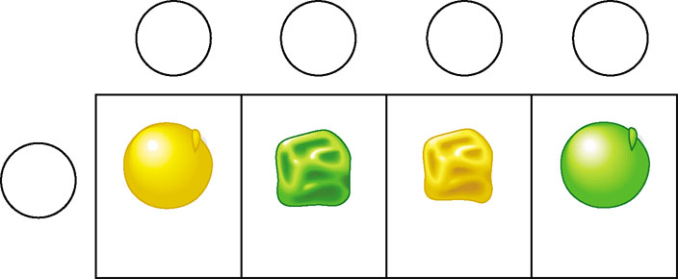
Recombination of Unlinked Genes: Independent Assortment of Chromosomes
Gametes from yellow-round
heterozygous parent (YyRr)
YR
yr
Yr
yR
Gametes from green-
wrinkled homozygous
recessive parent (yyrr)
yr
YyRr
yyrr
Yyrr
yyRr
Parental-
type offspring
Recombinant
offspring
When Mendel followed the inheritance of two characters
He observed that some offspring have combinations of traits that do not match either parent in the P generation

Slide 9
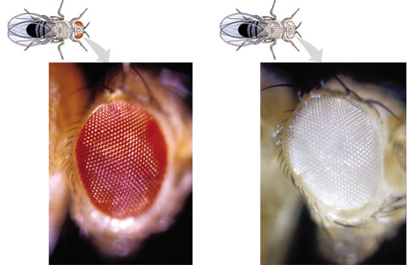
THOMAS HUNT MORGAN
1st observed and noted Wild type fruit fly phenotypes
Alternative alleles = mutants
1st to provide convincing evidence that chromosomes are the location of Mendel’s heritable factors

Slide 10
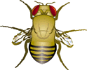
Correlating Behavior of a Gene’s Alleles with Behavior of a Chromosome Pair
female flies with red eyes (wild type)
male flies with white eyes
The F₁ generation all had red eyes
F₂ generation showed the 3:1 red:white eye ratio,
but only males had white eyes
Morgan proposed that the white eye mutation
was carried on X chromosome

Slide 11
Morgan did other experiments with fruit flies to see how linkage affects the inheritance of two different characters
What he discovered:
Genes that are close together on the same chromosome are linked and do not assort independently
Unlinked genes are either on separate chromosomes or are far apart on the same chromosome and assort independently
The frequency of crossing over is related to the distance between genes.
Linked genes have recombination frequencies less than 50%

Slide 12
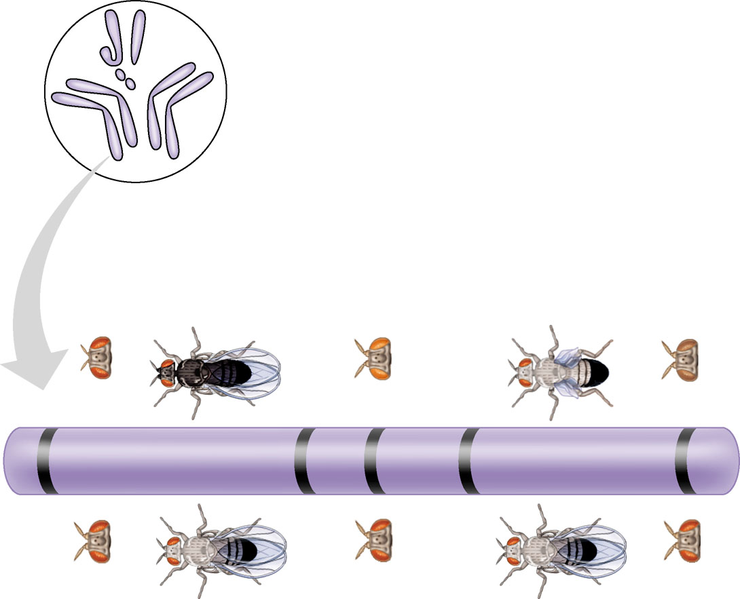
A genetic map = an ordered list of the genetic loci along a particular chromosome
Many fruit fly genes were mapped initially using recombination frequencies
The farther apart genes
are on a chromosome
the more likely they are
to be separated
during crossing over
I
Y
X
IV
II
III
Mutant phenotypes
Short
aristae
Black
body
Cinnabar
eyes
Vestigial
wings
Brown
eyes
0
48.5
57.5
67.0
104.5
Long aristae
(appendages
on head)
Gray
body
Red
eyes
Normal
wings
Red
eyes
Wild-type phenotypes
Copyright © 2002 Pearson Education, Inc., publishing as Benjamin Cummings

Slide 13
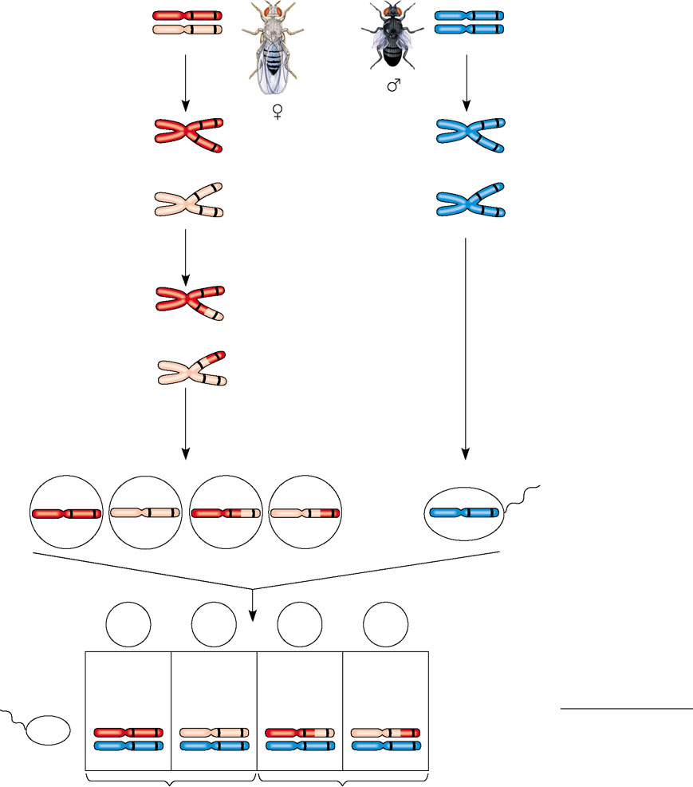
Gray body,
normal wings
(F₁ dihybrid)
b⁺
vg⁺
b vg
Black body, vestigial wings (double mutant)
Testcross
parents
×
b
vg
b vg
Replication of
chromosomes
Replication of
chromosomes
b⁺
vg
b
vg
b⁺
vg⁺
b
vg
b
vg
b
vg
Meiosis I: Crossing
over between b and vg
loci produces new allele
combinations.
b
vg
b vg
Meiosis II: Segregation
of chromatids produces
recombinant gametes
with the new allele
combinations.
Meiosis I and II:
Even if crossing over
occurs, no new allele
combinations are
produced.
Recombinant
chromosome
Ova
Sperm
Gametes
b⁺vg⁺
b vg
b⁺ vg
b vg⁺
b vg
b⁺ vg⁺
b vg
b⁺ vg
b vg⁺
Ova
Testcross
offspring
Sperm
965
Wild type
(gray-normal)
944
Black-
vestigial
206
Gray-
vestigial
185
Black-
normal
Recombination
frequency
=
391 recombinants
×
100 = 17%
b vg
b⁺ vg⁺
b vg⁺
b⁺ vg⁺
b vg⁺
2,300 total offspring
b vg
b vg
b vg
b vg
Parental-type offspring
Recombinant offspring

Slide 14
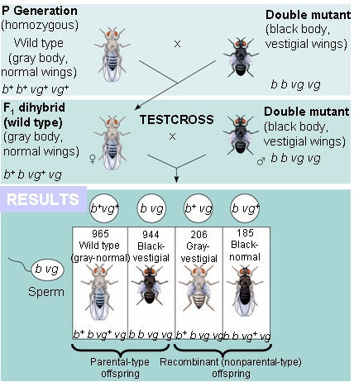
Linkage Mapping: Using Recombination Data
Cross true breeding parents of different phenotypes
Cross heterozygous F₁ organisms with pure breeding recessives (like a TEST CROSS)
Count recombinants (ones that look different from parental phenotype)

Slide 15
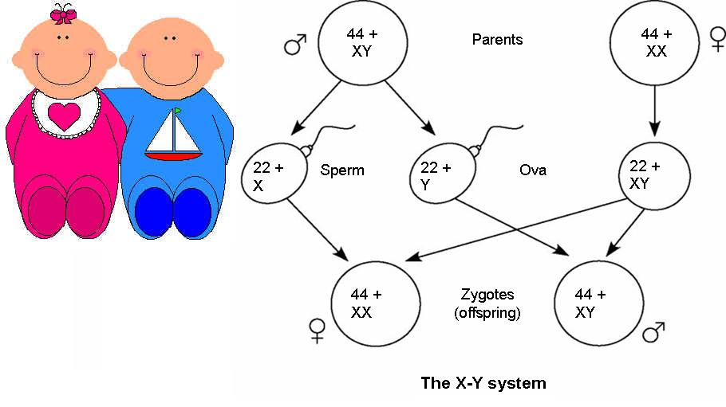
The Chromosomal Basis of Sex
SEX DETERMINATION in humans and other mammals There are two varieties of sex chromosomes, X and Y

Slide 16
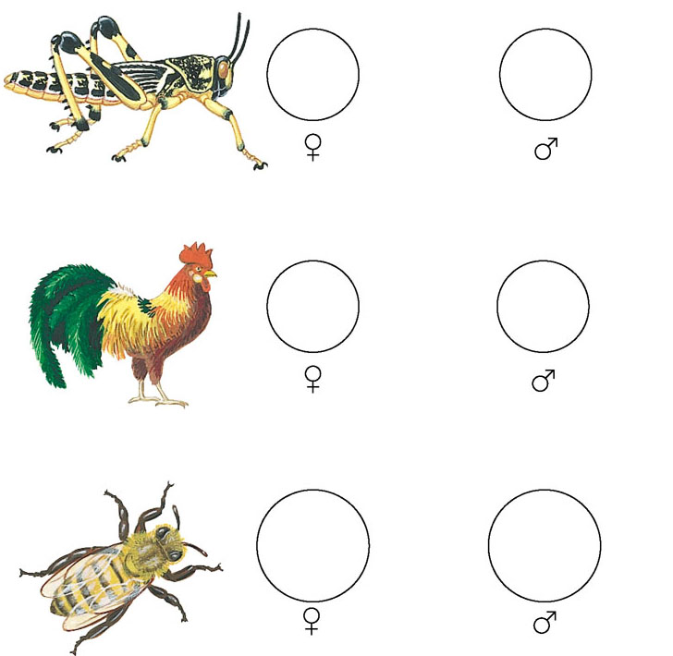
Different systems of sex determination
are found in other organisms
22 +
XX
22 +
X
(b) The X–0 system
76 +
ZW
76 +
ZZ
(c) The Z–W system
16
(Diploid)
16
(Haploid)
(d) The haplo-diploid system

Slide 17
Inheritance of Sex-Linked Genes
The sex chromosomes
Have genes for many characters unrelated to sex
A gene located on either sex chromosome
Is called a sex-linked gene

Slide 18
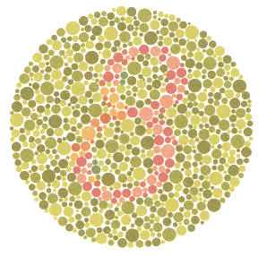
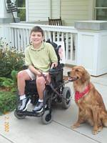
X-Linked Genes
Recessive genes carried on the X chromosome
Red-green colorblindness, hemophilia, an Duchenne muscular dystropy are examples of X-linked traits.
http://gizmodo.com/gadgets/peripherals/samsung-develops-lcd-for-colorblind-036306.php

Slide 19
What’s the pattern:
Y linked traits show up only in MALES
X Linked recessive traits Show up more frequently in males
because they have no back up
Females need two recessive alleles to show the trait.
Females can be carriers
Male can never be carriers of X linked recessive traits, but they can be carriers for autosomal recessive traits.

Slide 20
The X chromosome in males . . .
flies WITHOUT a copilot!

Slide 21
Alterations of Chromosome Structure
Breakage of a chromosome can lead to four types of changes in chromosome structure
Deletion
Duplication
Inversion
Translocation

Slide 22
A deletion occurs when a chromosome fragment lacking a centromere is lost during cell division.
This chromosome will be missing certain genes.
A duplication occurs when a fragment becomes attached as an extra segment to a sister chromatid.
Images from: Biology; Campbell and Reese; Pearson Education, Inc., publishing as Benjamin Cummings
Slide from: Slide show by Dr. Chuck Downing

Slide 23
An inversion occurs when a chromosomal fragment reattaches to the original chromosome but in the reverse orientation.
In translocation, a chromosomal fragment joins a nonhomologous chromosome.
See a Video
See a Video
Slide from: Slide show by Dr. Chuck Downing
Images from: Biology; Campbell and Reese; Pearson Education, Inc., publishing as Benjamin Cummings

Slide 24
Chromosomal translocations between nonhomologous chromosome are also associated with human disorders.
Chromosomal translocations have been implicated in certain cancers, including chronic myelogenous leukemia (CML).
CML occurs when a fragment of chromosome 22 switches places with a small fragment from the tip of chromosome 9.
Normal chromosome 9
Reciprocal
translocation
Translocated chromosome 9
Philadelphia
chromosome
Normal chromosome 22
Translocated chromosome 22
http://www.antigenics.com/diseases/images/philly_chrom.gif

Slide 25
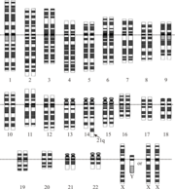
Some individuals with Down syndrome have the normal number of chromosomes but have all or part of a third chromosome 21 attached to another chromosome by translocation.
http://content.answers.com/main/content/wp/en/thumb/f/f5/180px-Down_syndrome_translocation.png

Slide 26
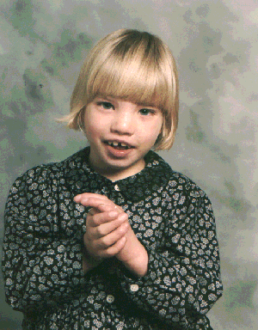
Duplications and translocations are typically harmful.
Cri du chat
Is a disorder caused by
a deletion in chromosome #5
Mental retardation
Small head
Unusual facial features
“cat cry”
http://www.morfosa.org/medweb/patologi/bilder/cri-du-chat.gif

Slide 27
The frequency of aneuploid zygotes may be quite high in humans, most of these alterations are so disastrous that the embryos are spontaneously aborted long before birth.
Certain aneuploid conditions upset the balance less, leading to survival to birth and beyond.
These individuals have a set of symptoms - a syndrome - characteristic of the type of aneuploidy.

Slide 28
Nondisjunction –
Failure of homologous chromosomes OR chromatids to separate at anaphase

Slide 29
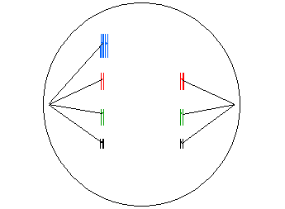
Nondisjunction
Results in chromosomal aberration in which one or more chromosomes have extra or missing copies= ANEUPLOIDY
Cell with only 1 copy of a chromosome instead of 2
= MONOSOMY
Cell with 3 copies of a
chromosome instead of 2
= TRISOMY

Slide 30
Normal Meiosis
Nondisjunction
http://web.udl.es/usuaris/e4650869/docencia/gen_etica/meioferti2.html
http://www.tokyo-med.ac.jp/genet/anm/domov.gif

Slide 31
Human Abnormalities caused
by Non-Disjunction
Down syndrome
Klinefelter syndrome
Turner syndrome
Triple XXX female
Xyy males

Slide 32
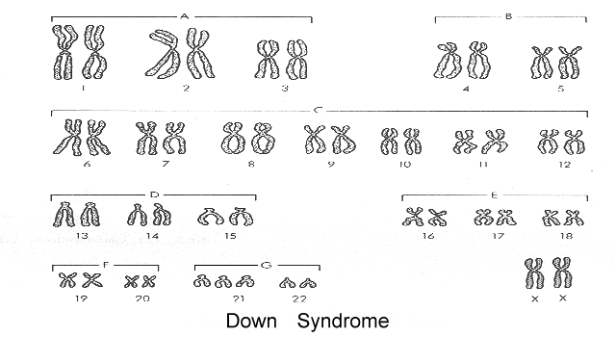
DOWN SYNDROME = TRISOMY 21

Slide 33
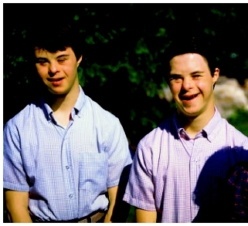
Down syndrome (Trisomy 21)
http://www.hadsa.org/
Most common chromosomal abnormality (1 in 800 births)
Similar facial features
Slanted eyes / Protruding tongue Mild to severe mental retardation
50% have heart defects that need surgery to repair
Both older (35+ years) and younger (under 16 years) mothers are more at risk.
http://www.healthofchildren.com/images/gech_0001_0002_0_img0096.jpg

Slide 34
Turner syndrome = X0

Slide 35
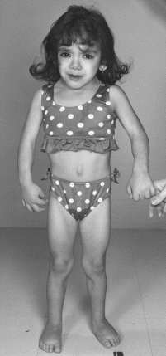
Turner syndrome
http://medgen.genetics.utah.edu/photographs/diseases/high/611.gif
1 in 5000 births
Females have only one X chromosome
Small size
Slightly decreased intelligence
35% have heart abnormalities
1Hearing loss common
Broad chest
Reproductive organs don’t develop at puberty

Slide 36
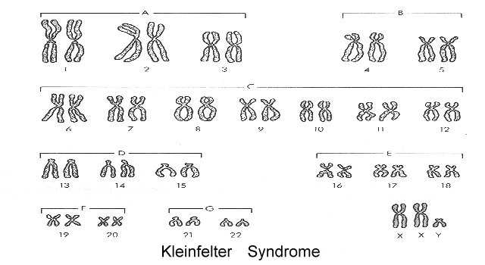
Klinefelter syndrome XXy

Slide 37
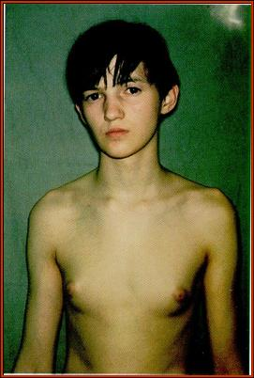
Klinefelter syndrome
http://www.akdeniz.edu.tr/tip/histoloji/embrders_dosyalar/slide0228_image1186.jpg
1 in 2000 births live births
Males have extra X chromosomes
(Can be XXy, XXXy, or XXXXy)
Taller than average
These individuals have male sex organs, but are sterile.
There may be feminine characteristics, but their intelligence is normal.
Usually not discovered until puberty when don’t mature like peers

Slide 38
TRIPLE X syndrome (TRISOMY X)
1 in 1000 females
Tall stature (height)
Normal IQ, but may be 10-15 points below siblings
Learning disabilities (70%):
Speech and language delays (50%)
Delayed motor skills: poor coordination, awkwardness, clumsiness
Behavioral: introverted, difficulty with interpersonal relationships

Slide 39
Xyy Males (1 in 1000 males)
Causes no unusual physical features or medical problems.
Usually taller than average and several centimeters taller than their parents and siblings.
Most 47,XYY males have normal sexual development and usually have normal fertility.
Usually detected only during genetic analysis for another reason.
Increased risk for learning disabilities (50%)

Slide 40
Organisms with more than two complete sets of chromosomes, have undergone polypoidy.
This may occur when a normal gamete fertilizes another gamete in which there has been nondisjunction of all its chromosomes.
The resulting zygote would be triploid (3n).
Alternatively, if a 2n zygote failed to divide after replicating its chromosomes, a tetraploid (4n) embryo would result from subsequent successful cycles of mitosis.
Copyright © 2002 Pearson Education, Inc., publishing as Benjamin Cummings

Slide 41
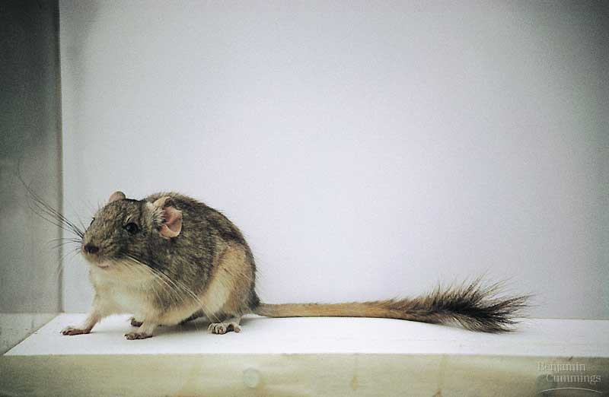
Polyploidy is relatively common among plants and much less common among animals.
Polyploids are more nearly normal in phenotype than aneuploids.
One extra or missing chromosome apparently upsets the genetic balance during development more than does an entire extra set of chromosomes.
Copyright © 2002 Pearson Education, Inc., publishing as Benjamin Cummings

Slide 42
If having extra chromosomes causes genetic problems,
how come having two X chromosomes in females and
one X in males is not a problem?

Slide 43
X-chromosome Inactivation
In female cells ONE X chromosome is randomly switched off
It condenses and forms a dense region in the nucleus called a
BARR BODY
http://fig.cox.miami.edu/~cmallery/150/gene/barr.htm

Slide 44
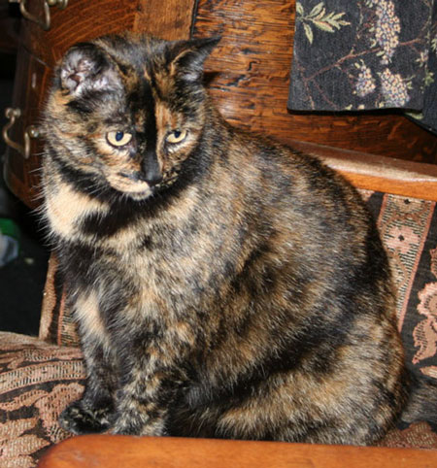
CAT COLOR
In cats the gene that
controls color is carried on the X chromosome Tortoiseshell cats express different alleles in different cells
http://www.eagle.ca/~roda/RodMerArts/SwallowHill/Kiisu.html
FEMALE CATS: Female cat can have BOTH
black and orange spots
http://www.islandstrolling.com/mainland/peloponnes/photo/mystra_cat_white_orange_black.jpg

Slide 45
CAT COLOR
http://ascensionparish.net/forum/messages/14/2493.jpg
MALE cats have only
one X chromosome, so they can only have
ONE COLOR of spots!
THINK ABOUT IT?
How many colors of spots could a male cat with
Klinefelter syndrome have?

Slide 46
Prader-Willi syndrome- Born floppy and pale; Mildly retarded; Obesity;|Tiny hands and feet; Short stature Underdeveloped sex organs, Spectacular temper tantrums especially if refused food
Angelman syndrome - spontaneous laughter, jerky movements, severe retardation; and other motor and mental symptoms.
Both missing same piece of chromosome #15
Prader- Willi- paternal piece missing Angelman – maternal piece missing
Difference is due to genomic imprinting
http://www.angelman.org/angel/

Slide 47
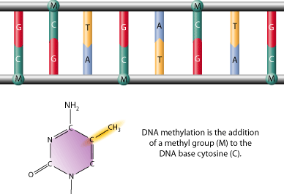
GENOMIC IMPRINTING
Involves the silencing of certain genes that are “stamped” with an imprint during gamete production so same allele (maternal or paternal) is expressed in all body cells
Involves methylation (-CH₃) (turns genes OFF)
or demethylation (turns genes on) of cytosine nucleotides
Several hundred mammalian
genes, many critical for
development, may be subject
to imprinting.
http://www.scq.ubc.ca/wp-content/uploads/2006/08/methylation%5B1%5D-GIF.gif

Slide 48
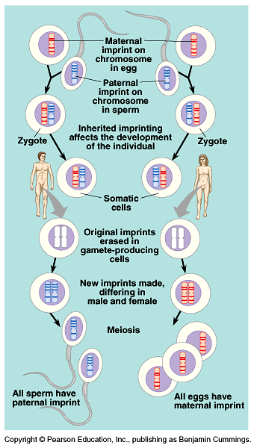
In the new generation, both maternal and paternal imprints are apparently “erased” in gamete-producing cells.
Then, all chromosomes are reimprinted according to the sex of the individual in which they reside.
Imprinting is critical for normal development.
Copyright © 2002 Pearson Education, Inc., publishing as Benjamin Cummings

Slide 49
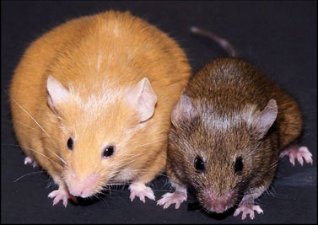
Addition or removal or “methyl tags” may be influenced by environment
Twins start with same methyl tags but become more different with age
Agouti rats – changing diet of pregnant mom can change expression of genes
VIDEO
http://www.precisionnutrition.com/wordpress/wp-content/uploads/2009/12/Figure-3-Agouti-mice.jpg

Slide 50
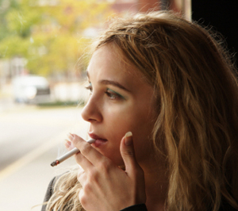
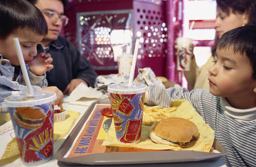
SO WHAT?
Epigenetic therapy in future ????
Can your choices affect your kids’ and grandkids’ epigenome?
http://www.naturepedic.com/blog/wp-content/uploads/2010/11/BPA_free_logo.jpg
http://www.knowabouthealth.com/wp-content/uploads/2010/06/mcdonalds_.jpg
http://emilyscarenhealth.wordpress.com/2011/10/04/attention-a-must-read-for-smokers/

Slide 51
Fragile X syndrome, which leads to various degrees of mental retardation, also appears to be subject to genomic imprinting.
This disorder is named for an abnormal X chromosome in which the tip hangs on by a thin thread of DNA.
This disorder affects one in every 1,500 males and one in every 2,500 females.
Inheritance of fragile X is complex, but the syndrome is more common when the abnormal chromosome is inherited from the mother.
This is consistent with the higher frequency in males.
Imprinting by the mother somehow causes it.
Image from: http://www.lakeforest.edu/images/userImages/eukaryon/Page_6605/Fig-1.jpg
Slide Copyright © 2002 Pearson Education, Inc., publishing as Benjamin Cummings

Slide 52
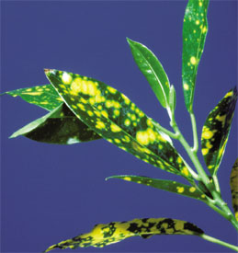
EXTRANUCLEAR GENES
The inheritance of traits controlled by genes present in the chloroplasts or mitochondria
Depends solely on the maternal parent because the zygote’s cytoplasm comes from the egg
EX: Variegated leaves result from mutations in pigment genes located in plastids inherited from mother
Image from Biology; Campbell and Reece; Pearson Prentice Hall publishing as Benjamin Cummings © 2005

Slide 53
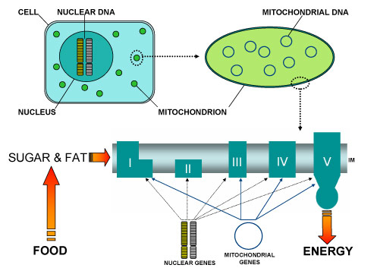
EXTRANUCLEAR GENES
Some diseases affecting the muscular and nervous systems are caused by defects in mitochondrial genes that prevent cells from making enough ATP
http://www.ncl.ac.uk/nnp/research/mrg/advice/inheritance.htm

Slide 54
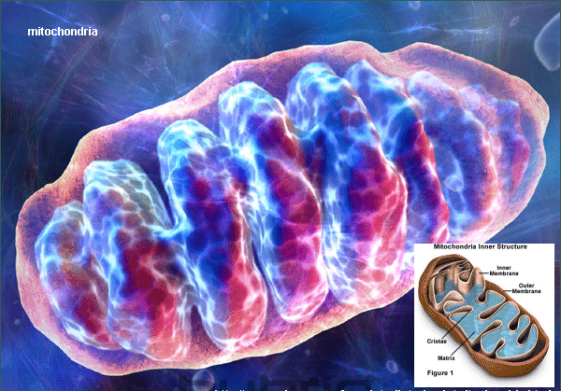
MITOCHONDRIAL DISEASES are RARE
Accumulation of mitochondrial mutations may play role in aging process, diabetes, heart disease, Alzheimer’s
EX: mitochondrial myopathy-
weakness, intolerance of exercise, muscle deterioration
http://employees.csbsju.edu/hjakubowski/classes/ch331/oxphos/mitochondria.gif

