Slide 1
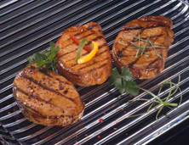
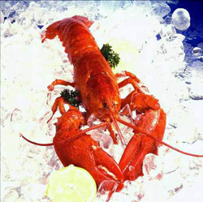
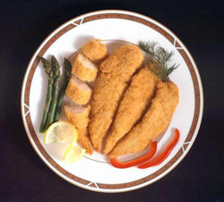
Proteins

Slide 2
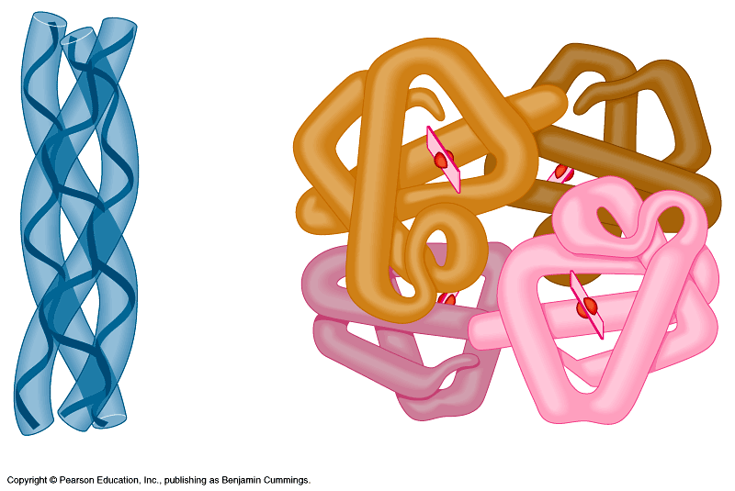
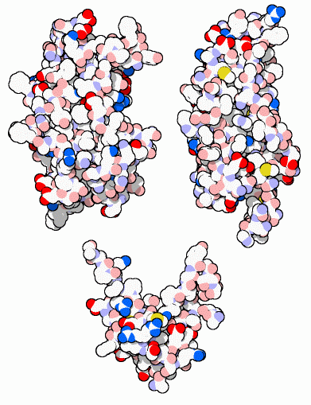
Proteins
Multipurpose
molecules
Notes:
clockwise:
Rubisco — most important protein on the planet?
Hemoglobin — a red blooded protein :-)
Collagen — strings you together
Growth Hormones — working hard in you right now!

Slide 3
Proteins
Most structurally & functionally diverse group
Function: involved in almost everything
  enzymes (pepsin, DNA polymerase)
  structure (keratin, collagen)
  carriers & transport (hemoglobin, aquaporin)
  cell communication
    signals (insulin & other hormones)
    receptors
  defense (antibodies)
  movement (actin & myosin)
  storage (bean seed proteins)
Notes:
Storage: beans (seed proteins)
Movement: muscle fibers
Cell surface proteins: labels that ID cell as self vs. foreign
Antibodies: recognize the labels
ENZYMES!!!!

Slide 4
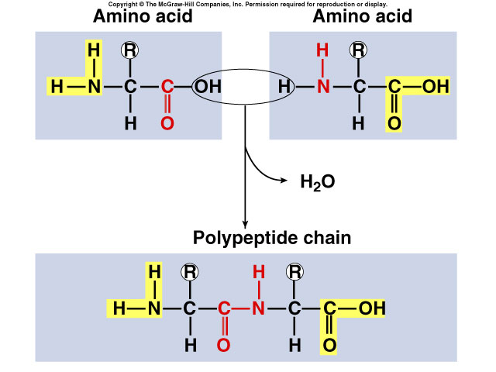
Proteins
Structure
  monomer = amino acids
    20 different amino acids
  polymer = polypeptide
    protein can be one or more polypeptide chains folded & bonded together
    large & complex molecules
    complex 3-D shape
H2O
hemoglobin
Rubisco
growth
hormones
Notes:
Rubisco = 16 polypeptide chains
Hemoglobin = 4 polypeptide chains (2 alpha, 2 beta)

Slide 5
Amino acids
H
O
Structure
  central carbon
  amino group
  carboxyl group (acid)
  R group (side chain)
    variable group
    different for each amino acid
    confers unique chemical properties to each amino acid
      like 20 different letters of an alphabet
      can make many words (proteins)
|
—C—
|
H
||
C—OH
—N—
H
R
Oh, I get it!
amino = NH2
acid = COOH

Slide 6
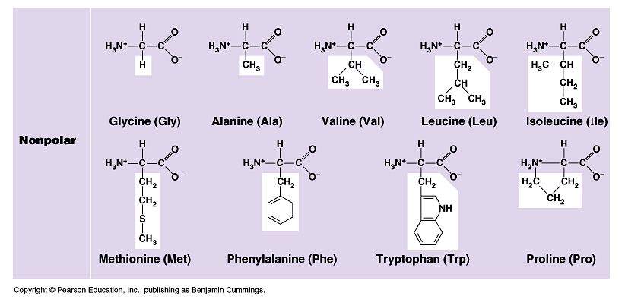
Effect of different R groups:
Nonpolar amino acids
nonpolar & hydrophobic
Why are these nonpolar & hydrophobic?

Slide 7
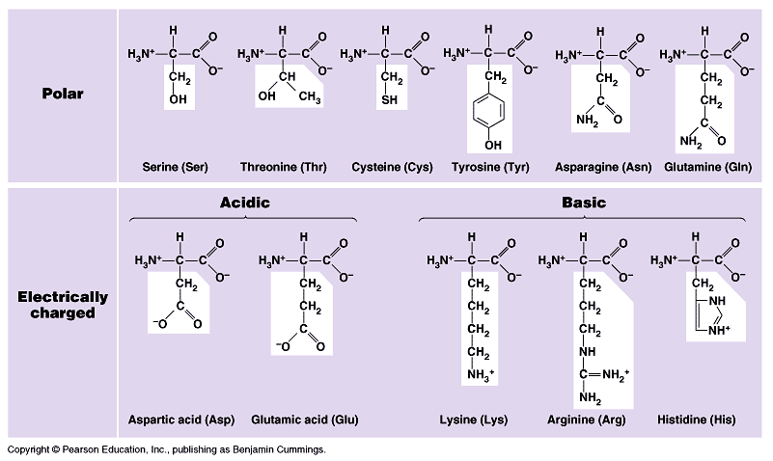
Effect of different R groups:
Polar amino acids
polar or charged & hydrophilic
Why are these polar & hydrophillic?

Slide 8
Ionizing in cellular waters
H+ donors

Slide 9
Ionizing in cellular waters
H+ acceptors

Slide 10
Sulfur containing amino acids
Form disulfide bridges
  covalent cross links betweens sulfhydryls
  stabilizes 3-D structure
H-S – S-H
You wondered
why perms
smell like
rotten eggs?

Slide 11
Building proteins
Peptide bonds
  covalent bond between NH₂ (amine) of one amino acid & COOH (carboxyl) of another
  C–N bond
H2O
dehydration synthesis
peptide
bond
Notes:
free COOH group on one end is ready to form another peptide bond so they “grow” in one direction from N-terminal to C-terminal

Slide 12
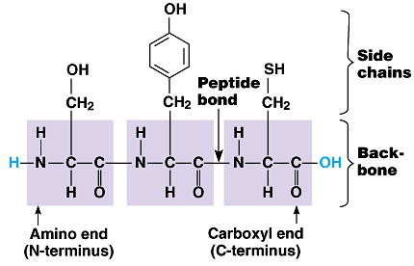

Building proteins
Polypeptide chains have direction
  N-terminus = NH₂ end
  C-terminus = COOH end
  repeated sequence (N-C-C) is the
  polypeptide backbone
    can only grow in one direction

Slide 13
Enzymes:
  Are used to change how quickly a chemical reaction will happen
    Catalysts

Slide 14
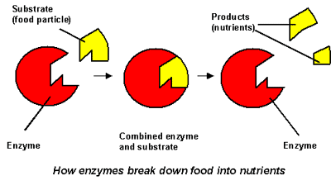
Enzymes fit with their substrates

Slide 15
Enzymes work at different rates depending on
  pH
  temperature
  concentration
  environmental factors.

Slide 16
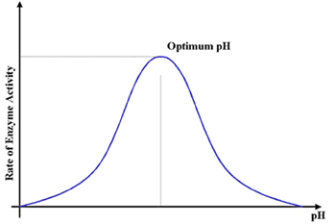
Affect of pH on Enzyme Activity

Slide 17
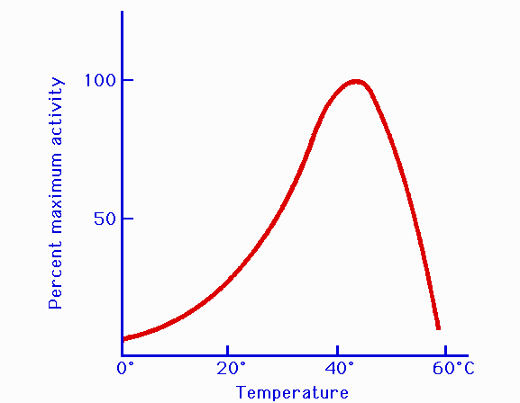
Affect of Temp on Enzyme Activity

Slide 18
Affect of Concentration on Enzyme Activity
Enzymes will work faster if there is more substrate to work on until….
There is so much substrate that there is not enough enzyme to work.
And vice versa. More enzymes work faster until they run out of substrate.

Slide 19
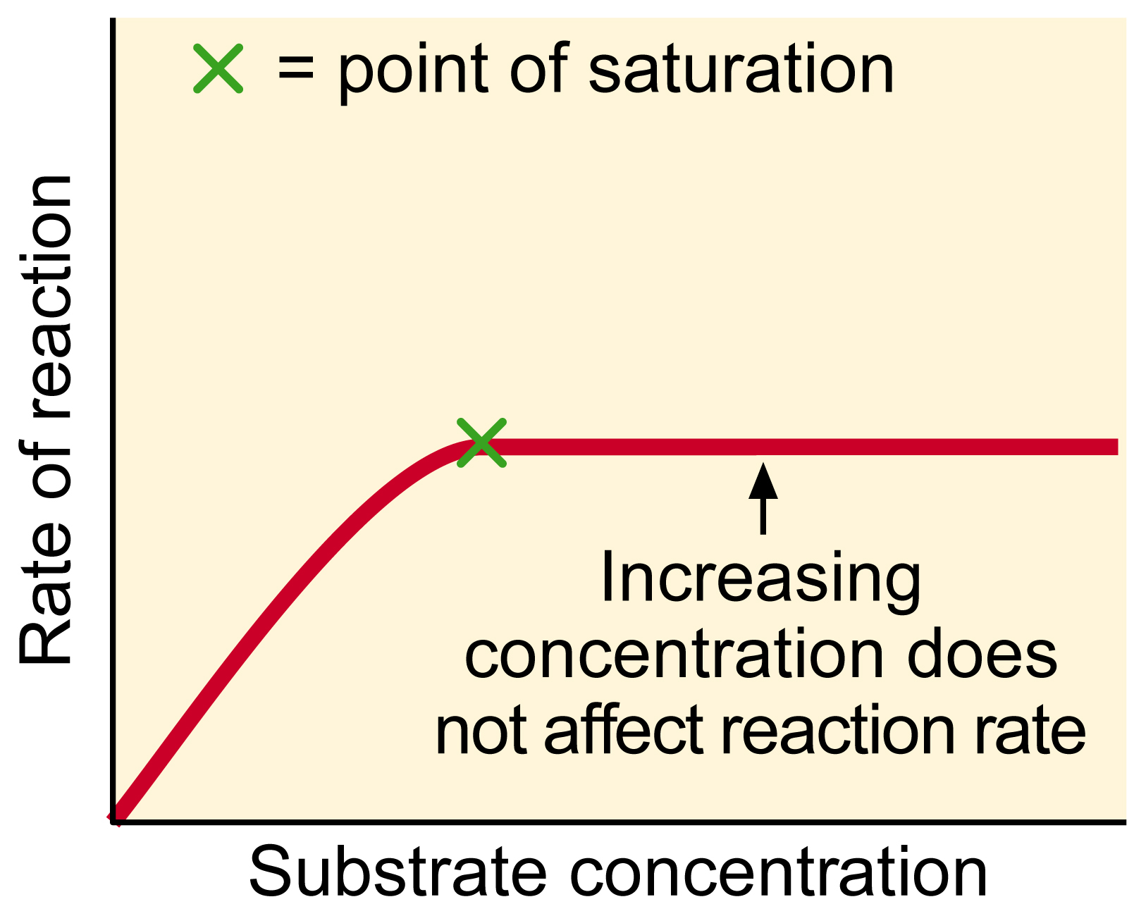

Slide 20
Enzymes are recyclable
When an enzyme has acted upon one substrate, it is not compromised. It can be reused for another substrate.

Slide 21
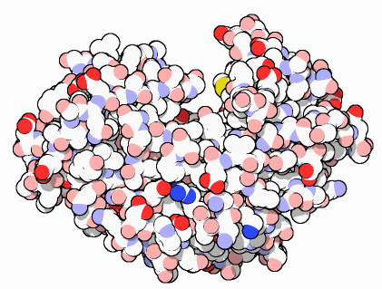
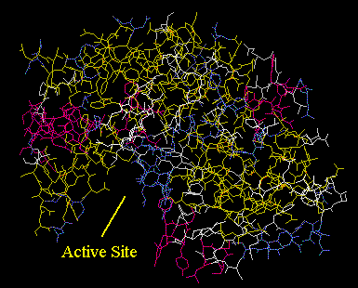
Protein structure & function
Function depends on structure
  3-D structure
    twisted, folded, coiled into unique shape
pepsin
hemoglobin
collagen
Notes:
Hemoglobin
Hemoglobin is the protein that makes blood red. It is composed of four protein chains, two alpha chains and two beta chains, each with a ring-like heme group containing an iron atom. Oxygen binds reversibly to these iron atoms and is transported through blood.
Pepsin
Pepsin is the first in a series of enzymes in our digestive system that digest proteins. In the stomach, protein chains bind in the deep active site groove of pepsin, seen in the upper illustration (from PDB entry 5pep), and are broken into smaller pieces. Then, a variety of proteases and peptidases in the intestine finish the job. The small fragments--amino acids and dipeptides--are then absorbed by cells for use as metabolic fuel or construction of new proteins.
Collagen– Your Most Plentiful Protein
About one quarter of all of the protein in your body is collagen. Collagen is a major structural protein, forming molecular cables that strengthen the tendons and vast, resilient sheets that support the skin and internal organs. Bones and teeth are made by adding mineral crystals to collagen. Collagen provides structure to our bodies, protecting and supporting the softer tissues and connecting them with the skeleton. But, in spite of its critical function in the body, collagen is a relatively simple protein.

Slide 22
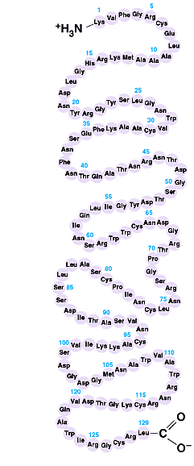
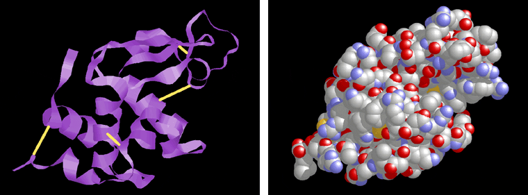
Primary (1°) structure
Order of amino acids in chain
  amino acid sequence determined by gene (DNA)
  slight change in amino acid sequence can affect protein’s structure & its function
    even just one amino acid change can make all the difference!
lysozyme: enzyme in tears & mucus that kills bacteria
Notes:
Sickle cell anemia: 1 DNA letter changes 1 amino acid = serious disease
Hemoglobin mutation: bends red blood cells out of shape & they clog your veins.

Slide 23
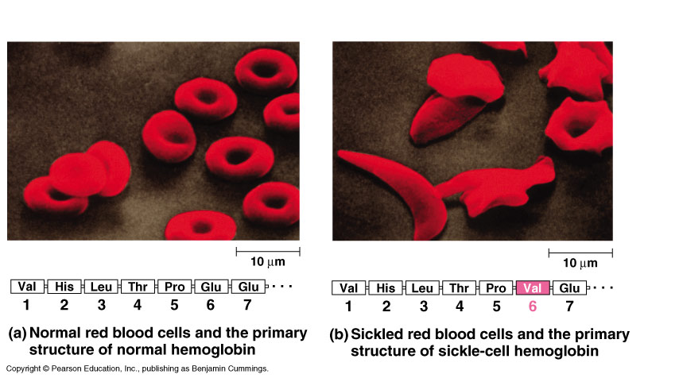
Sickle cell anemia
Just 1
out of 146
amino acids!
Sickled cells do not transport oxygen as effectively, therefore the cells become more oxygen deprived. This prevents the spread of the malarial infection.
I’m
hydrophilic!
But I’m
hydrophobic!
Notes:
glutamic acid is acidic & polar
valine is non-polar = tries to “hide” from water of cell by sticking to another hemoglobin molecules.

Slide 24
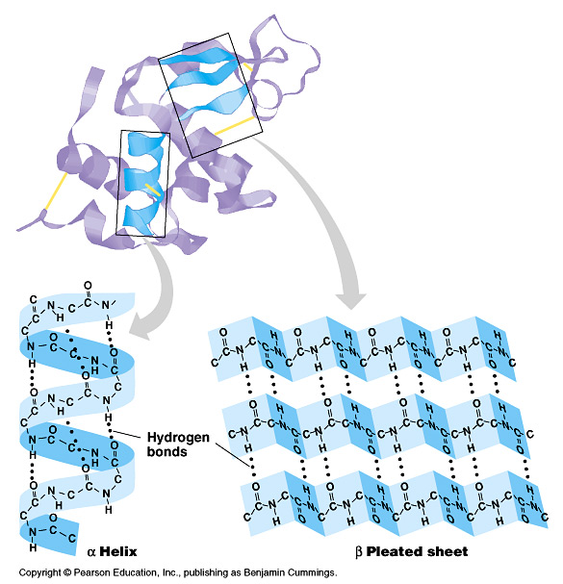
Secondary (2°) structure
“Local folding”
  folding along short sections of polypeptide
  interactions between
  adjacent amino acids
    H bonds
      weak bonds
      between R groups
  forms sections of
  3-D structure
    α-helix
    β-pleated sheet
Notes:
It’s a helix or B sheet within a single region. Can have both in one protein but a specific region is one or another

Slide 25
Secondary (2°) structure

Slide 26
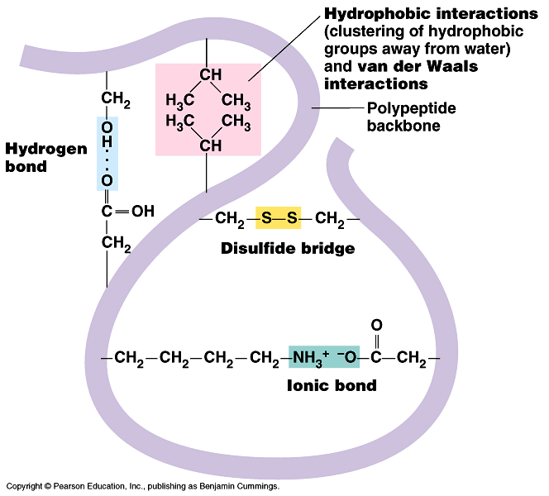
Tertiary (3°) structure
“Whole molecule folding”
  interactions between distant amino acids
    hydrophobic interactions
      cytoplasm is
      water-based
      nonpolar amino
      acids cluster away
      from water
    H bonds & ionic bonds
    disulfide bridges
      covalent bonds between
      sulfurs in sulfhydryls (S–H)
      anchors 3-D shape
Notes:
How the whole thing holds together

Slide 27
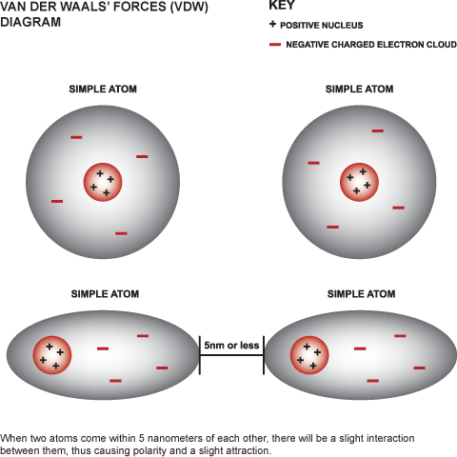
Van der Waals Interactions

Slide 28
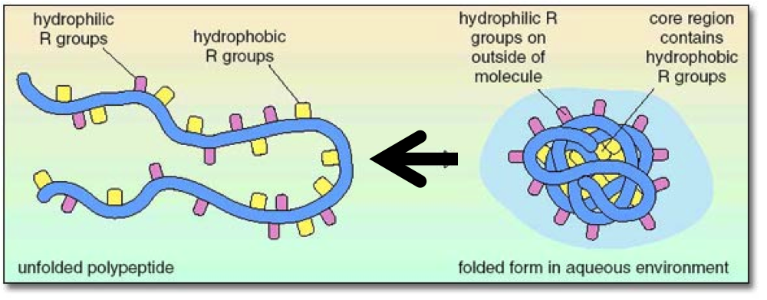
Hydrophilic and Hydrophobic Interactions

Slide 29
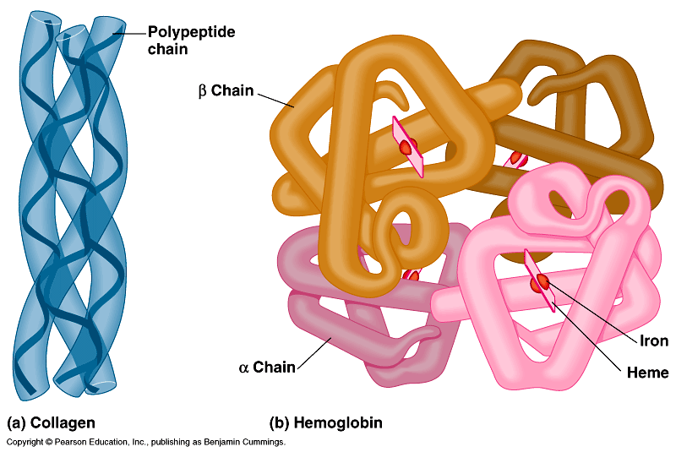
Quaternary (4°) structure
More than one polypeptide chain bonded together
  only then does polypeptide become
  functional protein
    hydrophobic interactions
collagen = skin & tendons
hemoglobin
Notes:
Structure equals function wonderfully illustrated by proteins
Collagen is just like rope -- enables your skin to be strong and flexible.

Slide 30
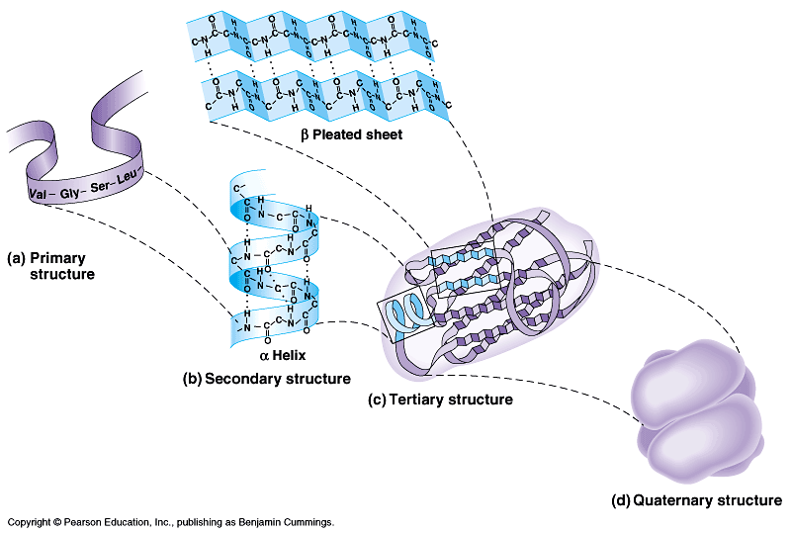
Protein structure (review)
R groups
hydrophobic interactions
disulfide bridges
(H & ionic bonds)
3°
multiple polypeptides
hydrophobic interactions
1°
amino acid sequence
peptide bonds
4°
2°
determined
by DNA
R groups
H bonds
Notes:
sequence determines structure and…
structure determines function.
Change the sequence & that changes the structure which changes the function.

Slide 31
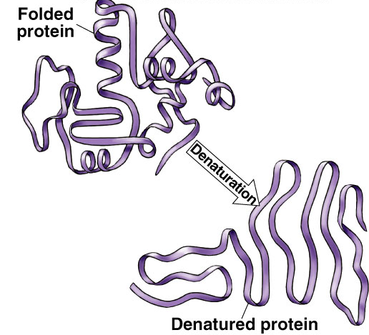
Protein denaturation
In Biology,
size doesn’t matter,
SHAPE matters!
Unfolding a protein
  conditions that disrupt H bonds, ionic bonds, disulfide bridges
    temperature
    pH
    salinity
  alter 2° & 3° structure
    alter 3-D shape
  destroys functionality
    some proteins can return to their functional shape after denaturation, many cannot

Slide 32
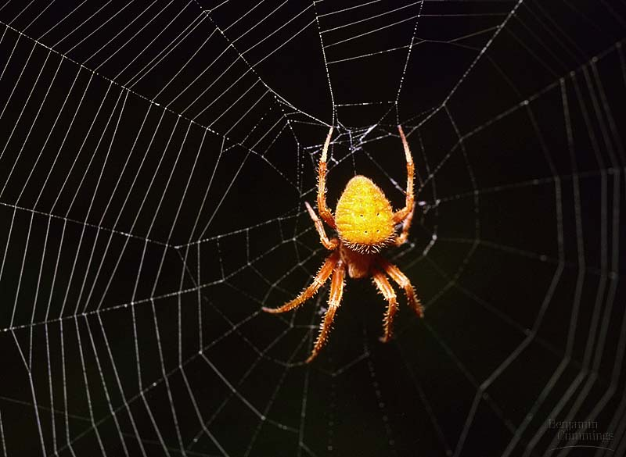
EAT
X
Let’s build some
Proteins!

Slide 33
Ghosts of Lectures Past
(storage)

Slide 34
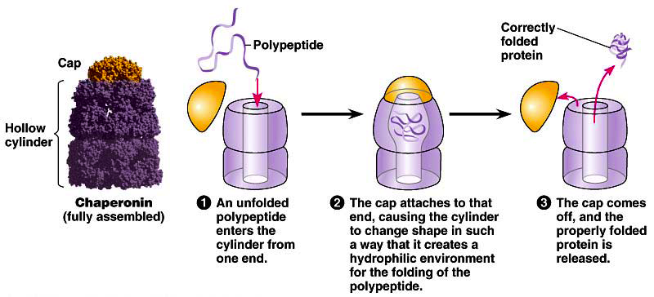
Chaperonin proteins
Guide protein folding
  provide shelter for folding polypeptides
  keep the new protein segregated from cytoplasmic influences

Slide 35
Protein models
Protein structure visualized by
  X-ray crystallography
  extrapolating from amino acid sequence
  computer modelling
lysozyme

