Slide 1
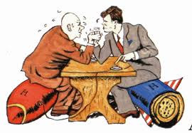
Introduction to the Cold War
Two Superpowers fighting for Global Dominance

Slide 2
Questions to Know
Why is it called the Cold War?
What major events occurred during the Cold War?
Berlin Wall ➔ Berlin Airlift
Korean War
Vietnam War
Cuban Missile Crisis
Fall of the Soviet Union
How did the Cold War shape our geopolitical relations today?
How did the Cold War end in 1991?
Who are the key players in the Cold War?

Slide 3
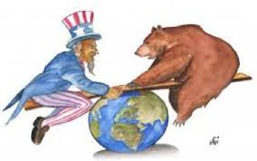
What is the Cold War?
Called ‘Cold’ War because there was never a direct battle between Soviets and the US. Instead, there were proxy wars.
Ideological Conflict between the US and Soviet Union
Democratic Capitalism vs. Totalitarian Communism
Ways of fighting the ‘Cold’ War:
1). Espionage: Spy vs Spy (KGB vs CIA)
2). Arms Race: Nuclear Escalation
3). Ideological Competition for support from other nations (Cuba, Greece, Yugoslavia, Vietnam, etc.)
4). Bipolarization of Europe: NATO vs. Warsaw

Slide 4
If the US & USSR Never Fought Directly, why do we call it a war?
Many wars WERE fought between Communists (supported by the USSR) and anti-Communists (supported by US)
The US and USSR competed for power by using their political, economic, and military clout throughout the world
Both sides felt their national survival was at stake

Slide 5
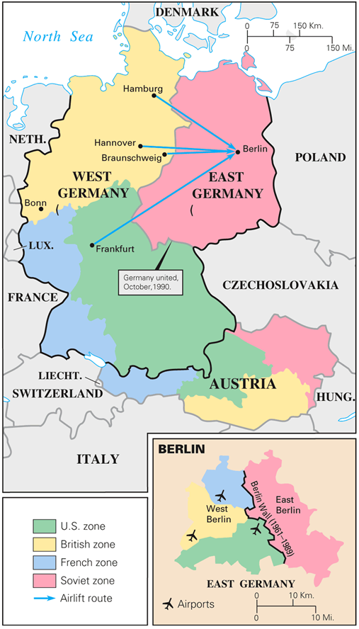
The Division of Berlin

Slide 6
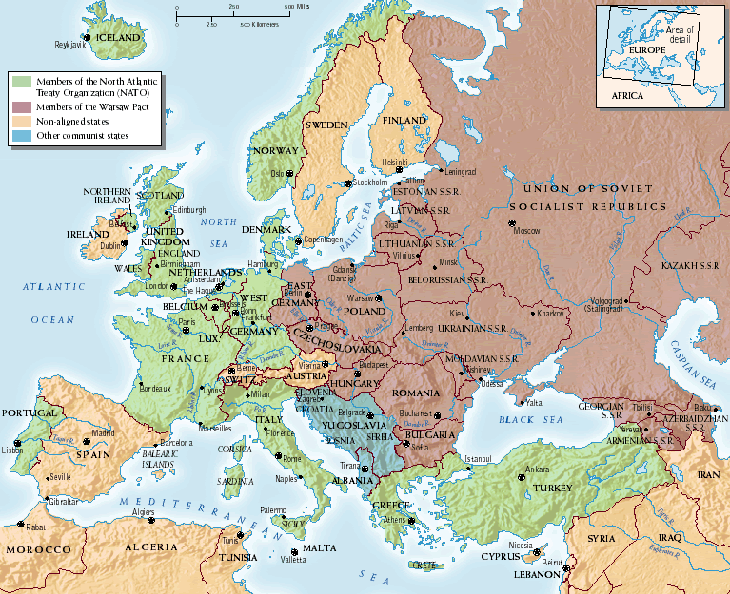
The Bipolarization of Europe

Slide 7
Part I. The Significance of the Cold War
Why should we study the Cold War?

Slide 8
How has the Cold War affected US History ?
Brought the world to the brink of nuclear destruction
Was the direct cause of the US wars in Korea and Vietnam, and the invasion of Cuba
Led to the 1969 moon landing
Is largely responsible for the US national debt
Shaped the post-World War II era
Contributed to current ‘rocky relationship’ with Vladimir Putin & Russia

Slide 9
1. To the brink of nuclear destruction
The US & the USSR raced to be ahead of one another in atomic warfare, building thousands of nuclear weapons much more powerful than those used in World War II.

Slide 10
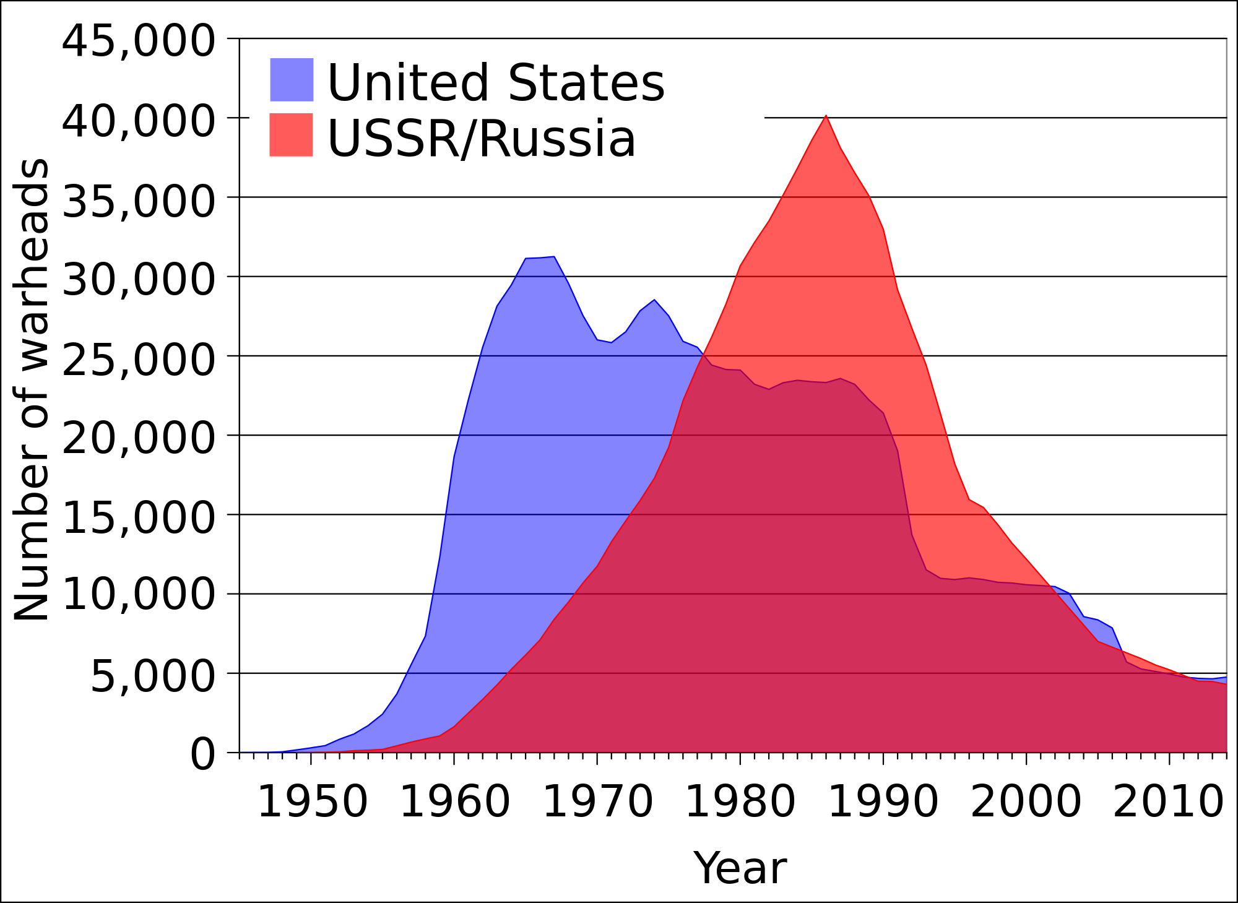

Slide 11
2. War in Korea & Vietnam
The US fought 2 wars to contain the spread of Communism. The spread of Communism was seen as a growth in the power of the USSR. Over 100,000 Americans were killed.

Slide 12
3. To the Moon
The Soviets and
Americans competed to develop new technology.
When the Soviets were
the first to launch a
satellite (‘Sputnik’) and put a man in space (Yuri Gagarin), the US raced to be the first to the moon.

Slide 13
4. We’re still paying...
The Soviet Union collapsed in 1991.1 reason is that it could not keep up with the US in defense spending. The US went heavily into debt to beat the Soviets.

Slide 14
5. Shaping the World
Why is there a North and South Korea? Why was there an East and West Germany? Why did the US support some dictators and oppose some free elections?
Answer: Cold War

Slide 15
Part II: What Caused the Cold War?
The US and USSR fought against a common enemy in World War II. The alliance did not last long. What caused the US and USSR to turn from allies to enemies?

