Slide 1
Activity 1
Ecosystems and Change

Slide 2
Warm Up Biology 9/11/2017
What changes have you seen in the environment as you’ve grown up?
Phenomenon: How does change affect ecosystems?

Slide 3
Agenda
Notebook Setup and Discussion (10 minutes)
Introduction for Activity 1 (15 minutes)
(Reading Activity w/discussion)
Vocabulary (10 minutes)
Ecological Change Video w/discussion) (20 minutes)
KWL Chart (10 minutes)
Case Study Activity
(Read Think and Take a Note, Diagram, Activity Sheet 1.1) (25 minutes)
Revisit KWL Chart (10 minutes)
Predictions (10 minutes)
(Individual, share with class)
Analysis Questions (15 minutes)
List of Changes Affecting Ecosystem (10 minutes)

Slide 4
Witnessing Environmental Change
https://mpt.pbslearningmedia.org/resource/nasa09.sci.life.eco.witness/witnessing-environmental-changes/#.WbMhmKhSxPY

Slide 5
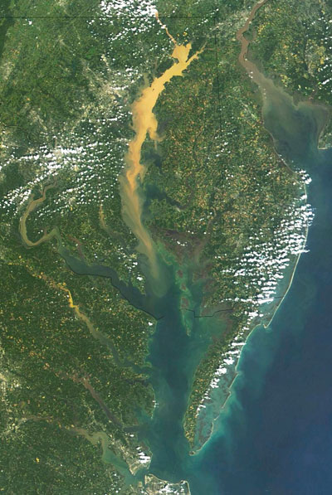
Nasa and the Chesapeake Bay
https://pmm.nasa.gov/education/videos/nasa-real-world-nasa-and-chesapeake-bay

Slide 6
Follow Up Question
Identify a method mentioned in the video that helps water managers enact policies to improve the health of the Bay.

Slide 7
Chesapeake Bay Report Card
https://ecoreportcard.org/report-cards/chesapeake-bay/health/

Slide 8
Abiotic
Describes factors in an environment that are not, and have never been, living, including temperature, light, and precipitation.

Slide 9
Biotic
Describes factors in an environment that are associated with living organisns.

Slide 10
Ecology Study of how organisms interact with one another and the environment

Slide 11
Ecosystem Community of various organisms interacting with each other within a physical environment

Slide 12
Sustainability The ability to meet a community’s present needs without compromising the ability of future generations to meet their own needs

Slide 13
Sustainable An ecosystems ability to support its diversity and ecological processes through time

Slide 14
Community Populations of multiple species living in the same area

Slide 15
Population Group of individuals of the same species that live in the same general area and are able to reproduce

Slide 16
Biodiversity Number of species found in a given ecosystem

Slide 17
Habitat Where an organism lives

Slide 18
What changes have you seen in the environment as you’ve grown up?
What do you think caused those changes?
What do you want to know about ecological change and its causes?
Notes:
As you discuss these questions with the class, use the students’ answers to fill out the KWL chart (see slide 5).

Slide 19
KWL Chart: Ecological Change
Know… | Want to know… | Learned…
Notes:
This chart will be developed as the unit progresses (see Activities 3 and 7).
For more information on using this literacy strategy with your students, and for suggested answers to this chart, see your Teacher’s Edition for this Activity and see Teacher Resources III: Literacy.

Slide 20
Read the introduction and discuss the following as a class:
What is an ecosystem?
What type of changes could affect an ecosystem? In what ways?
Is ecological change good or bad – or neither?
Notes:
This class discussion should take approximately 10 minutes. Accept all answers, but each time ask students to include supporting examples.

Slide 21
Warm Up 9/12/2017
Open your textbook to page 45. Using the introduction define the following:
What is an ecosystem?
Also answer the following question:
What makes and ecosystem sustainable?

Slide 22
A community of various organisms interacting with each other within a particular physical environment is known as an ecosystem.
An ecosystem is sustainable if it can support its diversity and ecological processes through time.

Slide 23
Agenda : Activity 1, Day 2
Warm Up
Introduce Jigsaw Procedure
Case Study Activity
(Read Think and Take a Note, Diagram, Activity Sheet 1.1) (25 minutes)
Revisit KWL Chart (10 minutes)
Predictions (10 minutes)
(Individual, share with class)
Analysis Questions (15 minutes)
List of Changes Affecting Ecosystem (10 minutes)

Slide 24
Challenge
How does change affect ecosystems?

Slide 25
For step 1, decide who in your group will read each case study:
The Crab Jubilee
The March of the Toads
The Bleaching of the Reefs
The Yellowstone Fires of 1988
For step 2, work with a same-case-study partner, as assigned.
Notes:
If appropriate, introduce the GI assessment variable and the use of science notebooks before students begin the Procedure. See your Teacher’s Edition for this Activity and Teacher Resources IV: Assessment for more information on how to do this.

Slide 26
Notes:
For more information on using this literacy strategy with your students see your Teacher’s Edition for this Activity and see Teacher Resources III: Literacy. These guidelines can also be found on Literacy Transparency 3, “Read, Think, and Take Note.”

Slide 27
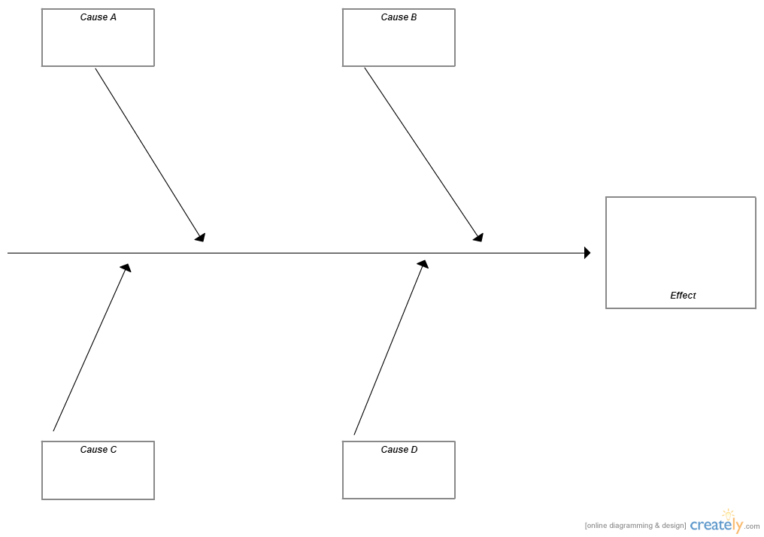
Warm Up 9/13/17
Based off of the case study that you were assigned…create a Cause and effect diagram. Use the following example or create your own version.

Slide 28
Agenda
With your original group, complete steps 7-8 (15 minutes).
Review Case Study Comparison (10 minutes)
Revisit KWL Chart (5-10 minutes)
Predictions (On your own complete step 9 (10-15 minutes)
(Individual, share with class)
Analysis Questions (20 minutes)
List of Changes Affecting Ecosystem (10 minutes)

Slide 29
With your case-study partner, complete steps 4-6.
With your original group, complete steps 7-8.
On your own, complete step 9.
Notes:
For more information on how to use a jigsaw strategy with your class, see your Teacher’s Edition for this Activity.

Slide 30
Share your predictions from step 9 with the class.
What types of changes can affect an ecosystem?
Notes:
This class discussion should take approximately 10-15 minutes.

Slide 31
List of Changes that can affect an Ecosystem
Type of Change | Sudden/ Gradual | Large/ Small | Single/ Multi Source | Natural/ Human
Example: Increased CO2 | Gradual | Large | Multi Source | Human

Slide 32
Yellowstone Fire
https://www.youtube.com/watch?v=CAgP9fo3f7s

Slide 33
Cane Toads
https://www.youtube.com/watch?v=oYcl0xxU5_s

Slide 34
Key Vocabulary
ecology
ecosystem
sustainability
sustainable
Notes:
See Teacher Resources III: Literacy for more information on key vocabulary and the most effective strategies to enhance student vocabulary learning.
Note that bold words are formally defined in this activity. Words in regular font are used in the activity, but not formally defined. The definition of a key vocabulary word should not be discussed as a class prior to the formal definition being introduced.

