Slide 1
Activity 4
Invasive Species

Slide 2
LIMITED LICENSE TO MODIFY. These PowerPoint® slides may be modified only by teachers currently teaching the Science and Global Issues SEPUP course to customize the unit to match their students’ learning levels or to insert additional teaching aides. Modified slides may be used only by the modifying teacher in his or her classroom, or shared with other teachers of Science and Global Issues within the teacher’s school district, with these same restrictions. Modified slides may not be taken out of the classroom or distributed to any non-student person or organization. Except for use with students in the classroom, modified slides may not be published in printed or electronic form, including posting on the Internet. Only text may be modified: photographs and illustrations on the slides may not be modified in any way except to change their size.
DISCLAIMER OF WARRANTY. THE REGENTS OF THE UNIVERSITY OF CALIFORNIA (“University”) MAKE NO REPRESENTATIONS OR WARRANTIES, EXPRESS OR IMPLIED, INCLUDING BUT NOT LIMITED TO THE IMPLIED WARRANTIES OF MERCHANTABILITY AND FITNESS FOR A PARTICULAR PURPOSE. University will not be liable for any costs, damages, fees or other liability, nor for any direct, indirect, special, incidental or consequential damages (including lost profits) with respect to any claims by the purchaser or user of Science and Global Issues or any third party on account of or arising from the use or modifications to the slides. Client acknowledges and accepts that University services are provided on an as-is basis.

Slide 3
What was the safety warning in Activity 2, “A Population of Duckweed”?
Why is this warning important?
Notes:
This class discussion should take approximately 5 minutes.

Slide 4
Invasive Species Video
Asian Carp
https://www.youtube.com/watch?v=0bZ_9B_RlGY
Post Video Discussion

Slide 5
Read the introduction and discuss the following as a class:
What determines if a species is considered an invasive species?
What are some examples of the effect an invasive species might have on a community?
Notes:
This class discussion should take approximately 10 minutes.

Slide 6
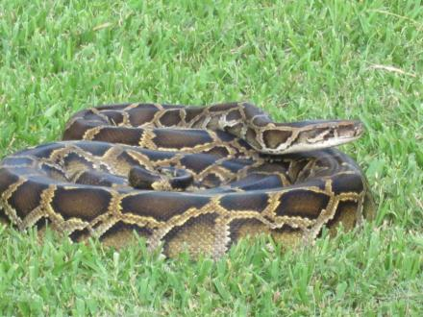
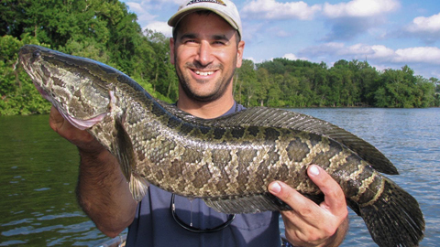
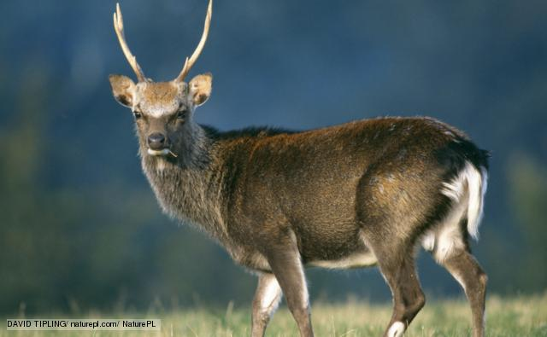
Nonnative
A nonnative species is a species introduced to an area where it is not normally found.

Slide 7
Habitat A habitat is the specific location where an organism lives within an ecosystem.

Slide 8
Invasive Species A nonnative species that causes harm to the economy, the environment, or human health.

Slide 9
Trade-Off An exchange of one thing for another, giving up something that is a benefit or an advantage, in exchange for something that may be more desirable

Slide 10
How do certain characteristics increase the likelihood that a nonnative species becomes an invasive species?
Another way to think of this question is: What features of a species make it more likely to become an invasive species?

Slide 11
The Round Goby Video
https://www.youtube.com/watch?v=VeqgjvGC6qs

Slide 12
The Indian Mongoose Video
https://www.youtube.com/watch?v=JLarD5vhdKk

Slide 13
Zebra Mussel Video
https://www.youtube.com/watch?v=abImqGDzXBo

Slide 14
Giant Salvinia Video
https://www.youtube.com/watch?v=7oyaXvKQf7w

Slide 15
Invasive Species List
http://www.iucngisd.org/gisd/

Slide 16
Warm Up Biology H 10/12/17
Using what we’ve discussed so far about invasive species…What conditions in an ecosystem are likely to allow a species to become invasive there?
Agenda
Warm Up (5 minutes)
Nonnative vs. Invasive (5-7 minutes)
Activity 4 Case Study Jigsaw (15 minutes)
Post It Gallery Walk/Discussion (15 minutes)
Analysis Questions: Exit Ticket (10 minutes)

Slide 17
Nonnative or Invasive?
Rooting, Wallowing, and Feeding Behavior damages many types of land.

Slide 18
A plant, fungus, or animal species that is not native to a specific location (an introduced species), and which has a tendency to spread to a degree believed to cause damage to the environment, human economy or human health.

Slide 19
Does not interrupt natural species processes.

Slide 20
A species introduced to an area where it is not normally found. Usually accidentally or deliberately by humans

Slide 21
Displaces Native Species

Slide 22
50,000 believed to exist in the United States of America alone.

Slide 23
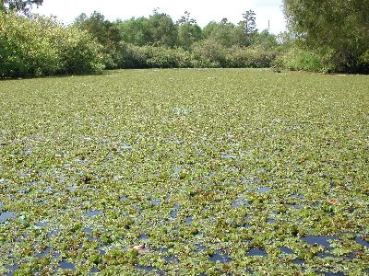
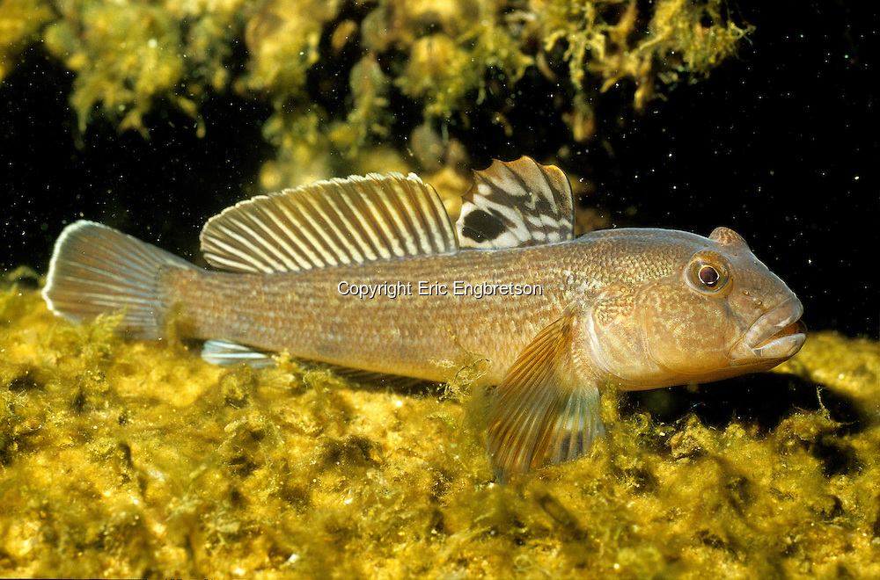
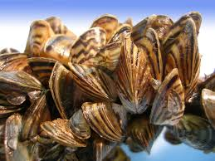
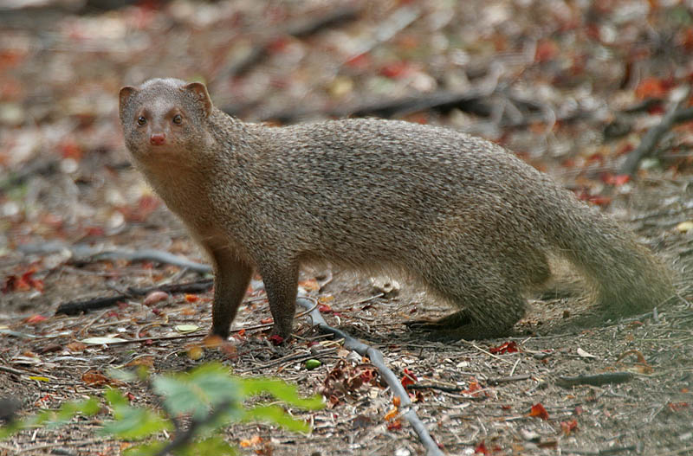
Part A
Work with your group of four to complete steps 1 – 4.

Slide 24
List Activity
Complete Student Resource Sheet 4.1
Share/Discuss your results with your group members
Write down the similarities your group identifies between case studies in the “Written Activities section of your science binder. Use these similarities to develop a list of characteristics that increase the likelihood of a nonnative species to become invasive.

Slide 25
Post-It Gallery Walk
Group #1: Effect on Economy
Group #2: Effect on Environment and/or Human Health
Group #3: Breeding, Reproduction, and Lifestyle
Group #4: Food Sources and Eating Habits
Group #5: Habitat and Methods of Spreading
*1 person from each group will post a commonality from list*

Slide 26
Analysis Questions/Exit Ticket
What characteristics increase the likelihood that a nonnative species will become invasive?
What are the trade-offs in introducing a nonnative species to control an established invasive species?

Slide 27
Part B
Read the introduction to Part B. Be able to explain what a trade-off is.
Everyday trade-off discussion/list:
Identify common trade-offs (ex. homework instead of spending time with friends)
Notes:
If appropriate, introduce the concepts of evidence and trade-offs here. See your Teacher’s Edition for more information on how to do this.

Slide 28
Part B Continued…
Complete steps 6 – 8. Be prepared to discuss your results with the class.

Slide 29
Chesapeake Bay
Part B Continued…

Slide 30
Discussion Web
Part B Continued…
In the center box, write the question being considered: Should nonnative oysters be introduced?
In the box at the top of each column write one of the viewpoints being presented. Record the evidence supporting each viewpoint in the appropriate column.
Notes:
The graphic is from Literacy Student Sheet 4, Discussion Web, found in the Teacher Resources.

Slide 31
Classroom Debate
Students will take sides as a class and we will debate the pros/cons of the possible introduction of the nonnative oyster (Crassostrea ariakensis) into the Chesapeake Bay.

Slide 32
Final Decision
The proposal to introduce nonnative oyster to Chesapeake Bay was in fact rejected in the middle of 2009 after eight years of study

Slide 33
Oyster Video

Slide 34
Analysis Questions
Turn to page 77 and complete Analysis Questions 1-4.

Slide 35
Exit Ticket
What is the difference between native, nonnative, and invasive species?
Why do some nonnative species become invasive while others do not?
Notes:
If appropriate, introduce the ET assessment variable here. See your Teacher’s Edition for more information on how to do this.

Slide 36
Analysis 4
Debate/Writing Assignment
Summarize the position taken by either the fishermen or the conservationists about the oysters in Chesapeake Bay. Include the evidence that supports that position. Weigh the evidence to make a recommendation for or against the introduction of the nonnative oysters into Chesapeake Bay. Include at least two trade-offs associated with your recommendation.
Notes:
If appropriate, introduce Evidence and Trade-offs (ET) assessment variable here. It can be used to score Analysis Question 4. More information on how to introduce and use this assessment variable, as well as a sample student response, is available in your Teacher’s Edition for this Activity and in Teacher Resources IV: Assessment.

Slide 37
What conditions and characteristics would increase the likelihood that a nonnative species would become an invasive species?
Be sure to think about the following:
Characteristics of the organism
Environmental conditions
Other native organisms being affected
Effects on the economy or health of the local human community

Slide 38
Analysis Questions
Answer the analysis questions 1-4 on page 77 in the Student textbook.

Slide 39
ecosystem
evidence
habitat
invasive species
nonnative species
trade-off
Notes:
See Teacher Resources III: Literacy for more information on key vocabulary and the most effective strategies to enhance student vocabulary learning.
Note that bold words are formally defined in this activity. Words in regular font are used in the activity, but not formally defined. The definition of a key vocabulary word should not be discussed as a class prior to the formal definition being introduced.

