Slide 1
Activity 9
The Photosynthesis and
Cellular Respiration Shuffle

Slide 2
LIMITED LICENSE TO MODIFY. These PowerPoint® slides may be modified only by teachers currently teaching the Science and Global Issues SEPUP course to customize the unit to match their students’ learning levels or to insert additional teaching aides. Modified slides may be used only by the modifying teacher in his or her classroom, or shared with other teachers of Science and Global Issues within the teacher’s school district, with these same restrictions. Modified slides may not be taken out of the classroom or distributed to any non-student person or organization. Except for use with students in the classroom, modified slides may not be published in printed or electronic form, including posting on the Internet. Only text may be modified: photographs and illustrations on the slides may not be modified in any way except to change their size.
DISCLAIMER OF WARRANTY. THE REGENTS OF THE UNIVERSITY OF CALIFORNIA (“University”) MAKE NO REPRESENTATIONS OR WARRANTIES, EXPRESS OR IMPLIED, INCLUDING BUT NOT LIMITED TO THE IMPLIED WARRANTIES OF MERCHANTABILITY AND FITNESS FOR A PARTICULAR PURPOSE. University will not be liable for any costs, damages, fees or other liability, nor for any direct, indirect, special, incidental or consequential damages (including lost profits) with respect to any claims by the purchaser or user of Science and Global Issues or any third party on account of or arising from the use or modifications to the slides. Client acknowledges and accepts that University services are provided on an as-is basis.

Slide 3
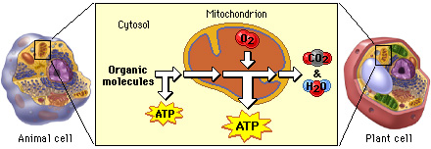
Cellular Respiration
a set of metabolic reactions and processes that take place in the cells of organisms to convert biochemical energy from nutrients into adenosine triphosphate (ATP), and then release waste products.

Slide 4
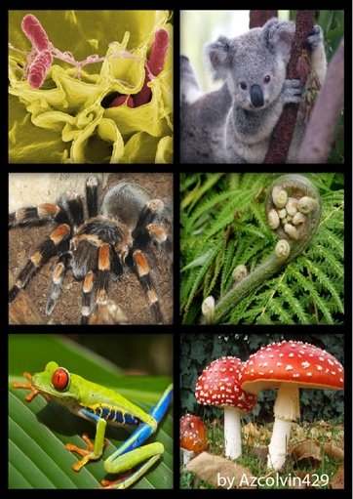
Organisms
An individual living thing that can react to stimuli, reproduce, grow, and maintain homeostasis. It can be a virus, bacterium, protist, fungus, plant or an animal.

Slide 5
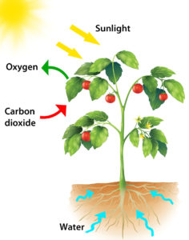
Photosynthesis
is a process used by plants and other organisms to convert light energy into chemical energy that can later be released to fuel the organisms' activities (energy transformation).

Slide 6
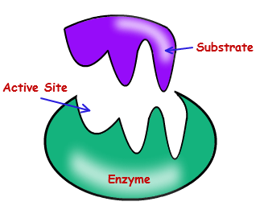
Enzyme
A protein that catalyzes (speeds up) a speciﬁc chemical reaction within an organism; important for many biological processes including photosynthesis, cellular respiration, DNAreplica-tion, and protein synthesis.

Slide 7
Cellular Respiration Intro Video
https://www.youtube.com/watch?v=Py4R_Up2uBc

Slide 8
Photosynthesis Intro Video
https://www.youtube.com/watch?v=68b1HAIfX08

Slide 9
Examine this kelp forest food web
Notes:
This image can be found on Ecology Transparency 9.1, “Kelp Forest Food Web.”

Slide 10
Examine this carbon cycle
Notes:
Have students identify where in the carbon cycle producers and consumers play a role.
This image can be found on Ecology Transparency 9.2, “Carbon Cycle.”

Slide 11
Read the introduction.
Where in the carbon cycle do you think photosynthesis would occur?
Where would cellular respiration occur?
Notes:
Show students the video clip “Energy Flow in the Coral Reef Ecosystem,” the link to which is on the Science and Global Issues page of the SEPUP website (sepuplhs.org/sgi). Discuss how the energy flow in this ecosystem parallels that in the kelp forest ecosystem.

Slide 12
Challenge
How do carbon and oxygen cycle through the environment?

Slide 13
As you work through the simulation, note the direction of the arrows, indicating if materials are entering or leaving an organism.
Your final summaries should be brief.
Notes:
The simulation can be found on the student page of the Science and Global Issues page of the SEPUP website, sepuplhs.org/sgi.

Slide 14
Energy Flow Through a Coral Reef Ecosystem
https://www.pbslearningmedia.org/asset/hew06_vid_foodweb/

Slide 15
Photosynthesis Simulation Link
https://store.lab-aids.com/high-school-curriculum/simulations/photosynthesis_sim.html

Slide 16
Check your predictions from the beginning of the activity.
Where in the carbon cycle are producers and consumers playing a role?
Which organisms in the kelp forest food web perform photosynthesis? Cellular respiration?

Slide 17
What revisions or additions did you make to Student Sheet 9.1, “Photosynthesis and Cellular Respiration Diagram”?
Notes:
Note that students revise their diagrams in Analysis Question 4.

Slide 18
Analysis 3
What roles do photosynthesis and cellular respiration have in an ecosystem?
Notes:
Analysis Question 3 may be scored using the Understanding Concepts (UC) scoring variable. More information and a sample student response can be found in your Teacher’s Edition for this activity, and in Teacher Resources IV: Assessment.

Slide 19
Analysis 6
If the mitochondria of half the organisms in the ecosystem stopped functioning, what indicators in the ecosystem would change? Explain.
Notes:
Analysis Question 6 may be scored using the Understanding Concepts (UC) scoring variable. More information and a sample student response can be found in your Teacher’s Edition for this activity, and in Teacher Resources IV: Assessment.

Slide 20
Revisit the Challenge
How do carbon and oxygen cycle through the environment?
Notes:
Students should understand that cellular respiration and photosynthesis cycle carbon through ecosystems. They should also know that the inputs and outputs of the two processes complement each other. The next several activities examine aspects of these processes, and the details of both are addressed in more depth in the “Cell Biology: World Health” unit of this course.

Slide 21
Key Vocabulary
cellular respiration
enzymes
organisms
photosynthesis
Notes:
See Teacher Resources III: Literacy for more information on key vocabulary and the most effective strategies to enhance student vocabulary learning.
Note that bold words are formally defined in this activity. Words in regular font are used in the activity, but not formally defined. The definition of a key vocabulary word should not be discussed as a class prior to the formal definition being introduced.

