Slide 1
El Verbo “estar”
Unidad 2, Leccíon B

Slide 2
Estar = to be, (describe the location of nouns or your state of being)

Slide 3
Estar indicates location or a state of being (a condition) at a given moment.
Location:
¿Dónde está el profesor? Where is the teacher?
Está en clase. He is in class.
State of being or condition:
¿Cómo estás? How are you?
Estoy bien, gracias. I am well, thanks.

Slide 4
Use estar with the following words of location:
al lado de = next to
cerca de = near
debajo de = under
delante de = in front of
detrás de = behind

Slide 5
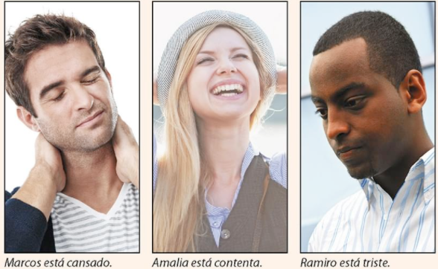
Use the following states of being along with estar.
cansado/a = tired
contento/a = happy
triste = sad
solo/a = alone

