Slide 1
Mendelian Genetics

Slide 2
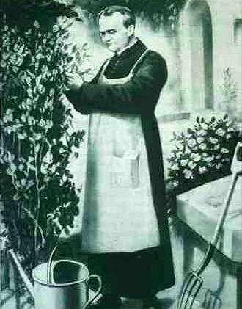
Gregor Mendel (1822-1884)
Responsible for the Laws governing Inheritance of Traits

Slide 3
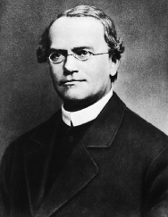
Gregor Johann Mendel
Austrian monk
Studied the inheritance of traits in pea plants
Developed the laws of inheritance
Mendel's work was not recognized until the turn of the 20th century

Slide 4
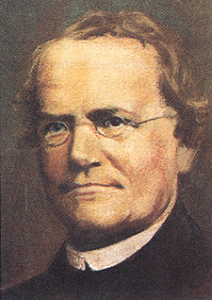
Gregor Johann Mendel
Between 1856 and 1863, Mendel cultivated and tested some 28,000 pea plants
He found that the plants' offspring retained traits of the parents
Called the “Father of Genetics"

Slide 5
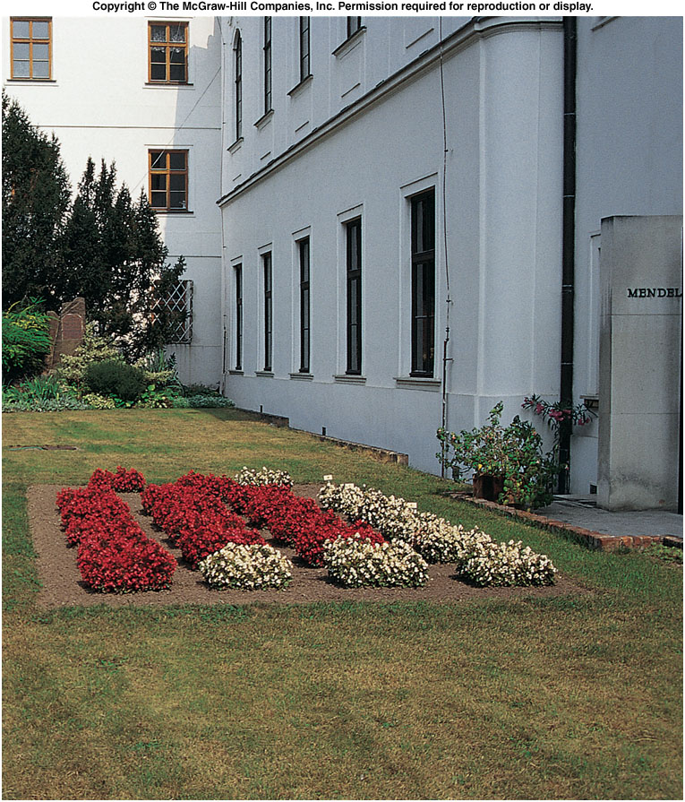
Site of Gregor Mendel’s experimental garden in the Czech Republic
Notes:
Fig. 5.co

Slide 6
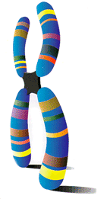
Particulate Inheritance
Mendel stated that physical traits are inherited as “particles”
Mendel did not know that the “particles” were actually Chromosomes & DNA

Slide 7
Genetic Terminology
Trait - any characteristic that can be passed from parent to offspring
Heredity - passing of traits from parent to offspring
Genetics - study of heredity

Slide 8
Types of Genetic Crosses
Monohybrid cross - cross involving a single trait e.g. flower color
Dihybrid cross - cross involving two traits e.g. flower color & plant height

Slide 9
Designer “Genes”
Alleles - two forms of a gene (dominant & recessive)
Dominant - stronger of two genes expressed in the hybrid; represented by a capital letter (R)
Recessive - gene that shows up less often in a cross; represented by a lowercase letter (r)

Slide 10
More Terminology
Genotype - gene combination for a trait (e.g. RR, Rr, rr)
Phenotype - the physical feature resulting from a genotype (e.g. red, white)

Slide 11
Genotypes
Homozygous genotype - gene combination involving 2 dominant or 2 recessive genes
Homozygous Dominant has a genotype of RR
Homozygous Recessive has a genotype of rr
Heterozygous E - gene combination of one dominant & one recessive allele (e.g. Rr); also called hybrid

Slide 12
Punnett Square
Used to help solve genetics problems

Slide 13
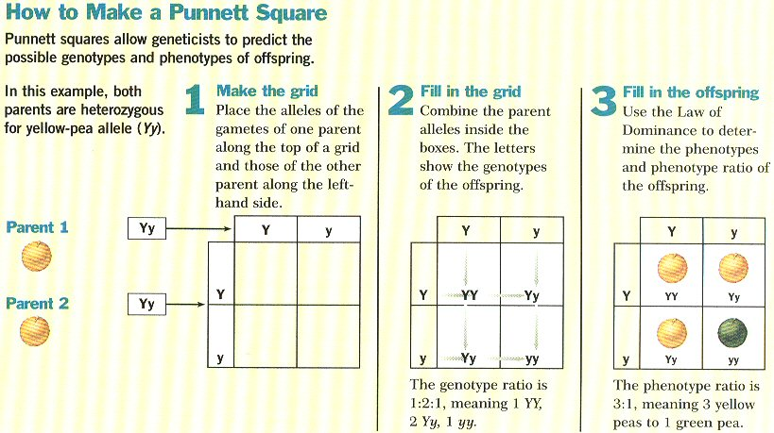

Slide 14
Eight Pea Plant Traits
Seed shape --- Round (R) or Wrinkled (r)
Seed Color ---- Yellow (Y) or Green (y)
Pod Shape --- Smooth (S) or wrinkled (s)
Pod Color --- Green (G) or Yellow (g)
Seed Coat Color ---Gray (G) or White (g)
Flower position---Axial (A) or Terminal (a)
Plant Height --- Tall (T) or Short (t)
Flower color --- Purple (P) or white (p)

Slide 15
What would happen if Mendel crossed two plants who were Homozygous dominant for seed shape?
RR x RR | R | R
R
R
Genotype Ratio:
Phenotype Ratio:

Slide 16
What would happen if Mendel crossed one plants who was Homozygous dominant for seed color and a heterozygous plant for seed color?
YY x Yy | Y | Y
Y
y
Genotype Ratio:
Phenotype Ratio:

Slide 17
What would happen if a Homozygous dominant plant for pod shape was crossed with a homozygous recessive pod shape plant?
SS x ss
Genotype Ratio:
Phenotype Ratio:

Slide 18
What would happen if two heterozygous plants for Pod color were crossed?
Genotype Ratio:
Phenotype Ratio:

Slide 19
A heterozygous plant for plant height and a homozygous recessive plant for plant height are crossed?
Genotype Ratio:
Phenotype Ratio:

Slide 20
Two homozygous recessive plants for color?
Genotype Ratio:
Phenotype Ratio:

