Slide 1
Political Cartoons

Slide 2
What is this political cartoon saying? Who is in the cartoon? What idea/key term is this a response to?

Slide 3
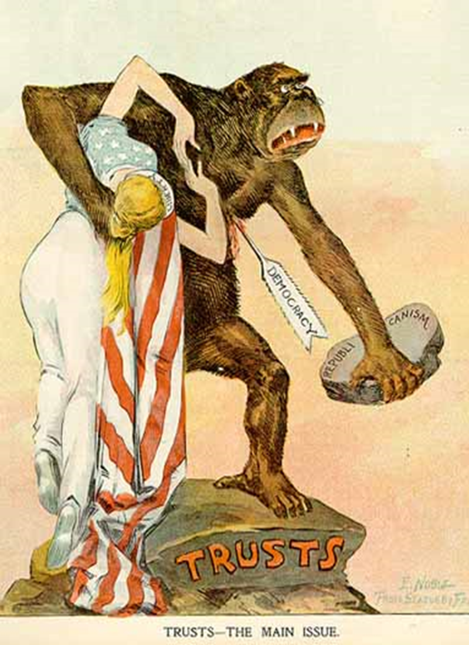
What is this political cartoon saying? Who is in the cartoon? What idea/key term is this a response to?

Slide 4
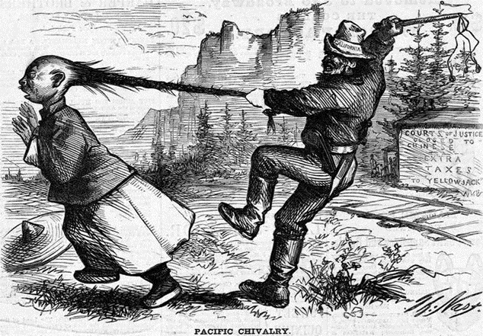
What is this political cartoon saying? Who is in the cartoon? What idea/key term is this a response to?

