Slide 1
What does it mean to be prejudice?

Slide 2
Warm-up: Check the posting outside my door to see where you go for parcc testing next week.

Slide 3
Chapter 9 Discussion Questions
Scout is yelling at Cecil Jacobs. Why are they fighting with each other?
How are the townspeople reacting to Atticus’ case?
What occurs between Scout and her cousin, Francis?
Scout ends the chapter with the words “…I never figured out how Atticus knew I was listening, and it was not until many years later that I realized he wanted me to hear every word he said.” Why do you think Atticus wanted Scout to hear what he said?

Slide 4
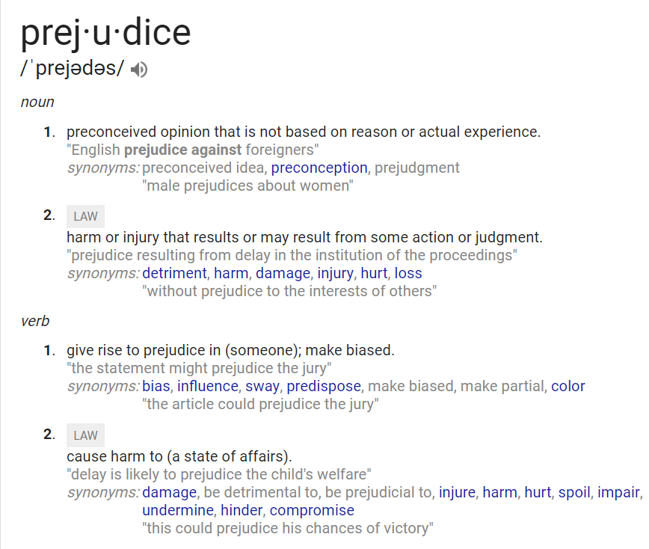
Prejudice—Where do you see prejudice in the novel?

Slide 5
Miss Caroline’s prejudice towards the town
Treatment of African-Americans
Prejudice in
“To Kill a Mockingbird”
Treatment of the poor
Town’s view of Boo Radley

Slide 6
Explanation of how this shows prejudice
Explanation of how this shows prejudice
Text Evidence (Lee pg. #)
Text Evidence (Lee pg. #)
Miss Caroline’s prejudice towards the town
Treatment of African-Americans
Prejudice in
“To Kill a Mockingbird”
Treatment of the poor
Town’s view of Boo Radley
Text Evidence (Lee pg. #)
Explanation of how this shows prejudice
Text Evidence (Lee pg. #)
Explanation of how this shows prejudice

Slide 7
Exit Ticket (on the back)
Where do you see prejudice in TO Kill a Mockingbird?

