Slide 1
Warm-up
Apply either the triangle sum theorem or the exterior angle theorem to set up and solve an equation to find the value of x.
Section Name: Triangle Congruency Theorems

Slide 2
Three Types of Proofs

Slide 3
There are 5 Triangle Congruency Theorems
SSS-
SAS-
ASA-
AAS-
HL-

Slide 4
WHICH ONE IS WHICH!?
SSS
SAS
ASA
AAS
HL

Slide 5
Which one is shown below: SSS SAS ASA AAS HL
Can you write a triangle congruency statement?

Slide 6
Which one is shown below: SSS SAS ASA AAS HL
Can you write a triangle congruency statement?

Slide 7
Which one is shown below: SSS SAS ASA AAS HL
C
F
Can you write a triangle congruency statement?

Slide 8
Which one is shown below: SSS SAS ASA AAS HL
Can you write a triangle congruency statement?

Slide 9
Which one is shown below: SSS SAS ASA AAS HL
Can you write a triangle congruency statement?

Slide 10
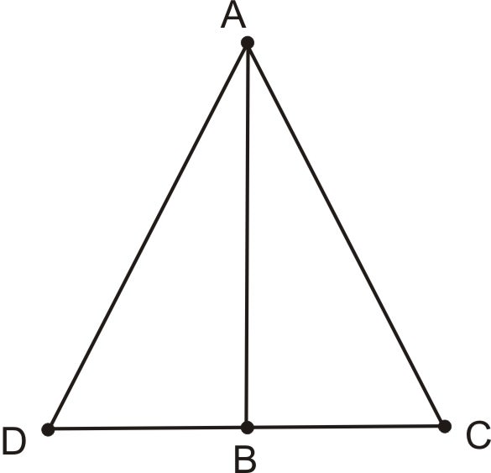
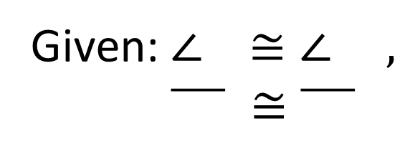
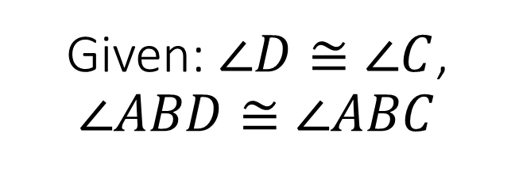
Given: $∠D≅∠C$, $∠ABD≅∠ABC$
Given: $∠ ≅∠ ,$
$\overline{ } ≅\overline{ }$

Slide 11
Exit Ticket
Name a combination of Sides and Angles that is NOT one of our triangle congruency theorems.

