Slide 1
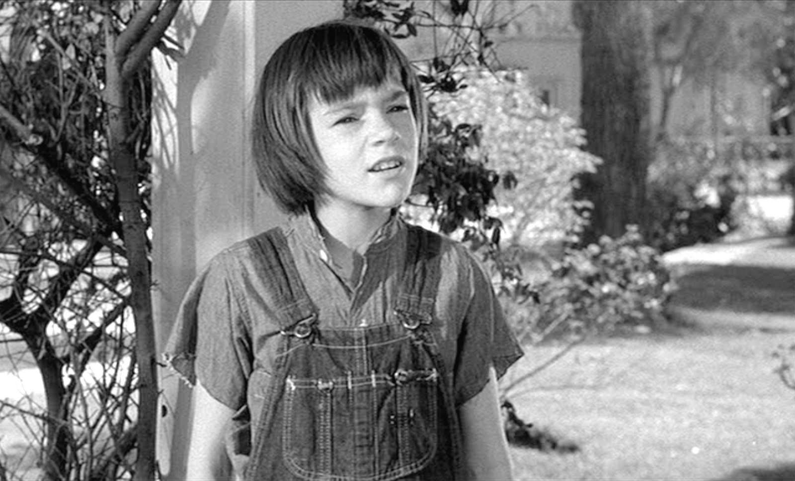
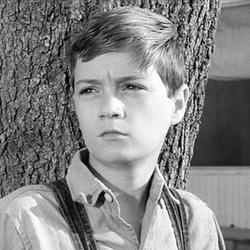
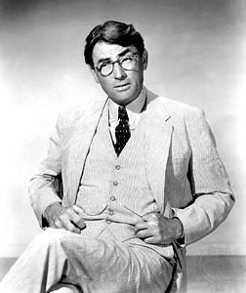
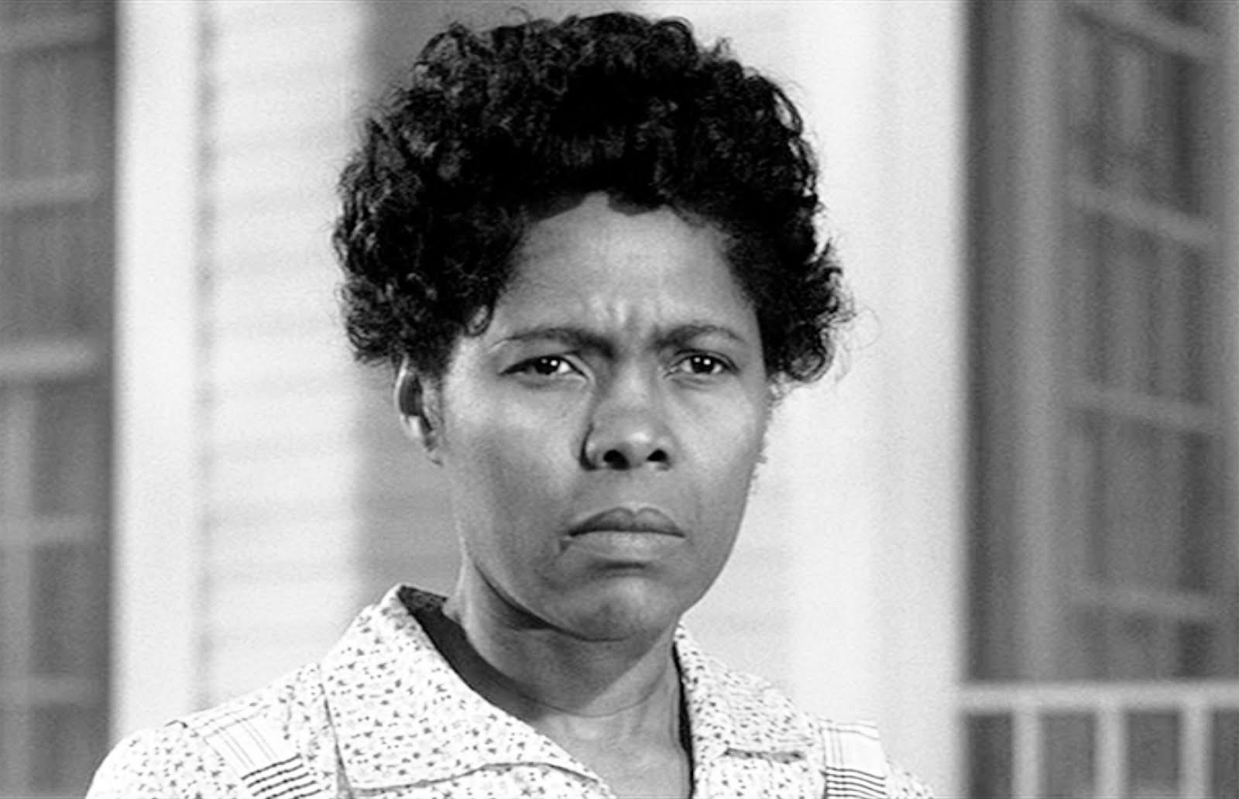
Ch. 1 Major Characters
Scout
Jem
Atticus
Calpurnia
Boo Radley

Slide 2
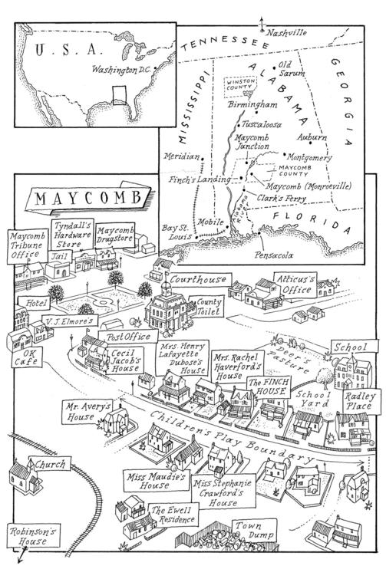
Setting

Slide 3
Read Chapter One

Slide 4
Chapter One Discussion Questions
Who is the narrator? What do we know about her?
What is Calpurnia’s role? What relationship does she have with the children?
What is Atticus’ career?
Where is the setting? How is it described?
What dare does Jem fulfill at the end of the chapter?

Slide 5
Exit Ticket
Begin working on your double-sided journal. Be sure to include characters as well as character relationships.
Homework: Read Ch. 2 by tomorrow. Ch. 1-3 notes sheet is due Friday.

Slide 6
Chapter Two Discussion
How does Scout describe Miss Caroline? How does Miss Caroline treat her?
Why did Miss Caroline become upset with Scout?
What did we learn about the Cunningham family?
What have we learned about those who are poor in Maycomb county?

Slide 7
Read Chapter Three

Slide 8
Chapter 3 Discussion Questions
Who is Walter Cunningham? What do we learn about his family?
What does Walter do at dinner that surprises Scout? How does Calpurnia react to Scout?
What happened with Burris Ewell in school?
What deal does Atticus make with Scout when she says she doesn’t want to refer to school? How is expectation different than the other children?

Slide 9
Exit Ticket
What is a character trait you would give Scout? Why have you selected this trait? Support with specific examples from the text.
Homework: Keep working on your Ch. 1-3 notes (due tomorrow). Review important characters and events from Ch. 1-3 for the quiz tomorrow.

Slide 10
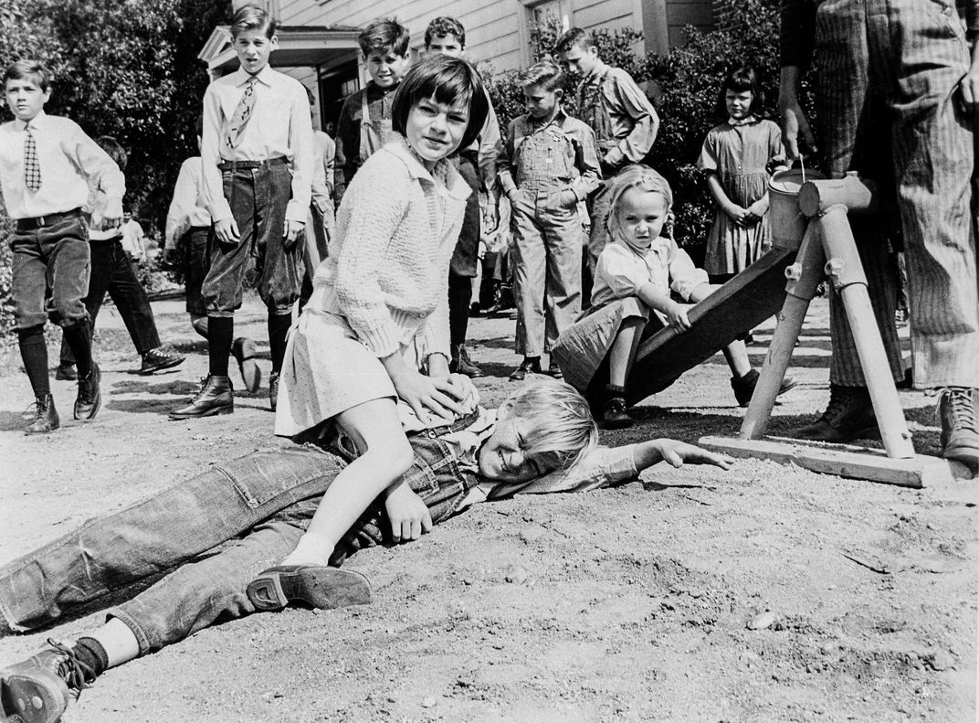
Warm-Up: Take out your TKM novel. Be ready to read!
Turn to the person next to you. Who is in this picture? What is going on? Think of what we have read so far.

Slide 11
Read Chapter Four

Slide 12
Chapter 4 Discussion Questions
How does Scout feel about school?
What games to the children play?
What do the children begin discovering in the tree?

Slide 13
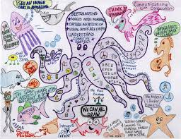
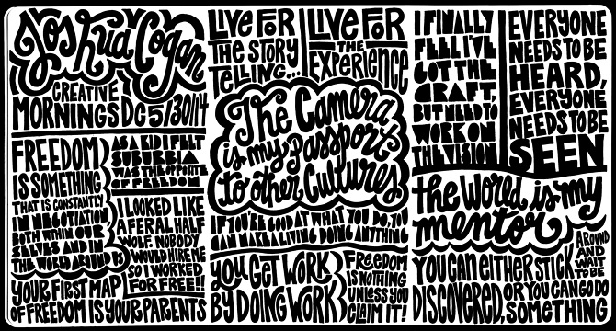
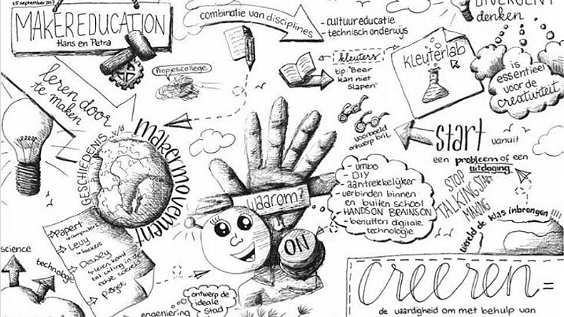
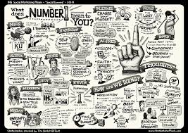
Sketch Notes

Slide 14
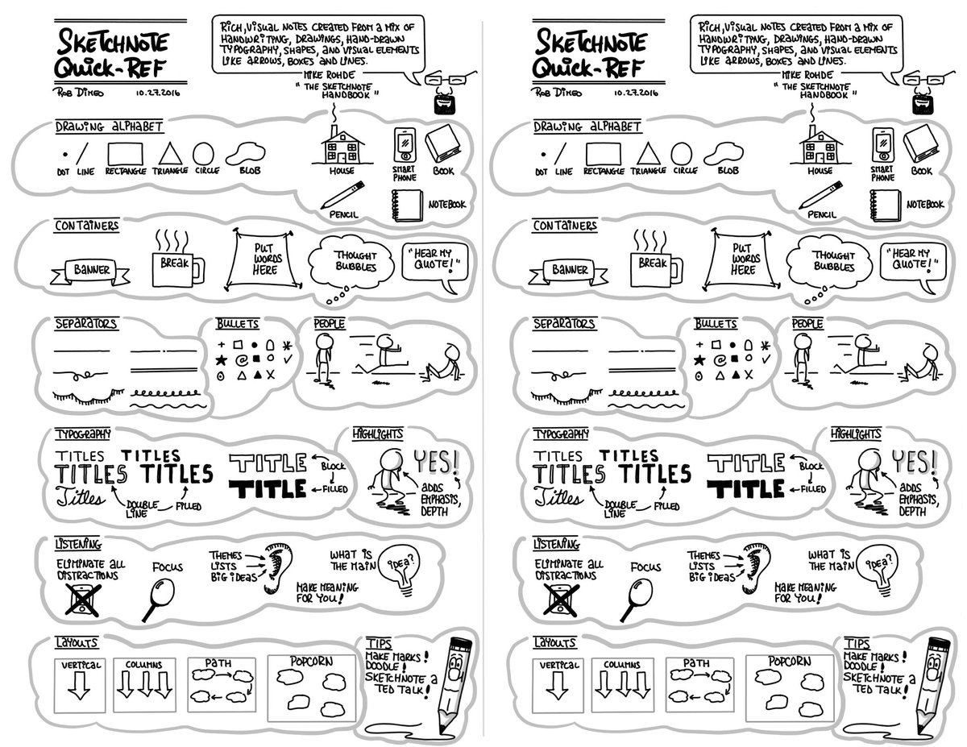

Slide 15
Homework: Read Ch. 5 for tomorrow

Slide 16
Chapter 5 Questions
Who is Miss Maudie? How would you describe her?
What do the children intend to give Mr. Radley?
Up to this point, what character traits would you use to describe Scout? Explain.

Slide 17
Read Chapter Six

Slide 18
Chapter 6 Questions
What do the children sneak out into the night to do?
How did Nathan Radley react to the children in his yard?
What happened to Jem’s pants?

Slide 19
Figurative Language Review
Metaphor
Hyperbole
Simile
Personification
“I spy…”

Slide 20
Chapter 7 Questions
At this point, what grade is Scout in?
What alarmed Jem about his pants from the other night?
What type of items were found in the tree hole? What do you think these items signify?
What game do the children continually play in the yard?

Slide 21
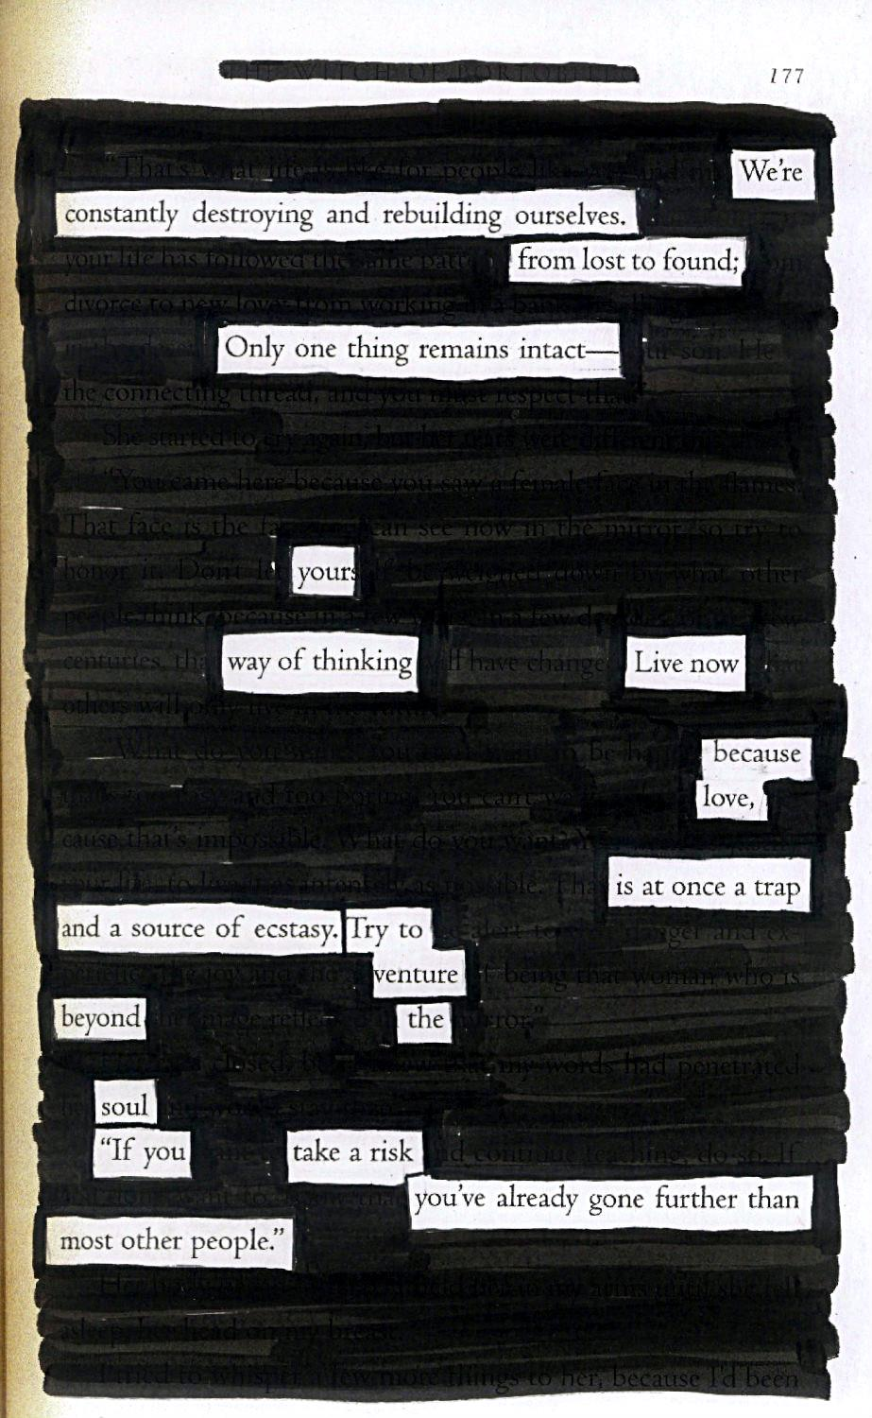
Blackout Poem
You will take the text from TKM and create a poem
Step 1: Go through and lightly underline
any words or phrases that stand out to you
or remind your of Boo Radley and his character.
Step 2: Edit your underlined list of words
and phrases and begin to form a poem
Step 3: Design your blackout space to
symbolize the themes of the speech
-make sure the words you want read stand out

Slide 22
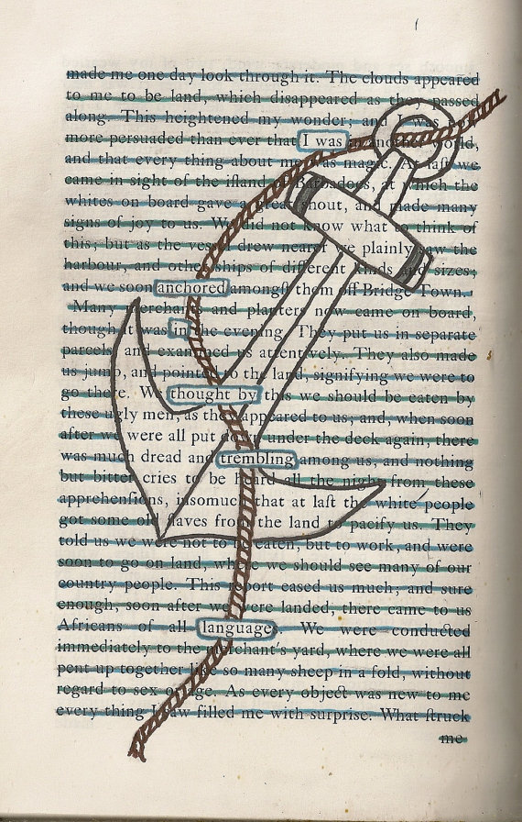
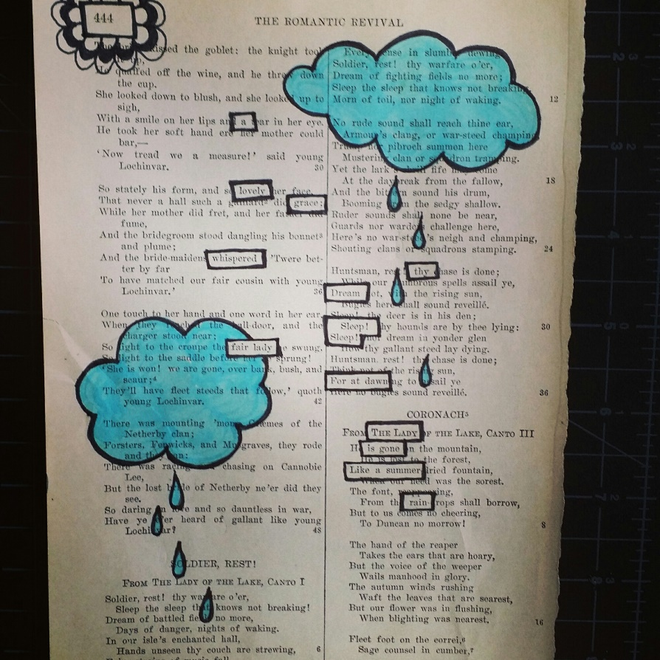
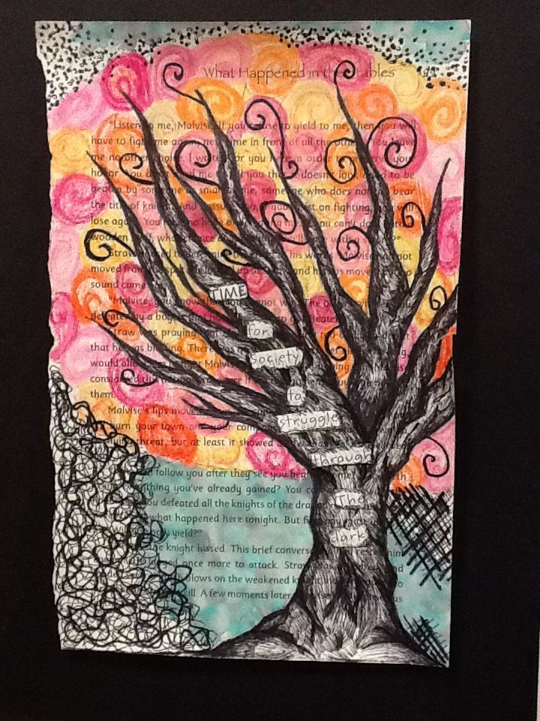

Slide 23
Exit Ticket
Who is Boo Radley? What can we infer about his character and his interactions with Jem, Scout, and Dill so far in the novel? Explain using examples from the text.

Slide 24
Chapter 8 Discussion Questions
What odd event occurs in Maycomb county?
How do the children spend their day?
The children are woken up in the middle of the night because of…
Scout says, “It looks like a pumpkin” (p. 79). What type of figurative language is this?
What did Boo Radley apparently do for Scout?

Slide 25
Boo Radley—Should he come outside?
Imagine you are Scout, Jem, or Dill and make an argument for why you think Boo Radley should come outside. Using your graphic organizer, develop at least three strong reasons with evidence for why Boo should come outside. For the counterargument, consider Boo Radley’s position on why he wouldn’t want to come outside. Be sure to close with a strong refutation to prove the opposite side wrong.

Slide 26
Warm-Up: Grab a slip of the yellow paper (by the exit ticket bin). Write the MLA header on the top.
WRITE A CLAIM AND COUNTERCLAIM FOR THE FOLLOWING TOPIC:
SHOULD COLLEGE BE FREE FOR ALL AMERICANS?
Claim: I believe that…
Counterclaim: Many others believe that…

Slide 27
CH. 4- 8 QUIZ You may use your sketch notes on the quiz! When you are finished, turn in the sketch notes and the quiz.

Slide 28
Ethos, Pathos, Logos—Boo Radley
From the point-of-view of either Jem, Scout, or Dill, write a letter to Boo Radley trying to persuade him to come out of the Radley place.
You can use your argument organizer from yesterday.
In your one-page (minimum) letter, you should use either ethos, pathos, or logos to support your argument of why it would be in his best interest to reveal himself. Mark and label your uses of ethos, pathos, and logos in your letter!

Slide 29
Chapter 9 Discussion Questions
Scout is yelling at Cecil Jacobs. Why are they fighting with each other?
How are the townspeople reacting to Atticus’ case?
What occurs between Scout and her cousin, Francis?
Scout ends the chapter with the words “…I never figured out how Atticus knew I was listening, and it was not until many years later that I realized he wanted me to hear every word he said.” Why do you think Atticus wanted Scout to hear what he said?

Slide 30
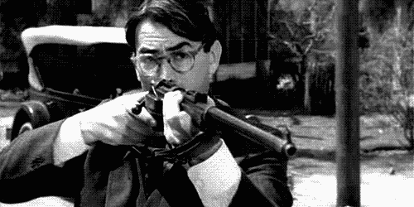
Turn to Chapter Ten

Slide 31
Chapter 10 Discussion Questions
Why is it “a sin to kill a mockingbird” (p. 103)?
What new attributes do we learn about Atticus in this chapter? What are some of his talents?
Find the metaphor on p. 105

Slide 32
Chapter 10 Activity ---HW: Rd. Ch. 11
You will create a miniature body biography for Atticus Finch
You should include
3 quotes that represent who he is
3 character traits with 1-2 sentences explaining why for each
A symbol or image that represents him
A picture of what Atticus would look like
Color (make it pretty!)

Slide 33
Chapter 11 Discussion Questions
Who is Mrs. Dubose? How is she described?
What does Mrs. Dubose do to upset Jem? How does he react? What is his punishment?
Why does Atticus feel Mrs. Dubose is a winner? Do you agree or disagree?
What does she send Jem?

Slide 34
Read Chapter Twelve

Slide 35
Chapter 12 Discussion Questions
How does Jem begin acting toward Scout? How does she react?
What have we learned about Dill?
Describe the situation at Calpurnia’s church.
Who are they raising money for? What has he been convicted of? How is his family being affected?

Slide 36
Character Cubes
Character name
Image of character
5 adjectives to describe character
What does your character not like?
What does your character like?
If your character could change one thing about him/herself, what would he/she change?

Slide 37
Read Chapter Thirteen

Slide 38
Chapter 13 Discussion Questions
Who has arrived to stay with the family?
How does she fit in in Maycomb?
How does Scout feel about this?

