Slide 1
Warm-up
What does a bisector/ midpoint/ median do?
Section Name: Triangle Proofs

Slide 2
A
D

Slide 5
$$∠A≅∠D$$

Slide 6
Given: BD is the median of $∆ABC$
$∠ADB≅∠CDB$
Prove: $∆BAD ≅ ∆BCD$

Slide 9
Exit Ticket Steps For Triangle Proofs

Slide 10
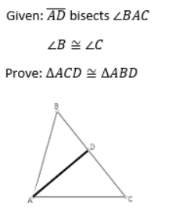
Warm-Up

