Slide 1
Mechanisms of Evolution

Slide 2
“There is grandeur in this view of life, with its several powers, having been originally breathed into a few forms or into one; and that, whilst this planet has gone cycling on according to the fixed law of gravity, from so simple a beginning endless forms most beautiful and most wonderful have been, and are being, evolved.”
Charles Darwin

Slide 3
Question
Which of the following statements about evolution is true?
Populations evolve, people don’t
Individuals evolve by changing the gene pool
Individuals evolve more slowly than populations
Individuals evolve, populations don’t

Slide 4
The founder of modern evolution theory is considered to be ____________?
Stephen J. Gould
Charles Darwin
Stan Laurel
Alexander Oparin

Slide 5
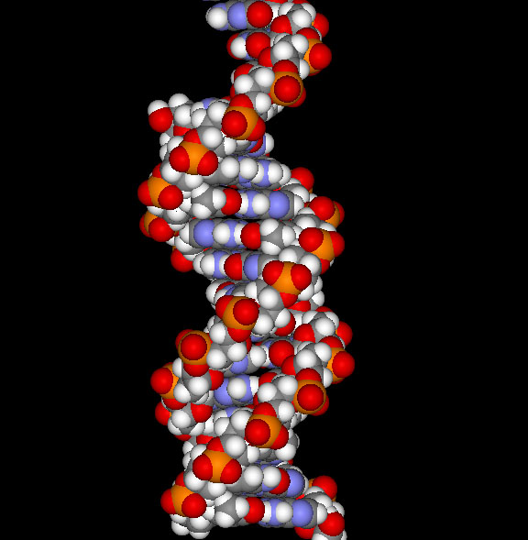
How has evolution changed since Darwin?
Genetic information is used to explain the variation among individuals.
Populations evolve --- NOT INDIVIDUALS

Slide 6
Key Terms
Gene Pool – all the genes of a population put together is the “gene pool”.
Genetic equilibrium – when the frequency of an gene remains the same from generation to generation – THEREFORE, EVOLUTION DOES NOT TAKE PLACE!

Slide 7
Changes in equilibrium …
Any factor that affects the genes in the gene pool of a population will result in the process of evolution.

Slide 8
Mechanisms for genetic change (Disruption of equilibrium):
Mutations
Genetic Drift
Immigration/Emigration (gene flow)
Natural Selection

Slide 9
Mutations
Mutations can be caused by radiation, chemicals, or just by chance.

Slide 10
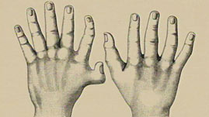
Genetic Drift
Genetic drift is the alteration of genetic frequency by chance events.
Genetic drift greatly affects SMALL populations
It can result in an increase of rare alleles in a small population (i.e. Polydactyly in the Amish)

Slide 11
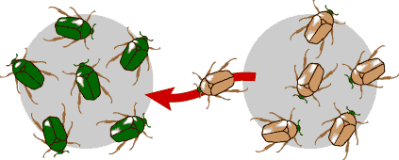
Movement In/Out of Population
When an individual moves in and out of a population, (s)he also takes with them their genetic contribution.
This migration of individuals (with their genes) is called GENE FLOW.

Slide 12
Natural Selection
Natural selection acts on variations
Variations can increase OR decrease an individual’s chance of survival.
There are 3 types of natural selection that acts on variations:
Stabilizing
Directional
disruptive

Slide 13
Stabilizing Selection
Favors the “average” individual in a population This type of selection reduces the variation in a population.

Slide 14
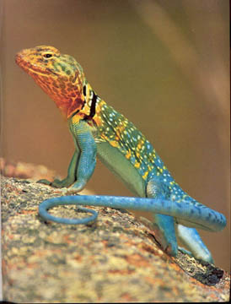
Stabilizing Selection
Example:
And you do not want to be too small or else you cannot run fast enough to escape predators that do find you.
If you are a lizard, you do not want to be too big, or else predators can find you easily.
You want to be average sized. Small enough to hide, but big enough to run if you have to.

Slide 15
Directional Selection
Favors one of the extreme variations of a trait and can lead to the rapid evolution of a new species

Slide 16
Directional Selection
Peppered moths experience directional selection depending on their background.
If trees are light, the lighter moths will survive better.
If trees are dark, the darker moths will survive better.
Lighter Direction
Darker Direction

Slide 17
Disruptive Selection
Favors both extreme variations of a trait, resulting in no intermediate forms of the trait and leading to the evolution of two new species.

Slide 18
Disruptive Selection
Birds with thick beaks can crack large shells
Birds with thin beaks can dig for bugs
But the poor birds with average beaks can’t do either! So if the only choices are big seeds or bugs, the average guys lose out.
We’re hungry!

Slide 19
Disruptive selection can easily lead to the formation of two new species from one ancestral species.
We both used to be the same species, sort of like that guy up there.
But over time we got more and more different because we liked to eat different foods.
And now we are two completely different birds.

Slide 20
https://study.com/academy/lesson/disruptive-selection-example-definition-graph.html
https://www.youtube.com/watch?v=ewOAGMGI8bI

Slide 21
Now lets practice………..

Slide 22
What type of selection is this?
Babies of low weight lose heat more quickly and get ill from infectious disease more easily, whereas babies of large body weight are more difficult to deliver through the pelvis.

Slide 23
Stabilizing

Slide 24
What type of selection is this?
A large sperm contains materials that can be used by the embryo for nutrition. Or, fitness may be enhanced by a small lightweight sperm that is more mobile and can therefore reach the egg more easily.

Slide 25
Stabilizing

Slide 26
What type of selection is this?
The Siberian Husky is a medium dog, males weighing 35-60lbs. These dogs have strong pectoral and leg muscles, allowing it to move through dense snow. If the Siberian Husky had heavier muscles, it would sink deeper into the snow, so they would move slower or would sink and get stuck in the snow. Yet if the Siberian Husky had lighter muscles, it would not be strong enough to pull sleds and equipment, so the dog would have little value as a working dog.

Slide 27
Stabilizing Selection

Slide 28
What type of selection is this?
Early breeders were interested in dogs with the greatest speed. They carefully selected from a group of hounds those who ran the fastest. From their offspring, the greyhound breeders again selected those dogs who ran the fastest. By continuing this selection for those dogs who ran faster than most of the hound dog population, they gradually produced a dog who could run up to 40mph.

Slide 29
Directional

Slide 30
Evolution of Species
The evolution of new species is called SPECIATION.
It occurs when members of similar populations no longer interbreed to produce fertile offspring.

Slide 31
How does speciation occur?
Two main ways speciation occur are:
Geographic Isolation
Reproductive isolation

Slide 32
Geographic Isolation
Geographic isolation occurs whenever a physical barrier divides a population.

Slide 33
Another Name for Geographic Speciation (Write in space provided)
Allopatric speciation is just a fancy name for speciation by geographic isolation, discussed earlier. In this mode of speciation, something extrinsic to the organisms prevents two or more groups from mating with each other regularly, eventually causing that lineage to speciate.

Slide 34
Parapatric Speciation (write in space provided)
Parapatric speciation is the evolution of geographically adjacent populations into distinct species. In this case, divergence occurs despite limited interbreeding where the two diverging groups come into contact.

Slide 35
Sympatric Speciation (write in space provided)
A speciation in which new species evolve from a single ancestral species while inhabiting the same geographic region. Supplement. Sympatric speciationis more common in plants

Slide 36
Reproductive Isolation
Occurs when formerly interbreeding organisms can no longer mate and produce fertile offspring.
When the genetic material of the populations becomes so different that fertilization cannot occur.
But they may be able to interbreed with similarly affected individuals and form a new species.
Behavioral – mating seasons, or other reproductive behaviors that isolate a group from another.

Slide 37
Theories about the Rates of Speciation
Gradualism
Punctuated Equilibrium

Slide 38
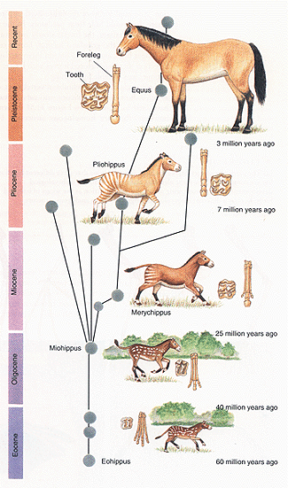
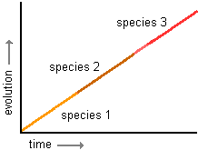
Speciation Rates
Gradualism – species arise through a gradual change of adaptations.

Slide 39
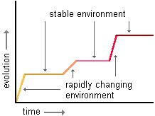
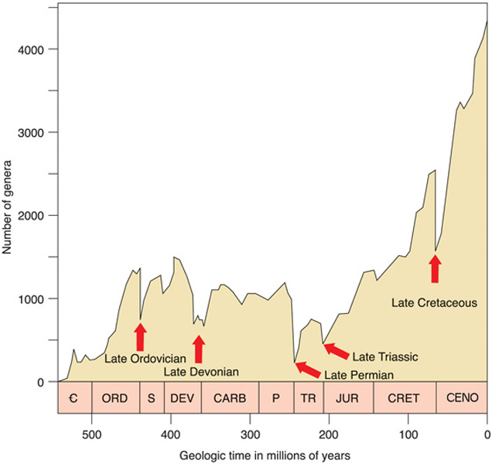
Punctuated Equilibrium
Speciation occurs relatively quickly, in rapid bursts, with long periods of genetic equilibrium in between.

Slide 40
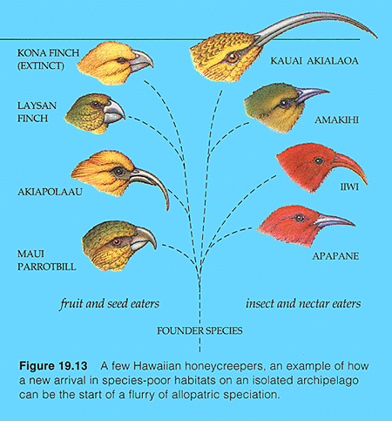
Patterns of Evolution
Adaptive Radiation – When an ancestral species evolves into an array of species to fit new niches.

Slide 41
Divergent Evolution
Species that were once similar to an ancestral species become increasingly distinct.
Occurs when populations change as they become adapted to different environmental conditions.

Slide 42
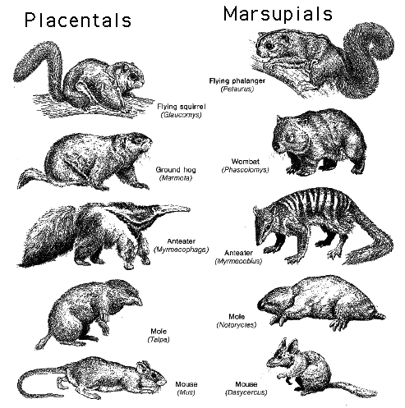
Convergent Evolution When unrelated organisms occupy similar environments in different parts of the world and take on similar characteristics.

Slide 43
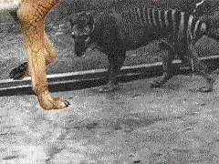
Convergence - the Thylacine or Tasmanian Tiger It’s not a dog or a cat, it’s more closely related to kangaroos!

